Slide 1
Cloud First, Mobile First
Innovation as a driver to a new world
Δημήτρης Κουτσαναστάσης
Cloud Business Evangelist, MS Hellas

Slide 2
IT Disruptive
Megatrends
Cloud
Mobility
Social
Big Data & BI
Innovation

Slide 3
mobile + connectivity
7B Global Population
in 4 years
wireless internet traffic > wired
6B SIM Cards
In 2016, wired devices will account for 39% of IP traffic,
while Wi-Fi & mobile devices
will account for 61% of IP traffic.
One month after the world’s population
topped 7 billion in October 2011, the
GSM Association announced that mobile
SIM cards had reached 6 billion.
Data source: Cisco, Virtual Networking Index, 2012
Data source: Erica Kochi, “How the Future of Mobile Lies in the Developing World” May 2012
Notes:
Speaker Notes:
It’s not just phones, but the connectivity that goes with it. Look at the growth in Internet users, which is being driven by emerging markets.
Source for Quote #1:
Kochi, Erica. “How The Future of Mobile Lies in the Developing World.” TechCrunch. 27 May 2012. Web. <http://techcrunch.com/2012/05/27/mobile-developing-world/>
Notes from Source:
“One month after the world’s population topped 7 billion in October 2011, the GSM Association announce that mobile SIM cards had reached 6 billion.”

Slide 4
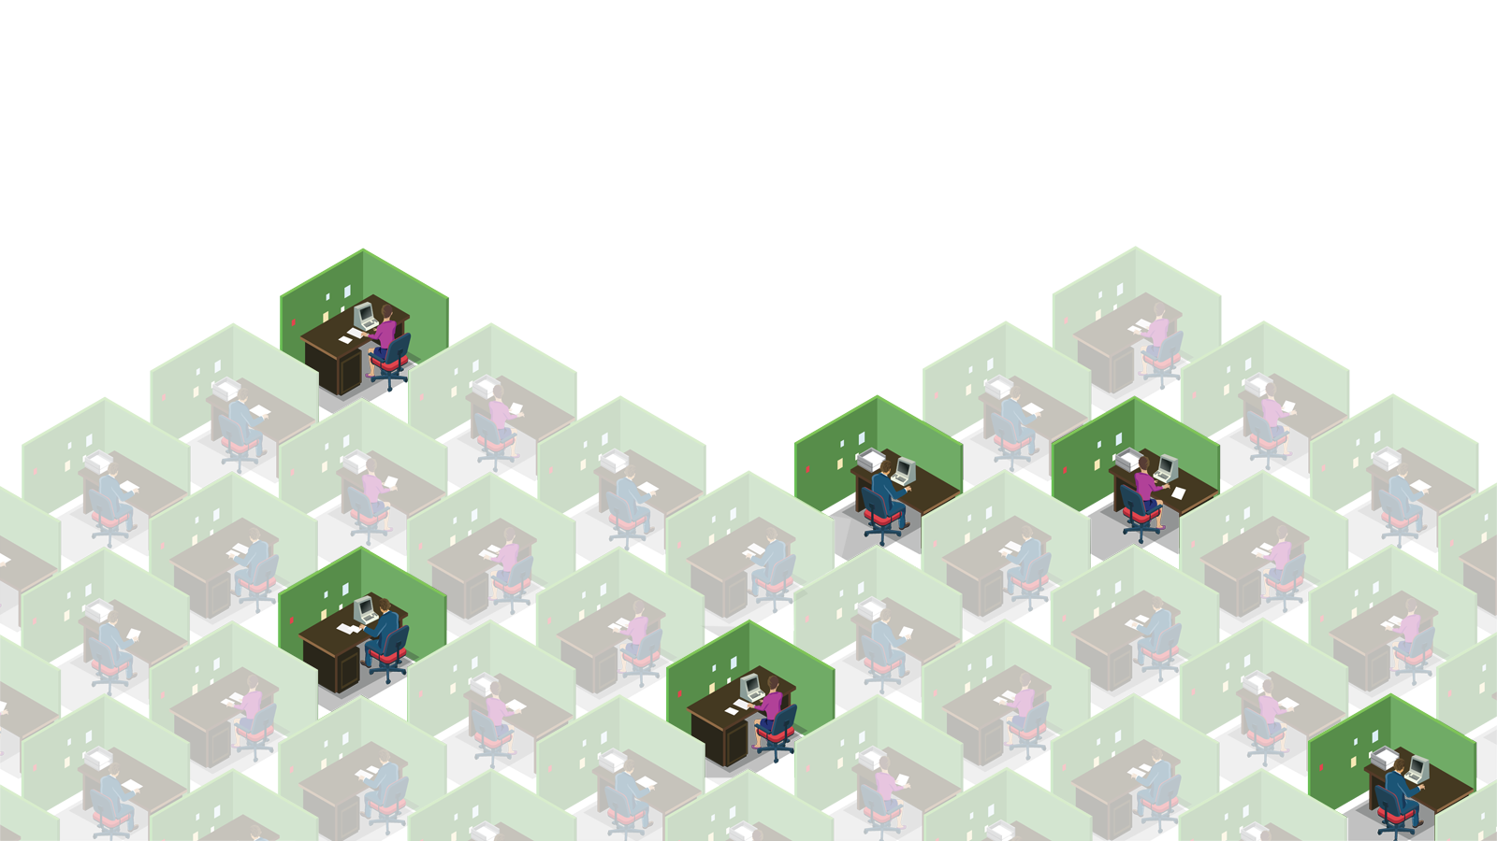
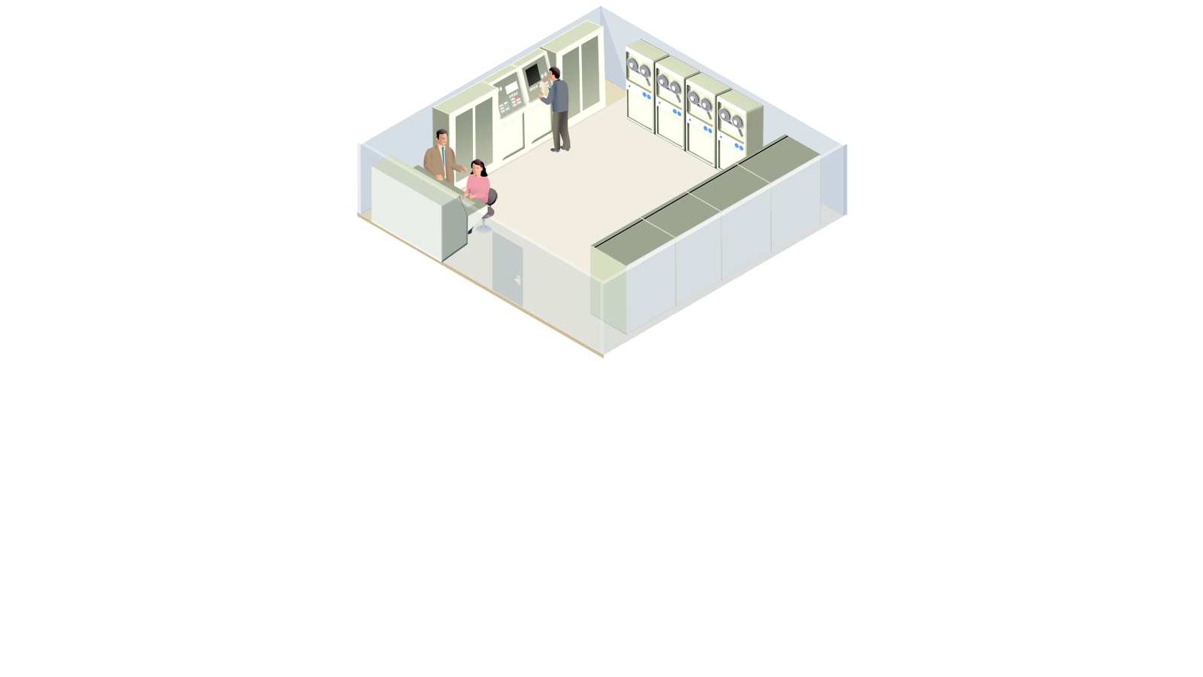

Slide 5
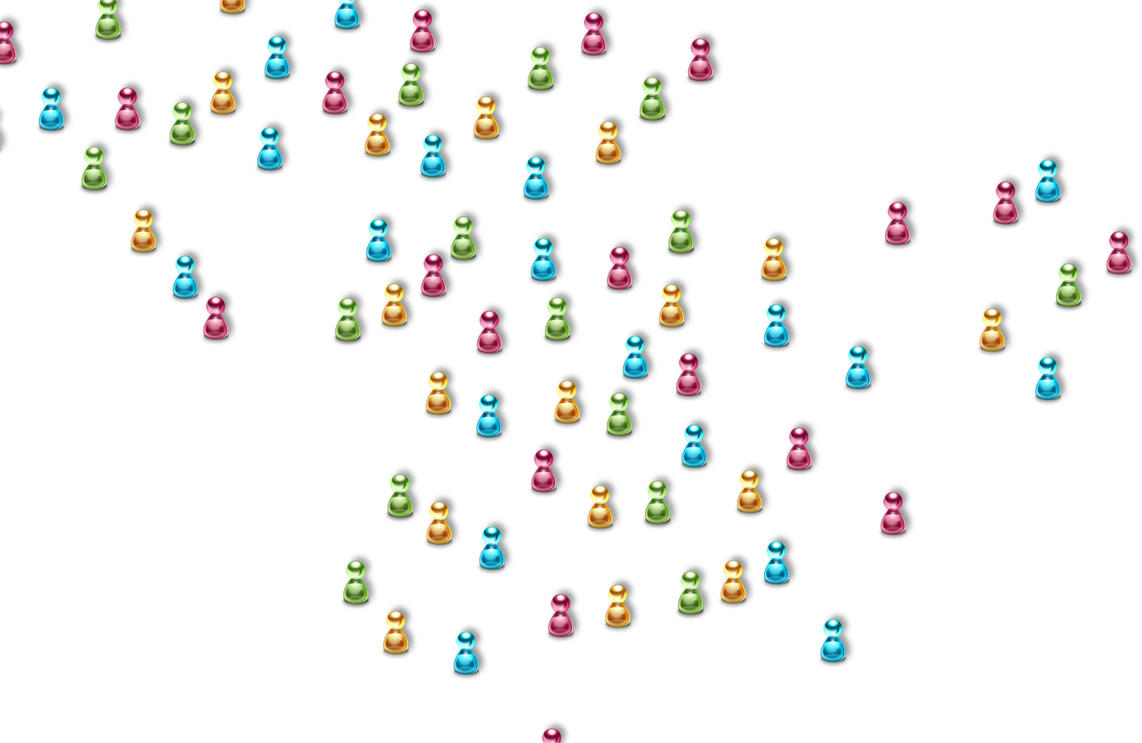
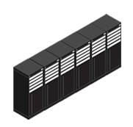
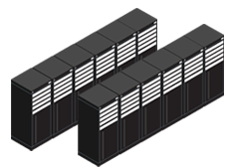

Slide 6
“Microsoft is the productivity and platform company for the mobile-first and cloud-first world.” Satya Nadella, Microsoft CEO

Slide 7
Today, we live in a
mobile-first, cloud-first world
Notes:
Presenter guidance:
Use this slide to set the context around our world view.
Key points:
When we characterize the future as we see it, the world view we come to is one of a mobile-first, cloud-first world.
Mobile-first: Soon there will be more than three billion people with Internet-connected devices powered by cloud service-based apps spanning work and life. It's the phones that you carry, it's the tablets, it's the big screens that you interact with, it's the sensors in the room that you enter, and that is what's going to be everywhere. And all of these things have applications. This exponential growth across connected users, connected devices and applications is what is leading to the growth of the cloud.
Cloud-first: A cloud not connected to devices is just latent potential because how does the cloud interact with the real world? It is by being able to get to devices. It could be a sensor, it could be a mobile device, it could be a tablet, or it could be a big screen in a conference room or a living room. And likewise, a device which is not connected to the cloud just cannot provide for the scenarios we all now expect.
The opportunity for enterprise leaders today is to reimagine their business in this mobile-first, cloud first digital age. How can you truly enable your employees to be productive wherever they may be using any device? How can you deliver the experiences your customers expect?

Slide 8
Microsoft’s Cloud
Delivering operational excellence in the cloud Infrastructure

Slide 9
Microsoft Datacenter Investment
> $5billion in Cloud Datacenters & Servers!!
Source: Microsoft Financial Analysts Meeting, September 19, 2013
Notes:
Slide has animation!

Slide 10
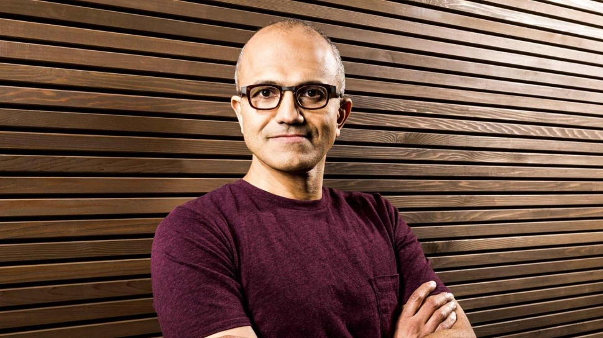

Slide 11
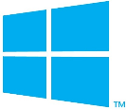
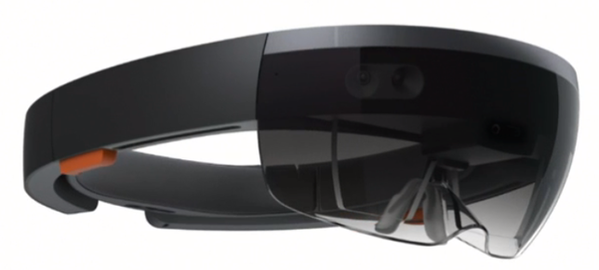
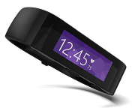
Our Innovation Approach
Hiring the best people
Embracing disruptions
A balance of invention, re-invention, and evolution
A commitment to openness and partnerships
A focus on scale
A long-term approach

Slide 12
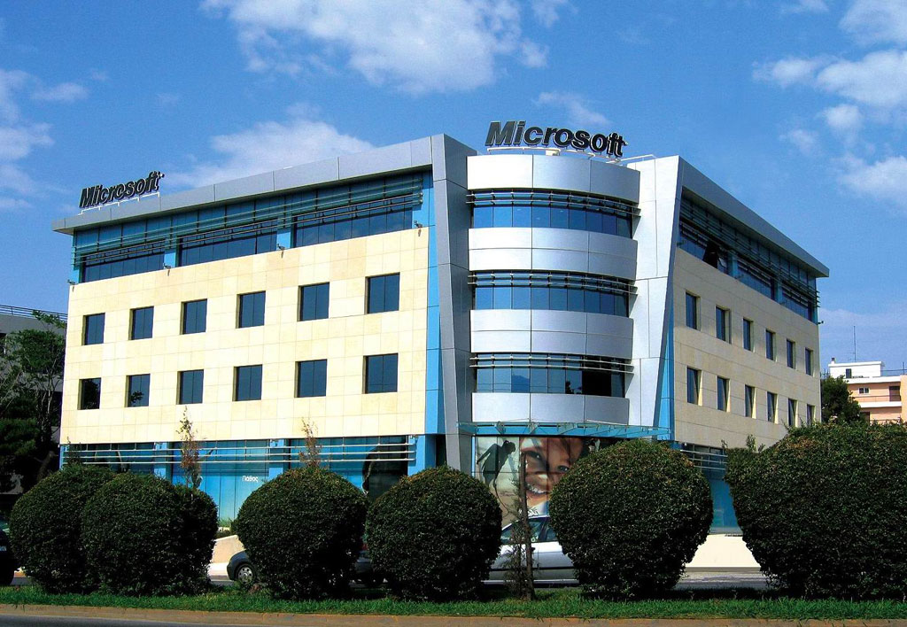
Inaugurated in 2008
Offices (Kifissias 221, Marousi)

Slide 13
Microsoft Innovation Center
Execution
Engage with the local communities, run competitions, offer trainings, support and host entrepreneurship events
Trigger
Microsoft Innovation Center
Enable
Engage, support and influence innovation & entrepreneurship practices, facilitate access to funding, offer free tools
Foundation
Support a selection of innovative ideas through implementation using Microsoft’s vast partner, business and worldwide Innovation Center network
Support
Promote final products or services through the Microsoft PR engine both locally and internationally
Promote

Slide 14
Free Software & Cloud Hosting
Free Software to Startups
300+ startups enrolled
Free Software to Students

Slide 15
Incubation
Startups are provided with working space free of charge
5 to 10 new startups incubated at the MIC every year
Overall support offered

Slide 16
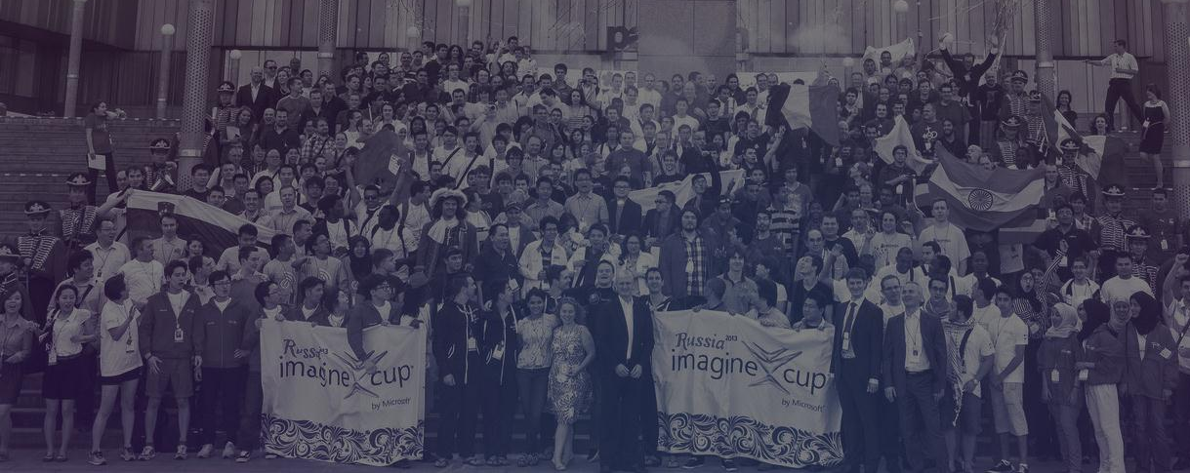
Trigger
Support Students in participating to Imagine Cup National Finals
Provide students with a platform and the resources to turn their ideas into real businesses

Slide 17
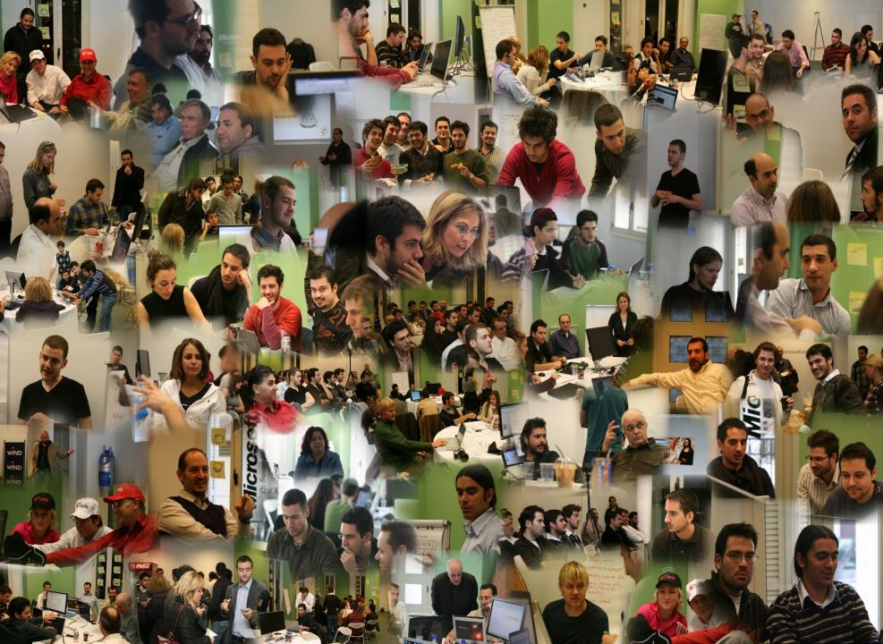

Slide 18
