Slide 1

A Platform for Multi-sensor Analysis and Intelligent Decision Making for Supporting People with Dementia
Ioannis Kompatsiaris
Information Technologies Institute (ITI)
Centre for Research & Technologies Hellas (CERTH)
Technology Forum 2015
Thessaloniki, 8 May 2015

Slide 2
CERTH-ITI Multimedia Knowledge and Social Media Analytics Lab
Personnel
  >40 people (researchers, developers, administration)
Areas
  Social media and big data analytics, semantic multimedia analysis, indexing and retrieval, knowledge structures, reasoning and personalization for multimedia applications, eHealth and environmental applications
European, national & privately funded research projects:
  H2020: MAMEM (coordination), DigiArt, KRISTINA, YOUNG
  FP7: SocialSensor & Dem@Care (coordination), Wikirate, MULTISENSOR (coordination), REVEAL, USEMP, WeKnowIt (coordination), Pescado, JUMAS, CHORUS+, etc
Contracts with Industry (Motorola UK and US)
Open source, available tools, datasets
Notes:
2

Slide 3
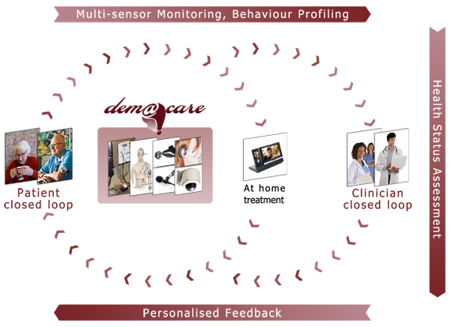
Multi-sensor Analysis and Intelligent Decision Making Platform
Sensor analytics
Detection of Activities of Daily Living (ADLs) from video/sensor data
Semantic knowledge structures to encode information
Context-based multi-sensor fusion and analysis
Personalised adaptive feedback

Slide 4
Technology Stack

Slide 5
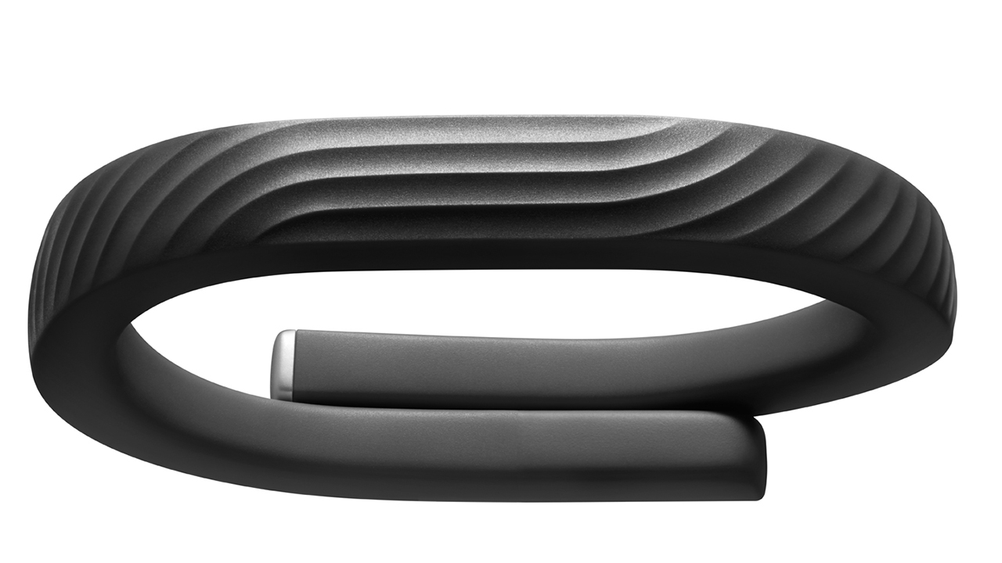
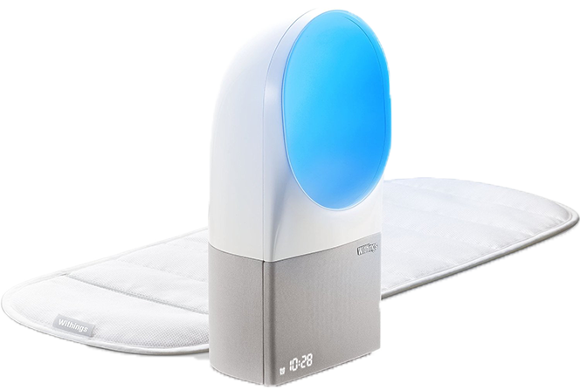
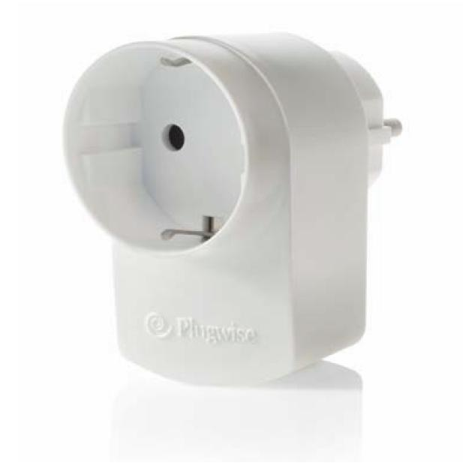
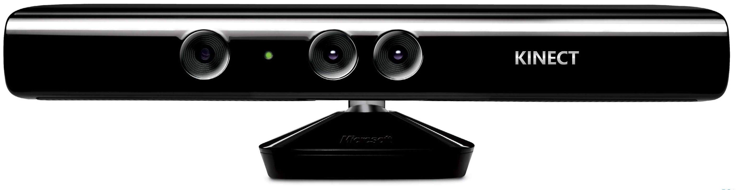
Example of Home Installation (Thessaloniki)
Sensors
  Presence: Kitchen, Bathroom
  Water: FlowerPot
  Physical activity: wearable
  Motion: Iron, TVRemote, PillBox, Phone
  Plugs: TV, Radio, Dishwasher
  Camera: Kitchen
  Sleep: Bedroom
Visual Analytics for Activity Recognition
  Cooking
  Washing dishes
  Eating
  Refrigerator usage
  Making a Call

Slide 6
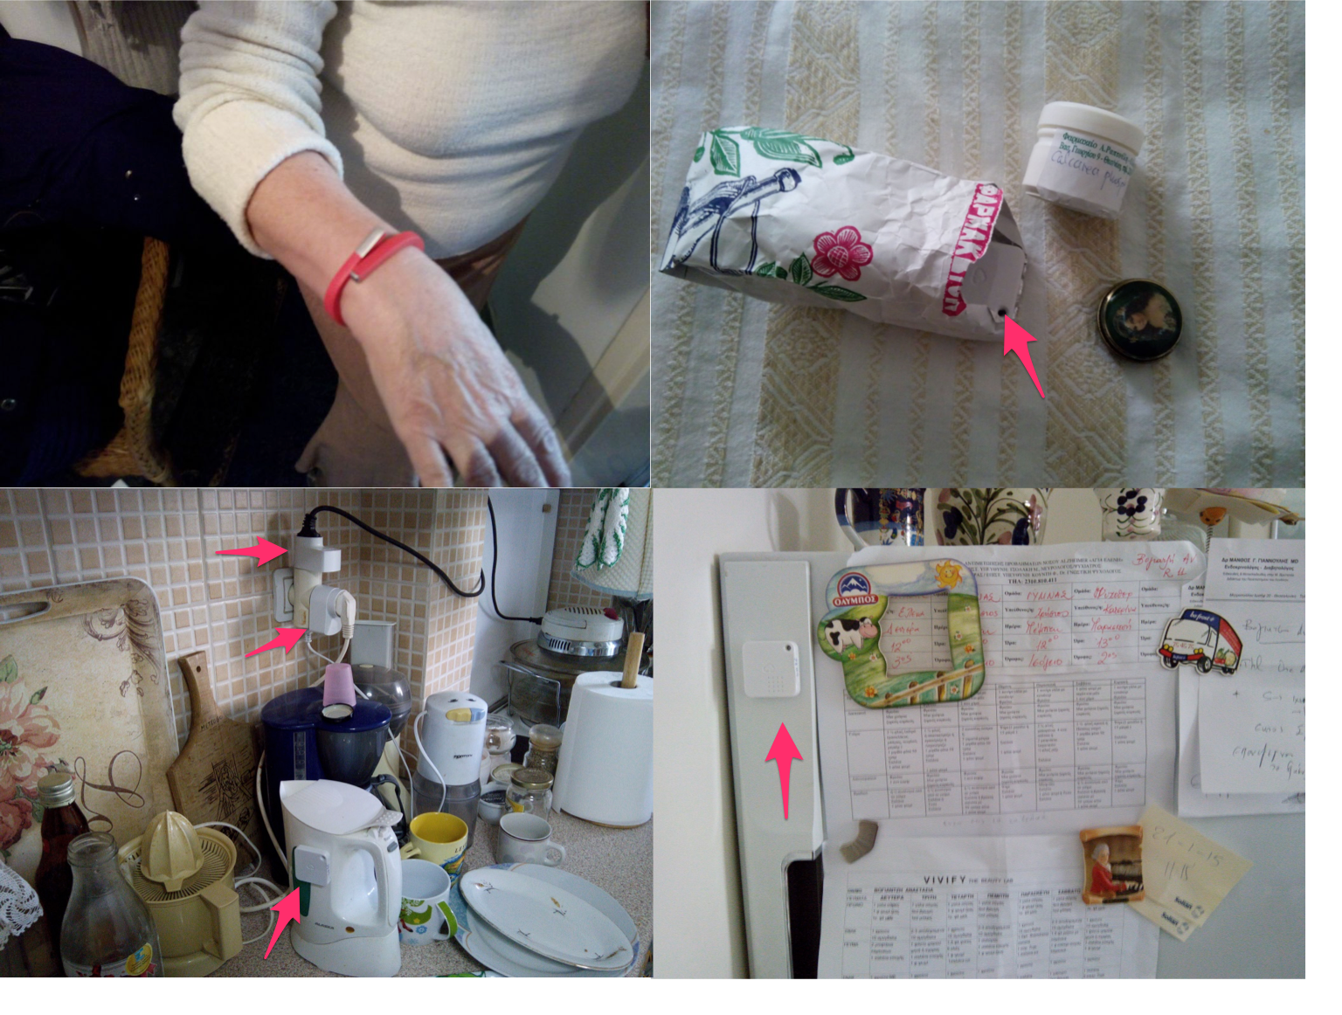

Slide 7
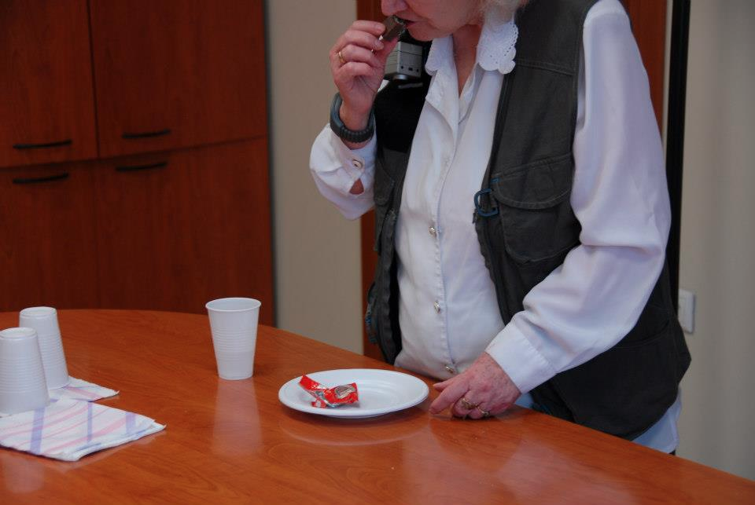
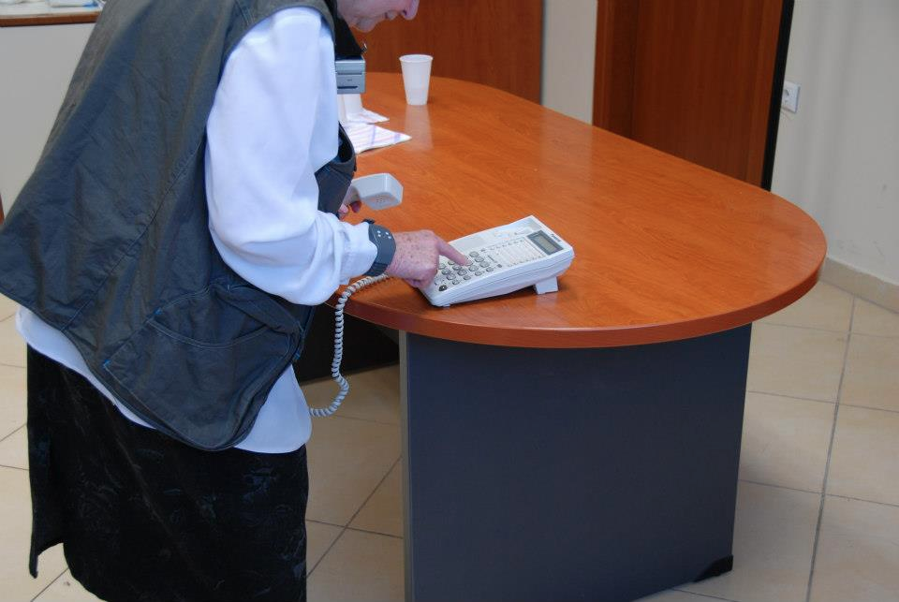
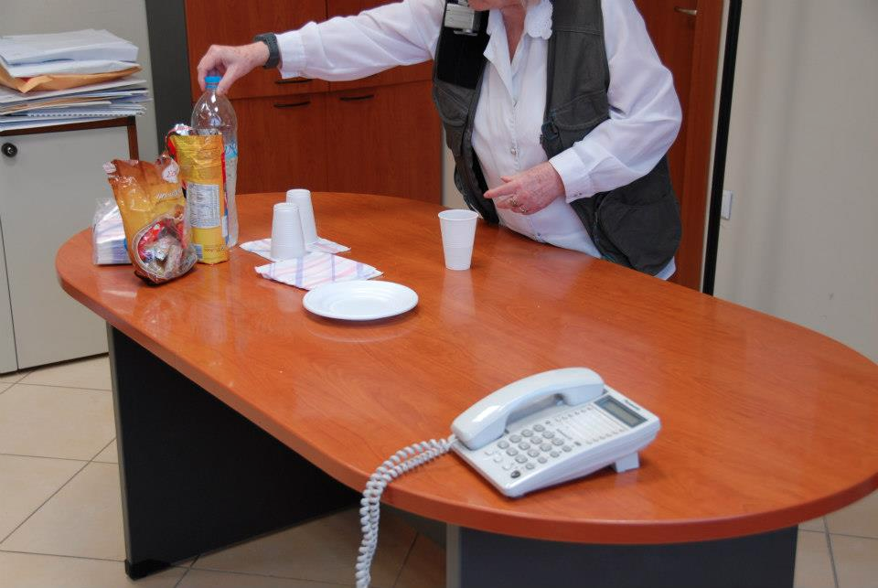
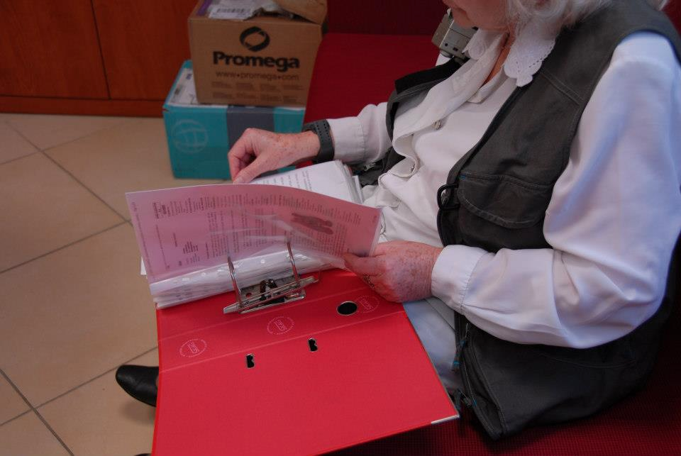
Lab-based Assessment
Mean accuracy of clinical assessment: 83.67% between Healthy – MCI - AD

Slide 8
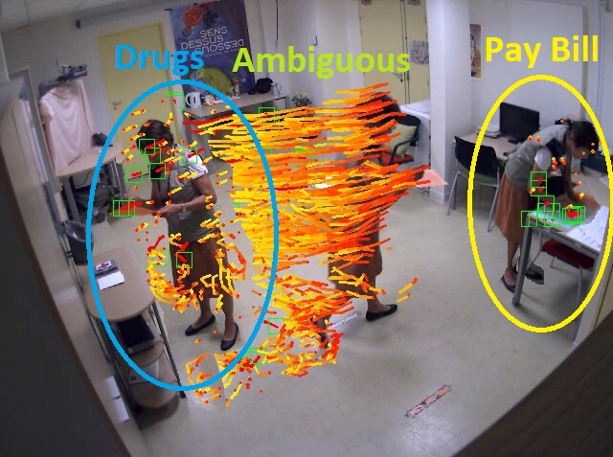
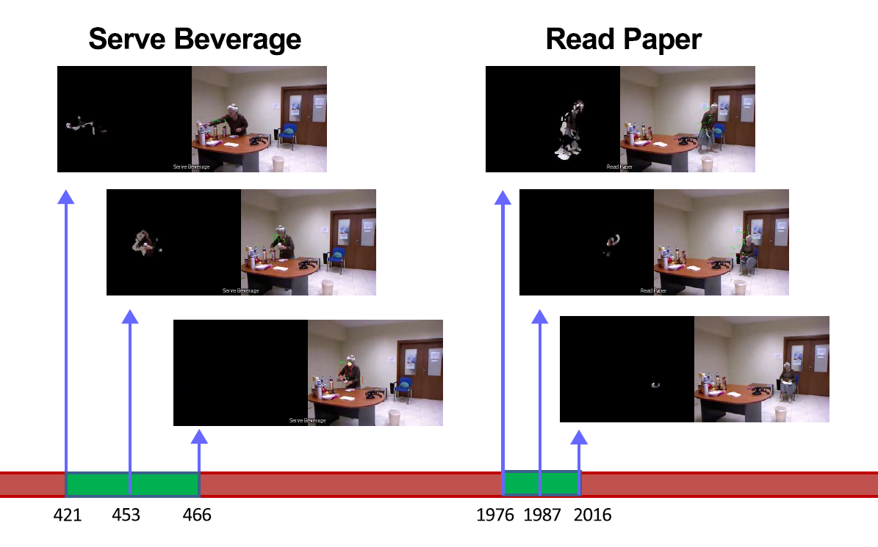
Visual Analytics for Activity Recognition
Video monitoring and construction of behavioural patterns.
Activity detection and recognition at home and lab environments.
ADL | Recall | Precision
Phone Call | 100.0% | 53.8%
Account Balance | 100.0% | 75.0%
Drug Box | 88.9% | 23.5%
Tea Preparation | 100.0% | 64.3%
Turn On Radio | 80.0% | 28.6%

Slide 9
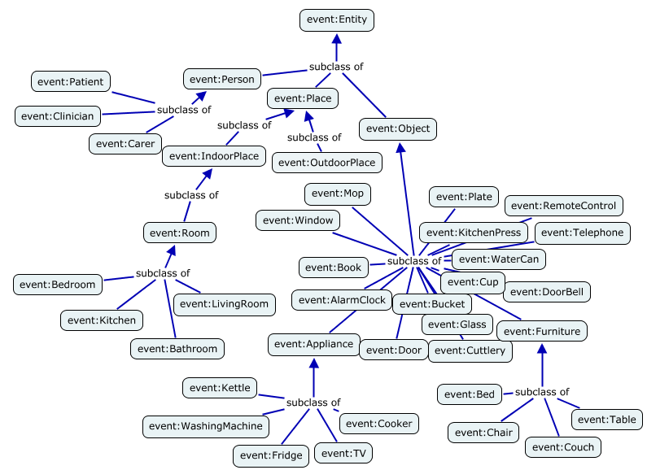
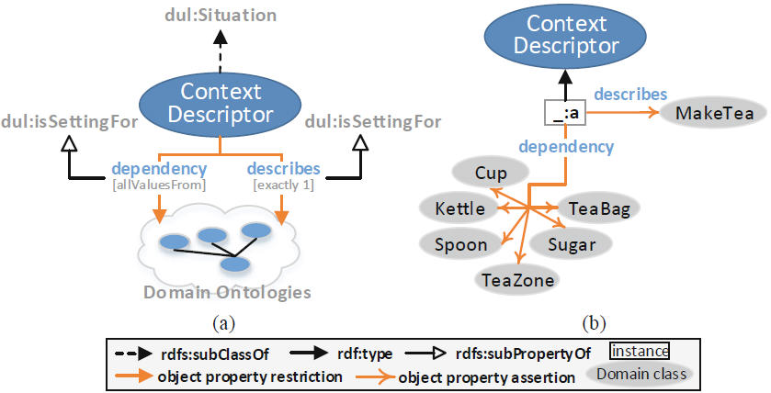
Semantic Knowledge Structures (OWL 2)
Formal vocabularies for capturing context in different levels of granularity
  Low-level observations (e.g. objects, locations)
  Complex activity models (e.g. tea preparation)
  Clinical knowledge (e.g. problems, monitoring parameters)

Slide 10
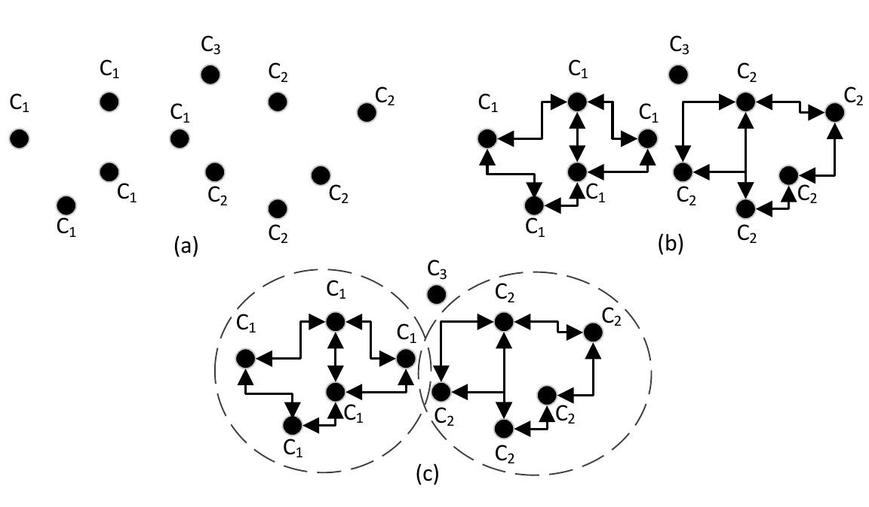
Context-based Multi-sensor Fusion and Analysis
Objective: Fusion of information coming from heterogeneous sources in order to derive high-level interpretations of the behaviour of the person
Our approach: Knowledge-driven semantic segmentation and classification of context
  Combination of SPARQL and OWL 2 meta-modelling
ADL | TPR% | PPV%
Prepare Drug Box | 92.00% | 88.46%
Make Phone Call | 89.29% | 96.15%
Watch TV | 84.00% | 95.45%
Water the plant | 80.00% | 95.24%
Read Article | 95.83% | 85.19%

Slide 11
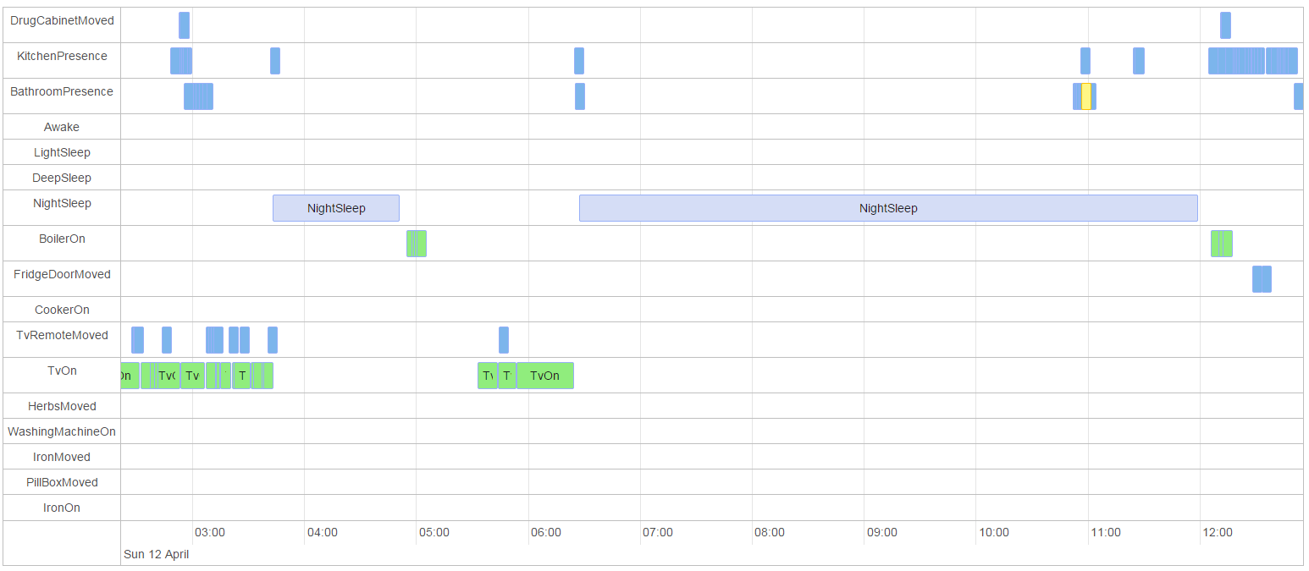
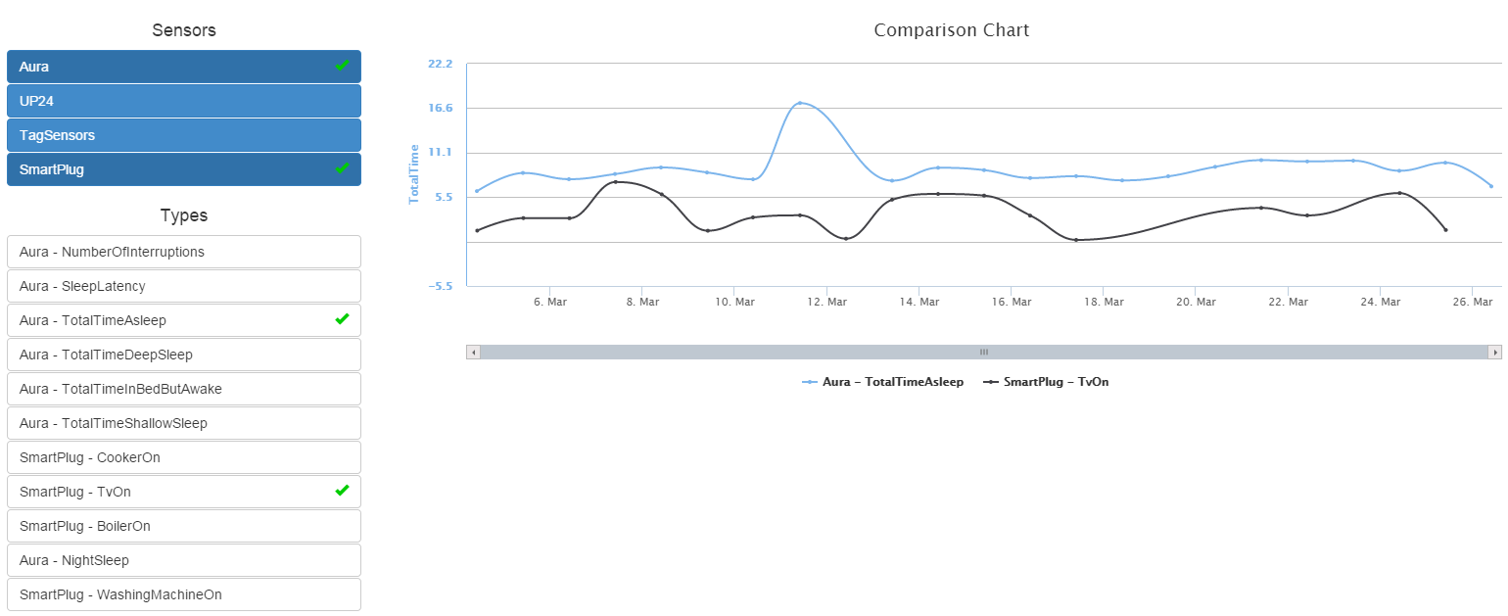
Patient improvements based on sensor feedback and monitoring
  Sleep quality: Less night sleep interruptions (sleep, presence and motion sensors)
  Sleep quality: Less TV watching lead to more sleep (sleep and plug sensors)
  Daily routine: Active Participation in ADLs (full set of sensors)

Slide 12
Installations
Lab pilots
  Nice: 105 participants (ambient and wearable camera, microphone, activity sensor)
  Thessaloniki: 74 participants (ambient, microphone, activity, motion and plug sensors)
  Preliminary results: the system can be used to differentiate between the different severity stages of dementia, from the early pre-demented on to more severe stages
Home pilots
  Dublin: 6 participants (wearable camera, sleep and activity sensors)
  Thessaloniki: 2 participants (full set of sensors)
Nursing home pilots
  Lulea: 4 users in 2 nursing homes (sleep and activity sensors)
  Nice: 2 people in 2 nursing homes (ambient camera and activity sensor)

Slide 13
Impact
Socio-economical benefits
  Not biased and objective clinical assessment
  24/7 personalised feedback and support to patients
  Delay hospitalization
  Reduce healthcare costs
  Enhance feeling of security both for patients and their families
  Improve cognitive and physical condition of patients
Customizable and adaptable to any AAL environment, sensor set and target group

Slide 14
Thank you for your attention!
ikom@iti.gr
http://mklab.iti.gr

Slide 15
Systems Visualizations and Interfaces
Clinician is able to monitor
  Sensors recordings
  Analysis results (e.g. completed activities) from the current or previous dates/periods
Patient is able to read messages-prompts-advices-guidelines that come from
  the system
  clinician

Slide 16
Interventions
Suggested Interventions (e.g)
  Gymnastic at home via smart TV every two days
  Ballroom dance therapy twice a week
  Psychotherapy
  Perform simple daily living activities: such as preparation of daily meals, bathing, maintaining their social life, feeling motivated to participate in everyday life, washing dishes, potting flower
  Relaxation exercises and learning techniques of how to manage her anxiety
Sensor-based intervention compliance and evaluation
  Compliance
    Activities according to weekly schedule
    Gait improvement (camera) from dancing
  Evaluation
    Sleep duration
    Activity records from the wearable sensors
    Reduce the repeated activities

Slide 17
Assessment
Clinical Assessment
Sensor-based support of assessment
  Wearable and motion door sensor : the patient doesn’t have interaction and social life
  Visual analysis: problems with gait and stability
  Wearable sensors: low activity correlated with the TV plug sensor
  Plug sensors: patient doesn’t use the iron and vacuum and/or the washing machines (activities of daily living (ADL))
  Sleep sensor: difficulties in sleep, palpitations and anxiety symptoms
  Sleep sensor data related to wearable sensor data (activity)
  Presence sensors in bathroom (number of visits, duration)

