Slide 1
Data mining, Video Content Analytics
Moutzouris Tasos – EPI Systems
2^{ο} Techology Forum
Παρασκευή 8 Μαΐου 2015

Slide 2
Introduction
EPI SYSTEMS SA
Company is related with informatics projects on the following areas
Hospitality Solutions
Cloud Software starting from small up to very large hotels
Interactive TV, thematic content
Digital Signage over cloud
Hot spots
Infrastructures
Outdoor Lighting Controllers
Microcontrollers
High-tech security systems
Video content analytics for security and marketing
EPI SYSTEMS SA 2015

Slide 3
Hospitality Solutions
Cloud Software for small and large Hotels
An easy, fast, and safe solution
Central Management of hotel services through cloud
Fast and easy deployment
Security of data
Accessible from any device, any place, any time
EPI SYSTEMS SA 2015

Slide 4
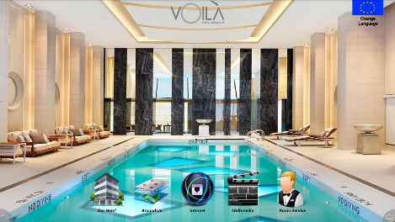
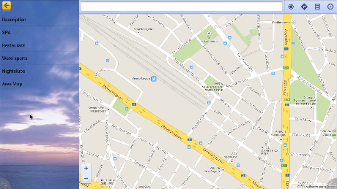
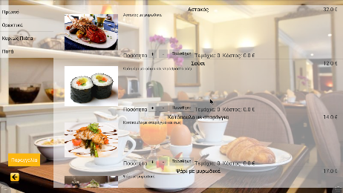
Hospitality Solutions
Interactive TV, thematic content
Make your smart TV, intelligent
Solution for small and big Hotels
No need to change your TV systems
Central Management though hotel intranet
Features
Information about hotel
Interactive maps
Multimedia Content
Games
Ordering system
EPI SYSTEMS SA 2015

Slide 5
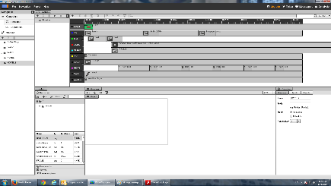
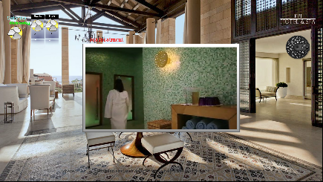
Hospitality Solutions
Digital Signage over Cloud
Advertise professionally your services !
Solution for small and big Businesses
Central Management though cloud
Deployment of the signage on multiple devices
Features
Images
Text
Videos
Sounds
Rss
EPI SYSTEMS SA 2015

Slide 6
Infrastructures
Outdoor Lightning Controllers
Total Control of Lighting !
Central Management though cloud
Grouping of lights and Grouping schedules
Control of electricity consumption and maintenance schedule
Features
Human Detector
human presence
Traffic Flow Detector
traffic density
Road Surface Detector
dry/wet/snow
EPI SYSTEMS SA 2015

Slide 7
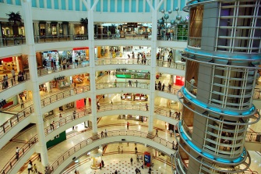
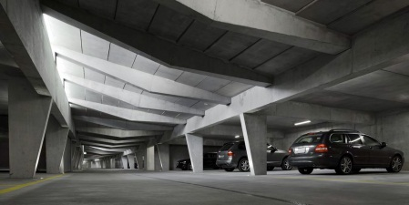
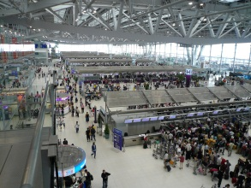
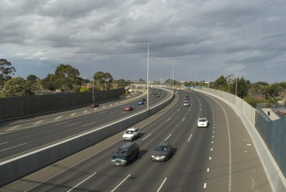
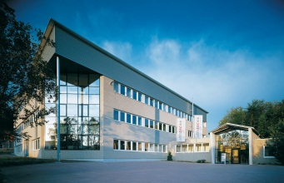
Infrastructures
VCA Data Mining
Extending simple CCTV to intelligent Marketing Tool !
Installation and customization of CCTV with algorithms
Data Collection from Algorithm Metadata
Design and Implementation of software based on customer needs
Areas of Use
Malls / Stores
Parking areas
Airports
Traffic Lanes
Company Buildings
Industrial areas
EPI SYSTEMS SA 2015

Slide 8
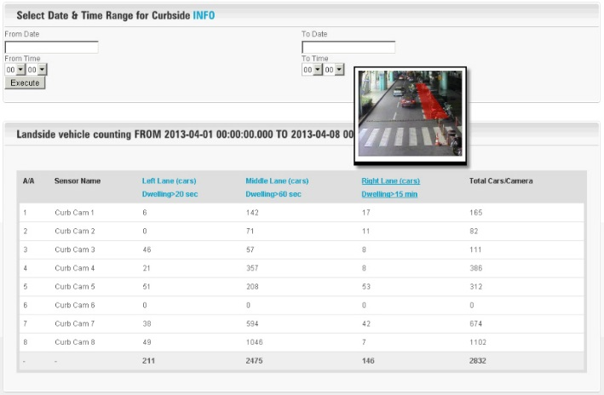
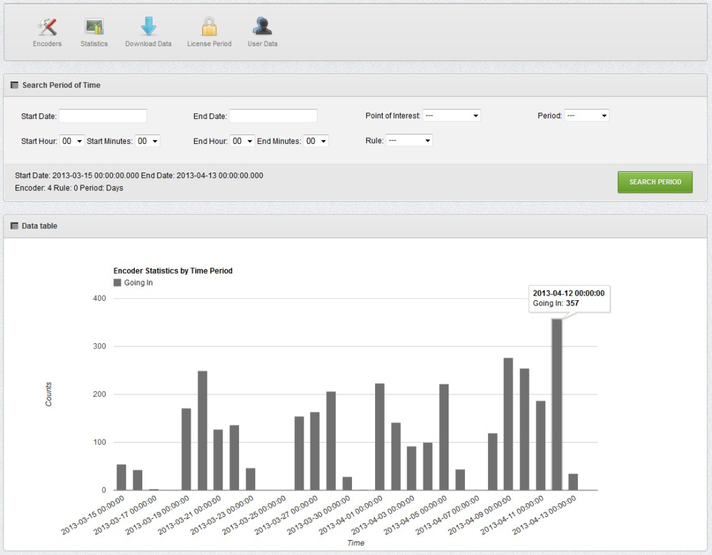
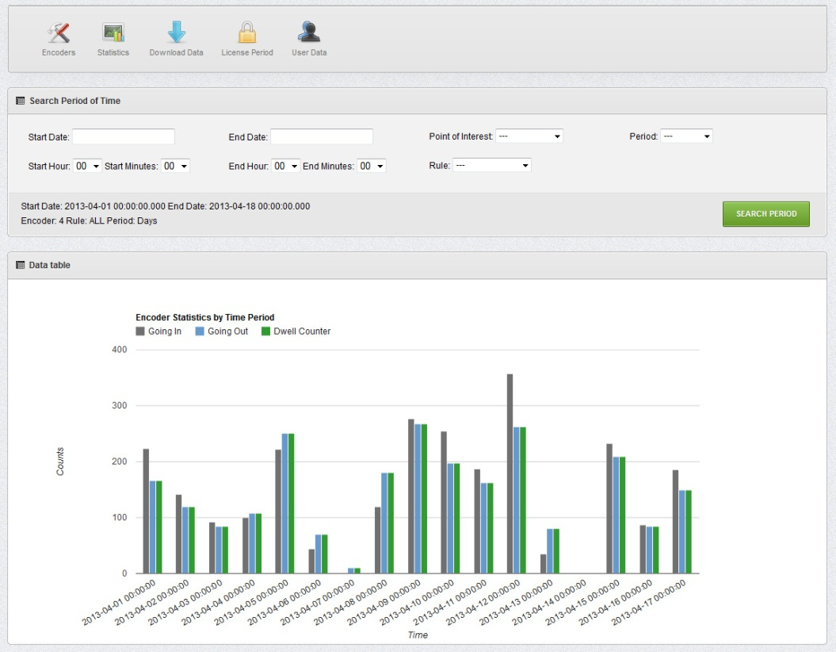
Infrastructures
EPI SYSTEMS SA 2015

Slide 9
Application Benefits
Cloud Solutions
Management of multiple installations from everywhere
Lower infrastructure and energy costs and much more safe and secure
Easily extensible in case of increased resources needed
Applying IoT solutions
Marketing with CCTV Algorithms
Better understanding of the customer needs and reactions
Better decision management, using the BI as a decision tool
Better resource management
EPI SYSTEMS SA 2015

Slide 10
Thank you
Q
A
&
EPI SYSTEMS SA 2015

