Slide 1

Fueling the Cognitive Economy
Nikos Maniatis
Manager of Enterprise and Commercial Sales, Greece & Cyprus
Notes:
What I’d like to discuss today is the following:
(1) What’s going on in the world and your industry.
(2) How cognitive technologies like Watson can be used as a source of competitive advantage today.
(3) How you can get started.

Slide 2
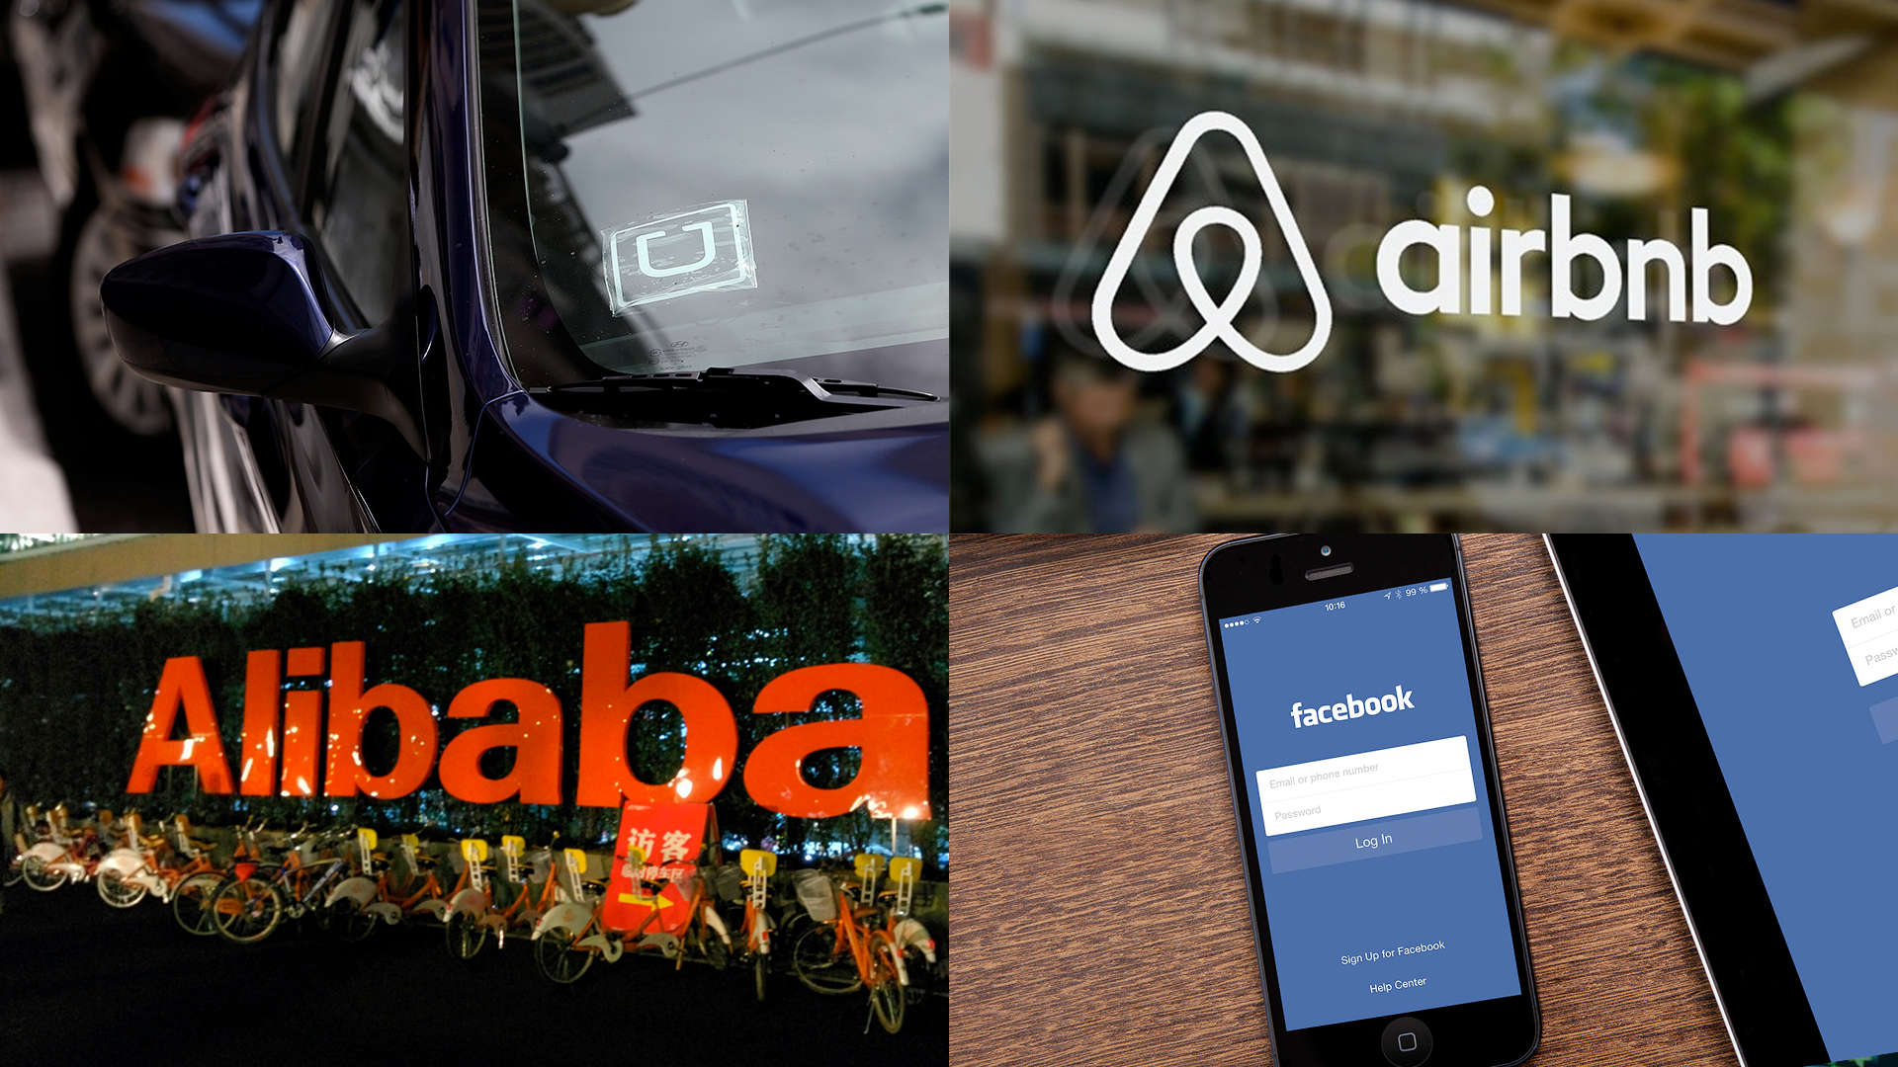
Disruption is upon us.
The biggest taxi company
owns no cars.
The largest accommodation company
owns no real estate.
The largest retailer
carries no inventory.
The biggest media company
owns no content.
Notes:
Even five years ago, I don’t think any of us could of possibly imagined the following…that:
The worlds largest taxi company owns no vehicles
The worlds largest accommodation company owns no real estate
The worlds largest Retailer carries no inventory, and the
The world’s largest Media company creates no content!

Slide 3
This disruption is fueled by three forces.
The proliferation of different types of data.
The ability to build business in code with the API economy.
The powerful capabilities and outcomes brought on by cognitive computing.
Notes:
The world is being disrupted by the sheer amount of data that is available and the potential to harness it beyond traditional analytics. Today, only 15% of organizations have the capability to leverage data and advanced analytics across their organization. (HBR Insight Economy Study).
This data that needs to be harnessed. This data is our ticket to change.
The greatest value comes from putting these capabilities together in the context of an industry or profession. These three forces are powerful, and at the heart of them are business innovation. A huge amount of potential lies ahead for leaders everywhere (from CEOs to Heads of State) who tell us that business innovation is a top priority.

Slide 4


Oil & Gas
Public Safety
80,000 sensors in a facility
produce 15 petabytes of data
520 terabytes of data are produced
by New York City's surveillance cameras each day
Energy & Utilities
Healthcare
680m+ smart meters will produce
280 petabytes of data by 2017
The equivalent of 300 million books of health
related data is produced per human in a lifetime
Notes:
Today, from Oil & Gas to Healthcare industries using data to transform their businesses can know with greater precision what their customers will want, where traffic will form, how disease will progress.
Yet 80% of data produced—including everything humanity encodes in language, from textbooks to conversation, plus all that is captured in sight, sound, motion—is invisible to traditional computers and, therefore, of limited use to those using them.
Where do you see it in your industry?

Slide 5
More devices are creating
more information.
1,200,000
80,000
100,000,000
5,000,000
lines of code in a smartphone
lines of code in
a pacemaker
lines of code in
a new car
lines of code in
smart appliance
Notes:
The world is being reinvented with code.
With the common adoption of more devices, there is now more information for us to harness– if we know how to understand and use it.
This code is connecting pipelines of data and integrating APIs- using the plethora of data now available.
This is the core of the API economy—and every business can take advantage of it.

Slide 6


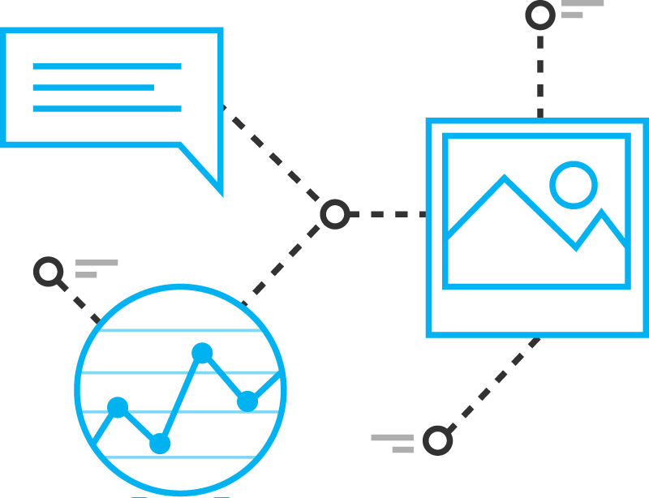
Three capabilities differentiate cognitive systems from traditional programmed computing systems…
Learning
Reasoning
They never stop learning getting more valuable with time. Advancing with each new piece of information, interaction, and outcome. They develop “expertise”.
They reason. They understand underlying ideas and concepts. They form hypothesis. They infer and extract concepts.
Understanding
Cognitive systems understand like humans do.
…. allowing them to interact with humans.
Notes:
Enter Cognitive….solutions that understand, reason and learn, while interacting with humans. What do I mean by Understand, Reason and learn?
Understand: Two key attributes define understand. First, the ability of a system to navigate the complexities of human speech– understanding the idiosyncrasies, colloquialisms and knowing the ways we would express ourselves to one another. This is not an easy task. We say things like, “This morning I got a haircut.” This could reference the barbershop, OR a bad financial trade. The second attribute is being able to put content into context- not search and keyword– but actually bringing forward relevant, actionable content.
Reason: There are very few times where we, as humans, are presented with information that is useful WITHOUT having to infer from the data to extract what we need for our purposes. In doing so, we are reasoning with a purpose– often generating a hypothesis and then proving out the theory. This is something cognitive systems, like Watson, can do.
Learn: Cognitive systems are fundamentally different from traditional computational computers, which are hard hard coded with rules and logic, following a decision tree format. Cognitive systems get progressively smarter with each outcome, action, iteration– with each new peace of information.
Together these attributes allow cognitive systems to understand data – structured and unstructured, text-based or sensory – in context and meaning, at astonishing speeds and volumes. In fact, Watson reads 800 million pages per second.
With one client, Watson initially ingested 80 million documents and incrementally adds 30,000 additional documents every day.
These combined attributes- understand, reason, and learn- make cognitive systems great resources for humans- helping them to make decisions, discover needed information, and weigh pros, cons, risks in industries around the world.

Slide 7





Cognitive systems democratize innovation by scaling knowledge.
Sensors
Data
Analytics
Information
Cognitive
Ingestion, Integration, Governance
Notes:
For several decades we’ve been digitizing the world; building
networks to connect the world around us.
Social networks that created awhole new channel of information
that runs in parallel to all otherbusiness information that’s Flowing..
And with the Internet of Things, we’re connecting all of the world’s devices; applying sensors and instrumentation to all of our applications, products, operations and processes creating connected cars, satellites, supply chains, and factories.
These are the elements of a supply chain that are driving cognitive businesses—these sensors and instruments generate the data that becomes information once analytics are applied.
But we’ve reached an inflection point in which the sheer volume of
information generated is so vast; we no longer have the ability
to use it productively.
Cognitive systems change this dynamic – they present humans with the ability to extend their expertise and knowledge gleaned from that vast amount of information.

Slide 8

Cognitive systems forge a new partnership between man and machine.
Cognitive Systems
excel at:
Humans excel at:
Locating Knowledge
Common Sense
Pattern Identification
Morals
Natural Language
Imagination
Machine Learning
Compassion
Eliminate Bias
Abstraction
Endless Capacity
Dilemmas
Dreaming
Generalization
Notes:
Cognitive systems, like IBM Watson, allow a partnership between man and machine.
Humans are inherently capable of a set of skills that help us learn, discover and make decisions:
We can apply common sense, morals, and reason through dilemmas; we can dream up new ideas and make generalizations when essential clues and pieces of information are missing.
But we’re restricted by the time it takes to learn, process, and absorb new information and limited by the unconscious biases we all possess that influence the decisions we make.
Cognitive systems enable us to understand the world differently and make better decisions. They help you:
Enable new kinds of engagement
Create better products and services
Improve your processes and operations
Leverage expertise
Accelerate your ability to explore and discover as a business
Enable new business models.

Slide 9
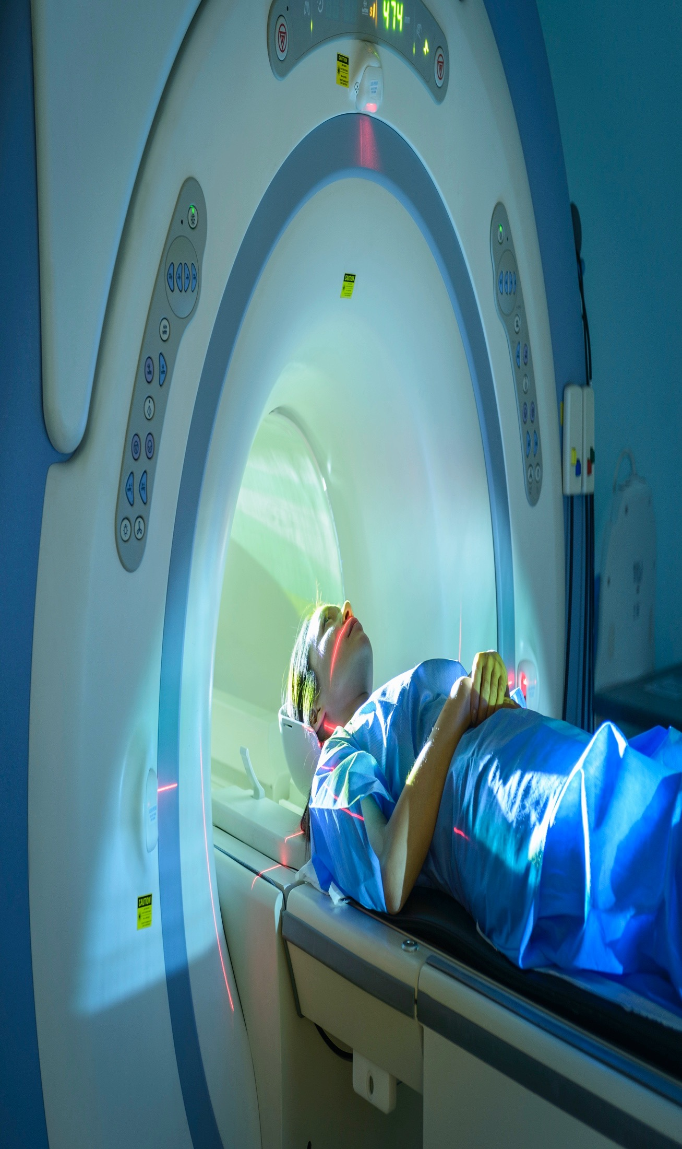


The price
of not knowing.
©2016 IBM Corporation
Notes:
What is the greatest motivator for organizations to pursue cognitive capabilities? It’s the price of not knowing:
For an oil company it’s drilling in the wrong location and having a dry well
For a wealth manager it’s making a poor investment decision based on lack of information
For a doctor it’s an incorrect diagnosis
What is the price of not knowing for you?
A Baylor Medical School retrospective study focused on a particular protein, called p53 -- a protein that inhibits tumor growth in cancer patients.
Holding constant all the research and insights that had been done prior to 2003, and testing Watson's capabilities against it, Watson was able to extract from the over 23M Medline articles it read, a 100% of the known proteins that affect p53. It compressed what had been a decade of research to a matter of weeks.
Watson was also able to identify the 7 new proteins that have been discovered since 2003 as well as 6 new phosphates that appear to impact p53, all of which are now being investigated.
But this is just one example; oil pipeline analysts are using Watson to trim years off of production timelines; KPMG is using Watson to reinvent audits – the difference between manually analyzing a small sample of hundreds of documents to using Watson to read and derive insights from thousands or millions of materials.

Slide 10









As the Watson technology evolves and deepens,
so are the ways it’s being put to work in the world.
20
Industries
45
Countries
50,000
Students
in Melbourne
80K
Developers
building with Watson
500+
Partners
Powered by Watson
1.1M
Patients
at Bumrungrad
8
Languages
Learned by Watson
200
Universities
offering Watson courses
5.5M
Citizens
in Singapore
Notes:
Today, businesses and organizations in 45 countries, across 20 industries and 8 (soon to be 9) languages (English, Japanese, French, Italian, Spanish, Brazilian, Portuguese, Arabic– and Korean announced as coming soon in May 2016) are using Watson to build cognitive abilities into their products, applications, processes, and offerings:
The 50,000 students at Deakin University in Australia using Watson as a student advisor to answer their questions as they arrive on campus;
The 1.1 million patients in Bumrungrad Hospital’s network who now have access to personalized cancer treatment recommendations with help from a system trained by the doctors at the worlds leading cancer centers;
The 5.5 million citizens in Singapore who have access to government services with help from Watson;
80,00 developers, VCs, and start-ups using Watson APIs.
More than 350 Watson ecosystem partner companies, with 100 of their applications already in market.
And countless chief marketing officers, analysts, researchers, and many more who are making connections and discoveries with apps powered by Watson.
Let’s take a closer look at a few examples:
Korean language coming soon: https://www.ibm.com/blogs/think/2016/05/10/watson-learns-korean/

Slide 11
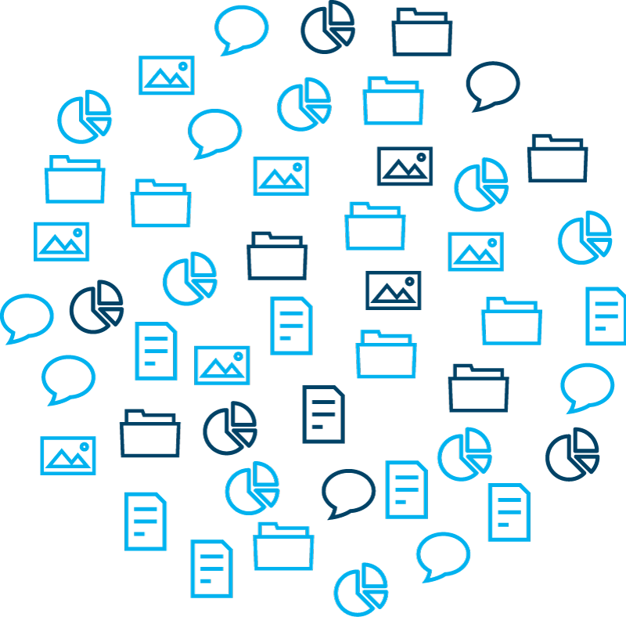
Cognitive systems rely on collections of data and information:
Data, information, and expertise create the foundation.
Examples include:
Analyst reports
tweets
Wire tap transcripts
Battlefield docs
E-mails
Texts
Forensic reports
Newspapers
Blogs
Wiki
Court rulings
International crime database
Stolen vehicle data
Missing persons data
Notes:
So, let’s take a step back– what is making cognitive valuable for our clients and partners?
Data, information, and expertise create the foundation for working with Watson.
These organizations identified and determined the content and expertise within their organization – or externally – that informs their knowledge base.

Slide 12

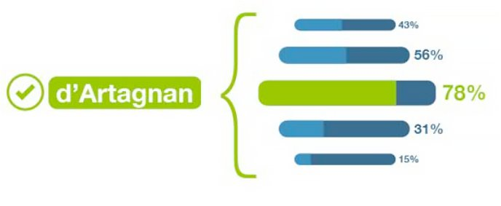





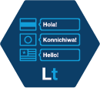






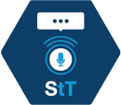



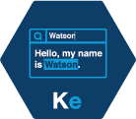





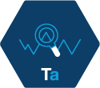




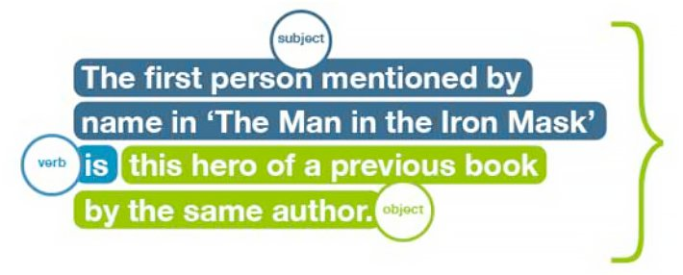

…and then leverage Watson APIs to apply cognitive capabilities.
Retrieve and Rank
50 underlying technologies
Entity Extraction
Sentiment Analysis
Emotion Analysis (Beta)
Keyword Extraction
Concept Tagging
Taxonomy Classification
Author Extraction
Language Detection
Text Extraction
Microformats Parsing
Feed Detection
Linked Data Support
Concept Expansion
Concept Insights
Dialog
Document Conversion
Language Translation
Natural Language Classifier
Personality insights
Relationship Extraction
Retrieve and Rank
Tone Analyzer
Emotive Speech to Text
Text to Speech
Face Detection
Image Link Extraction
Image Tagging
Text Detection
Visual Insights
Visual Recognition
AlchemyData News
Tradeoff Analytics
Natural Language Classifier
Tone Analyzer
Notes:
Next, they leverage Watson APIs – cognitive building blocks - to apply Watson’s capabilities.
Watson APIs are delivered on a cloud-based, open platform, and with Watson, you can build cognition into your digital applications, products, and operations, using any one or combination of the available APIs.
For example, Natural Language Classifier API enables developers without a background in machine learning or statistical algorithms to create machine-learning, natural language interfaces for their applications.
Tone analyzer helps individuals understand the linguistic tone of their writing. This API uses linguistic analysis to detect and interpret emotional, social, and writing cues that are located within the text, and also offers rhetorical suggestions for an author to improve the intended tone.
Retrieve and rank helps users find the most relevant information for their query by using a combination of search and machine learning algorithms to detect “signals” in the data. – cognitive building blocks – to leverage capabilities including relationship extraction, personality analysis, tone analysis, concept expansion, and trade-off analytics, among others.
Each API is capable of performing a different task, and in combination, they can be adapted to solve any number of business problems or create deeply engaging experiences.
And we continue to add new and expanded cognitive capabilities to the platform.

Slide 13


Slide 14






















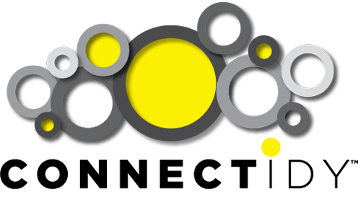


































Watson at work in the world.
Notes:
The Watson ecosystem now represents more than 500 ecosystem partners across 17 industries and disciplines.
Over 100 of which have already introduced commercial cognitive enabled apps, products and services to the market.
These partners join the more than 80,000 developers globally that are tapping into APIs via the Watson Developer Cloud to pilot, test and deploy new business ideas.
IBM has allocated $100 million for venture investments to support this community of start-ups and businesses building cognitive applications powered by Watson, six investments have been made.
The rate at which companies are introducing cognitive computing and AI-infused apps to market has tripled in less than a year.
IDC predicts that by 2018, half of all consumers will interact with services based on cognitive computing on a regular basis.
Watson is being trained in four additional languages including Brazilian Portuguese, Spanish, Japanese and Arabic. [Five in total, including English]

Slide 15
Watson at work in the world.
"Thomson Reuters to deploy IBM Watson technology”
- InfoTechLead
"IBM's Watson Lands A Job With KPMG.” -InformationWeek
"How Can I Help You? IBM's Watson Powers Hilton's Robotic Concierge" - Fast Company
"Woodside to tap into IBM's Watson” - CIO
"SoftBank's Pepper robot is getting an intelligence boost from IBM's Watson"- The Verge
"IBM’s Watson Helped Pick Kia’s Super Bowl ‘Influencers’”
- Wall Street Journal
"IBM and Apple can put Watson's A.I. insights inside Apple Watch"- ComputerWorld
"IBM’s Watson Now Powers AI For Under Armour”
- TechCrunch
"The North Face Uses IBM's Watson to Make Online Shopping Smarter" -The Street
"Medtronic, IBM team up on diabetes app to predict possibly dangerous events hours earlier."- The Washington Post
Notes:
Watson is being used to expand expertise and improve decision making in a variety of areas – healthcare, financial services, law, retail, education. Today hundreds of clients and partners across 36 countries and more than 17 industries have active projects underway with Watson. This work is expected to grow as IBM continues to enter Watson into new geographies and industries.
Most recently, we announced new client engagements with Thomson Reuters, Swiss Re and KPMG to adopt Watson to help transform their business solutions and provide new levels of intelligent information to customers.
Thomson Reuters (http://www-03.ibm.com/press/us/en/pressrelease/47794.wss) has begun a project to apply Watson to its solutions for business customers who require accurate, in-the-moment knowledge in order to make strategic decisions across multiple fields including science, legal, tax and finance.
Swiss Re (http://www-03.ibm.com/press/us/en/pressrelease/47904.wss) is using Watson to develop a range of underwriting solutions and help its professionals make better-informed decisions and more accurately price risk.
KPMG (http://www-03.ibm.com/press/us/en/pressrelease/49274.wss) is applying Watson to its audit practice, transforming the firm’s ability to deliver innovative and enhanced business services to clients.
Other examples:
The North Face (http://www-03.ibm.com/press/us/en/pressrelease/48479.wss) launched a new interactive online shopping experience powered by IBM Watson. Customers can now use natural conversation as they shop online via an intuitive, dialog-based recommendation engine, receiving outerwear recommendations that are tailored to their needs.
IBM Watson helped Kia to identify “social media influencers” who could buoy Kias message before and during the motor company’s 60-second spot during the Superbowl in 2016. http://www.wsj.com/articles/ibms-watson-helped-pick-kias-super-bowl-influencers-1454432402
Hilton (https://www-03.ibm.com/press/us/en/pressrelease/49307.wss) is piloting “Connie,” the first Watson-enabled robot concierge in the hospitality industry. Connie draws on domain knowledge from Watson and WayBlazer (a Watson ecosystem partner) to inform guests on local tourist attractions, dining recommendations and hotel features and amenities.
IBM and Apple are using the Watson Health Cloud to support health data entered by customers in iOS apps using Apple’s ResearchKit and HealthKit frameworks, arming medical researchers with a secure, open data storage solution. (https://www-03.ibm.com/press/us/en/pressrelease/46583.wss)
IBM is powering Softbank Robotic’s Pepper robots aimed at global enterprise customers. The robots under development will be equipped with core functionalities as well as a Watson software development kit that allows developers and clients to tailor the interaction experience. https://www-03.ibm.com/press/us/en/pressrelease/48763.wss

Slide 16








The market is validating the benefits of cognitive.
“[Watson] is specifically designed to support the development of a broad range of enterprise solutions.”
“No doubt, Watson has the means to radically change the industry. “
“IBM Crafts a Role for Artificial Intelligence in Medicine.”
IDC: IBM’s Go-to-Market Transformation – Deeper, Wider, Newer (#AP257527, April 2015, Chris Zhang, Sabharinath Balasubramanian, Mayur Sahni)
“IBM Watson represents a bold technological and visionary step”
“What is distinctive about IBM is the breadth of its effort to create Watson tools … for a wide range of developers.”
“…it’s not just AI algorithms themselves that have improved, but the ability to deliver them”
“The worldwide cognitive software platforms market will grow to $30 billion by 2018, at a CAGR”
‘You can't do this without Watson. -Former Sun CEO Scott McNealy. His startup, Wayin, uses Watson to trawl and drag photos.
“IBM’s [Watson] can help banks with complex financial operations and attack important health care problems.”
IDC: Worldwide Cognitive Software Platforms Forecast, 2015-2019: The Emergence of a New Market (#258781, September 2015, David Schubmehl)
Notes:
And that’s not it– not only are our customers validating the value of IBM Watson’s cognitive capabilities.

Slide 17
What will you do with Watson?

Slide 18



Notes:
This year 2 million women will be diagnosed with breast cancer worldwide. In the US, a recent study of breast cancer risk revealed that 1 in 8 women develop invasive breast cancer during her lifetime. (In India, 1 in 28.)
As the most diagnosed cancer for women, in the last 20 years the number of therapies available for breast cancer treatment has increased from four to more than 800.
But, it’s a challenge for oncologists to stay abreast of the latest research, therapies, and clinical trials.
And the issue is growing exponentially across healthcare; in fact, by 2017 health data will grow by 99%. To keep up with this information, it would take a physician 160 hours of reading per week, when the average physician spends only five.
So how can cognitive help?
Bumrungrad International Hospital in Bangkok, Thailand – home to 580 beds and more than 30 specialty centers— and a network that spans 16 countries and four continents— in total 1.1 million patients— needed a way to give their oncologists access to world leading expertise without taking them away from patients to read and digest the latest information.
So they chose IBM Watson for Oncology, trained by Memorial Sloan Kettering Cancer Center.
Why IBM Watson? Why Cognitive?
Unlike doctors, IBM Watson is not bound by volume, memory, or format. Using the power of cognitive, Watson can understand, reason and learn. It can read millions of unstructured documents in seconds.
Since 2011 IBM has partnered with Memorial Sloan Kettering Cancer Center to train IBM Watson in the field of Oncology. During more than 15,000 hours of training by MSK, Watson ingested more than 600,000 pieces of medical evidence, 2 million pages of text, 1.5 million patient records and 26,000 clinical cases.
In choosing IBM Watson for Oncology, Bumrungrad oncologists gained access to an expert cognitive advisor that helps them to make more informed, personalized treatment decisions for its cancer patients.
So, for the next female patient- wife, mother, daughter, aunt- that comes in with breast cancer, oncologists at Bumrungrad can use IBM Watson to analyze relevant portions of her electronic medical record, including her family history, notes from prior office visits, and test results, then summarize and highlights aspects of her individual record and notes that are potentially significant to her cancer based on the expertise of oncologists at Memorial Sloan Kettering, and using IBM Watson for oncology they are provided with confidence-ranked, evidence-based personalized treatment options for this woman, something that they previously did not have the manpower to accomplish as personalized and confidently.
What will you do with Watson?
Key Stats
1 in 5 individuals are misdiagnosed - an alarming statistic. But it’s not the fault of the physician.
It is estimated that the doubling time of medical knowledge in 1950 was 50 years; in 1980, 7 years; and in 2015, less than three years.
An epidemiologist, according to a government study, would have to read 167 hours of research each week to keep up with the latest information. That is not humanly possible. This issue is growing exponentially across health care with medical data now doubling every 3 years.
The average primary care doctor in the US has a caseload of 2,300 patients and spends 15 minutes per patient visit.
As a result of the collaboration between IBM and Memorial Sloan Kettering, Watson for Oncology draws upon clinical expertise and over 20 years of experience and 1.5M patient records.
Bumrungrad International Hospital is home to 580 beds and more than 30 specialty centers— and a network that spans 16 countries and four continents— in total 1.1 million patients.
Today, clients in 36 countries, across 17 industries are applying cognitive technologies.
84% in healthcare believe it will play a disruptive role in the industry—and 60% believe they lack the skilled resources and technical expertise to achieve it.
Healthcare data will grow 99%, and 88% of all healthcare data will be unstructured. It is coming from electronic medical records (EMRs), test results, medical images, and video, patient sensors such as wearables, bedside devices and implants. Medical image archives alone are increasing by 20–40% annually.
Cognitive systems are designed to keep pace, serving as a companion for professionals to enhance their performance.

Slide 19
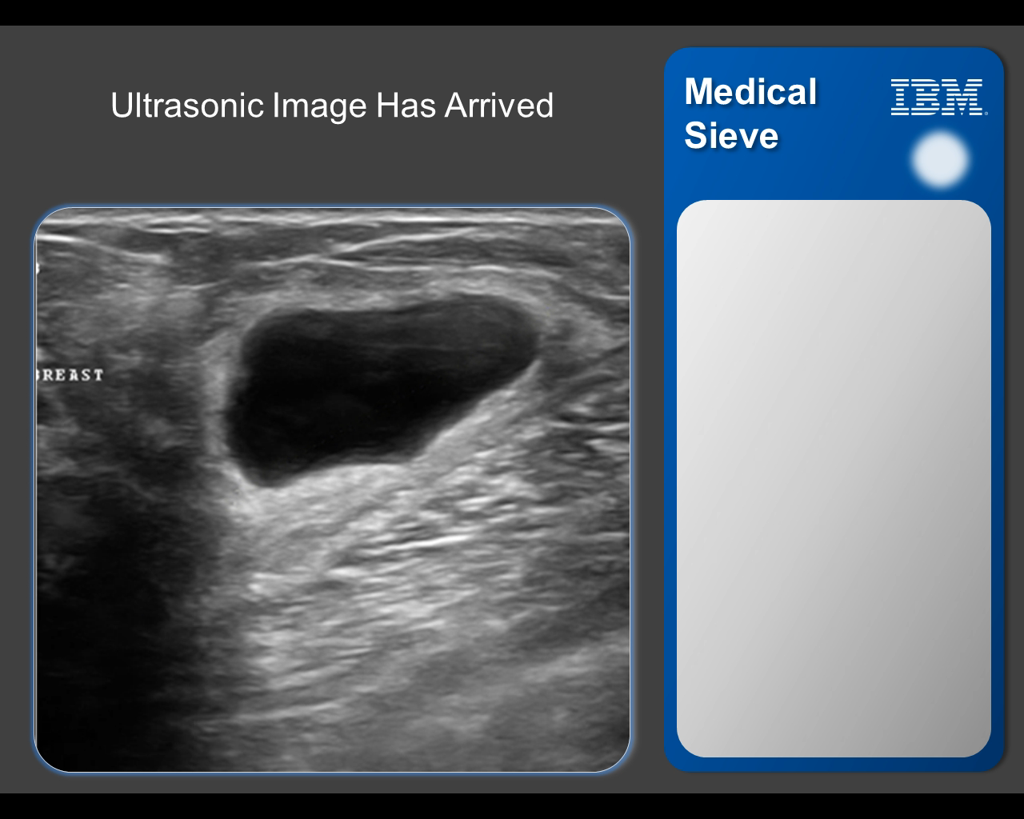

Slide 20


Notes:
The President of Medtronic, Annette Bruls, remembers a very clear story from 2012 when met a woman in Berlin who convinced her that the healthcare community had to change the way it was addressing diabetes.
The woman and her two beautiful children, ages 2 and 5, both with diabetes, attended an awareness event Medtronic hosted at the German Parliament. She told her that there’s no vacation from diabetes. She got up 10 times each night to measure her children’s blood glucose levels. She struggled with diabetes every minute of every day, and she feared that her kids would live under its dark cloud all the days of their lives.
I thought: there must be more we can do.
Now, Medtronic and IBM are attempting to take diabetes care to the next level.
In a pilot to see how Watson can help people with diabetes, Medtronic and IBM took 600 past patient cases and applied cognitive analytics to the data from Medtronic insulin pumps and glucose monitors. Watson was able to predict hypoglycemia – extreme low blood sugar – up to three hours in advance of onset — early enough so a person with diabetes could take action to prevent a potentially dangerous health event.

Slide 21

Notes:
As the insurance market becomes digital, digitally-savvy customers, based on their experience with other industries such as retail, expect insurers to provide the same advanced customer experience to them during their interactions. They expect insurers to know them in advance when they call, proactively engage with them after gathering relevant information from data such as social media and call center logs, and provide them with proactive advice and guidance.
To meet these changing customer expectations, Life and Property and Casualty (P&C) insurers are looking for innovative solutions that can enable them to shape the future of insurance by improving customer experiences. They are looking for intelligent automated chat solutions with self-service capability at their call centers, with which the customers can chat in natural language just as they chat with a CSR and obtain the required support quickly in real time.
Enter cognitive. Enter IBM Watson.
IBM Watson uses the cognitive abilities of understanding, reasoning and learning to deliver a new level of customer engagement to insurers, fundamentally changing how customers and insurance companies interact.
For example, a major insurance company built a Watson-based digital assistant that answers complex inquiries in natural language and coaches the user to complete the sale.
Watson Engagement Advisor enables insurers to deliver actionable insights and considered response to customers in need. In deploying IBM Watson, insurers, like you, can deliver more consistent, personalized and evidence-based recommendations to clients.
Key Stats
94% of C-Suite executives in retail and 96% in insurance intend to invest in cognitive capabilities
Today, clients in 36 countries, across 17 industries are applying cognitive technologies.
Marketers are achieving 15–20% ROI improvements by putting data-driven personalization at the center of their efforts.

Slide 22


Notes:
Imagine knowing the answer to a problem exists, but not having a viable way to get it without redoing the work. Frustrating, right? In the oil and gas industry, leaders around the world create hundreds of thousands of documents per project—engineering studies, environmental reports, risk analyses, developmental concepts—the list goes on. But having all this content and not being able to derive value from it is less than optimal.
How can cognitive help? How can IBM Watson help?
Australia’s largest independent oil and gas producer leveraged IBM Watson Engagement Advisor to create a cognitive advisory service called “Lesson Learned.” Lesson Learned pulls together decades of engineering data from numerous sources including testing, projects and messages and makes it accessible to a wide group of employees.
For example, a project engineer in just the training phase at Woodside needed to ask IBM Watson through Lesson Learned about a serious issue they were having with birds and their helicopter landing pads at a new offshore platform.
The engineer typed “What design features have we put in offshore platforms to deter birds?” into Lesson Learned, and in 3 seconds—one instant— Watson culled through 30 years of Woodside’s data to surface an applicable solution used in another project 10 years prior. Non only that, IBM Watson included the report’s author, review team and approver— providing an evidence-based answer, further propelling collaboration across the organization, and preventing the rework of an problem previously solved.
Imagine that one instant hundreds of times a day in your organization.
What will you do with IBM Watson?
Key Stats
Woodside has more than 30 years of internal data science operations knowledge as a leading liquefied natural gas operator.
Woodside, like many oil and gas providers, creates 100,000s documents per projects.
Woodside projects range from $1-2billion to $10s of billions.
Today, clients in 36 countries, across 17 industries are applying cognitive technologies.
According to an industry analyst, decision management platforms will expand at a CAGR of 60% through 2019 in response to the need for greater consistency in decision-making and process knowledge retention.
Cognitive systems like IBM Watson are designed to keep pace, serving as a companion for professionals to enhance their performance.

Slide 23

Notes:
The global hotel industry generates approximately between 400 and 500 billion U.S. dollars in revenue each year, one third of that revenue is attributable to the United States. Often, customer service is the differentiating factor between dollars and cents.
In fact, when surveyed, almost 9 in 10 consumers said they would pay more to ensure a superior customer experience. What makes up good customer service? Friendly staff, customized experiences, proactive attention, accurately solved problems, and accurate answers to guest questions.
But, according to consumers, customer service agents fail to answer their questions 50% of the time, and 59% of those unsatisfied consumers attest that they will try a new brand or company for a better experience.
How do you save these customers?
Enter cognitive. Enter IBM Watson.
Hospitality/Travel and Transportation providers are striving to remain competitive—improving efficiency and creating unique experiences to improve customer satisfaction.
Using data from on premise and off-premise data, loyalty programs, guest stays and more, IBM Watson can use the power of cognitive to understand, reason and learn to help hospitality leaders gain insights into the behavior of guests—helping you to provide a more personal touch.
Take our partners Go Moment and WayBlazer, these Powered by IBM Watson apps are disrupting the travel industry by creating unique customer experiences, tailored to their individual needs through the power of cognitive.
In fact, in 2016, 20 million hotel guests will have access to Ivy—an automated guest engagement platform powered by IBM Watson—that can welcome them, deliver instant service and help hotel staff improve satisfaction.
Another example. By employing IBM Watson’s cognitive computing technology, WayBlazer listens to your customers and presents considered, personalized recommendations. Powered by IBM Watson, WayBlazer can integrate with consumer touch-points at every stage of the travel experience: from early research and pre-stay to on-premise and about town.
This is just the beginning. What will you do with Watson?
Key Stats
According to an industry analyst, by 2018 half of all consumers will regularly interact with services based on cognitive.
The global hotel industry generates approximately between 400 and 500 billion U.S. dollars in revenue each year.
3 in 5 Americans (59%) would try a new brand or company for a better customer service experience.
In 2011, 7 in 10 Americans said they were willing to spend more with companies they believe provide excellent customer service.
According to consumers, customer service agents fail to answer their questions 50% of the time.
Almost 9 in 10 consumers say they would pay more to ensure a superior customer experience.
Today, clients in 36 countries, across 17 industries are applying cognitive technologies.
Marketers are achieving 15–20% ROI improvements by putting data-driven personalization at the center of their efforts.

Slide 24


Notes:
UA Record is your body’s dashboard, with insights powered by IBM Watson. It collects your data and provides a 24/7 view of your progress. Set goals, capture sleep, log workouts, measure activity, track nutrition and connect with friends and athletes. Then UA Record analyzes all of your data and provides a single view of your daily progress with personalized insights and recommendations.
For example, a person can compete and compare against other people that are their same age. A male in his 40’s will see that there are 4.5 MILLION other people in the database today – that areJUST LIKE YOU. The UA Record app will share health and fitness insights comparable to others similar to you, including average weight, average resting heart rate and average steps taken per day. Additional insights could show how long an average workout is or how long someone like you is sleeping, down to the minute.
https://www-03.ibm.com/press/us/en/pressrelease/48764.wss

