Slide 1


Digitization
Nikos Botinis
Regional Sales Manager

Slide 2

277X
Data created
by IoE devices
v. end-user
30M
New devices
connected
every week
180B
Mobile apps
downloaded
in 2015
78%
Workloads processed
in Cloud DCs
by 2018
5TB+
of data per person
by 2020
4.2B
Web filtering
blocks per
day
...signs of a Digital World
© 2015 Cisco and/or its affiliates. All rights reserved. Cisco Public

Slide 3
Industry Revolution 4.0 – Digital Transformation - IoT

Slide 4
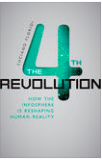
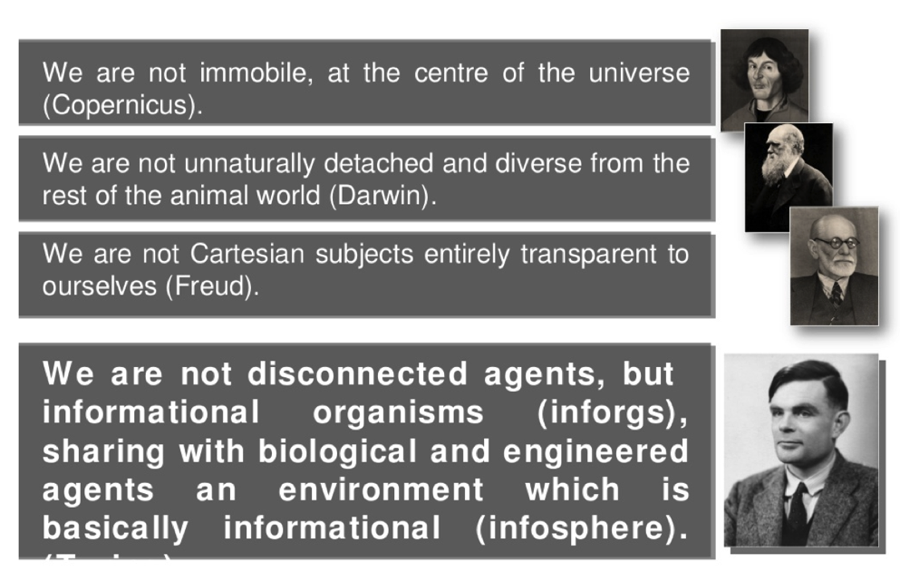
The 4th revolution
(Turing)
Src. Luciano Floridi, Slideshare
Notes:
Disconnected agents = aposindedemenoi paragondes
Engineered agents = mixanikoi paragondes

Slide 5
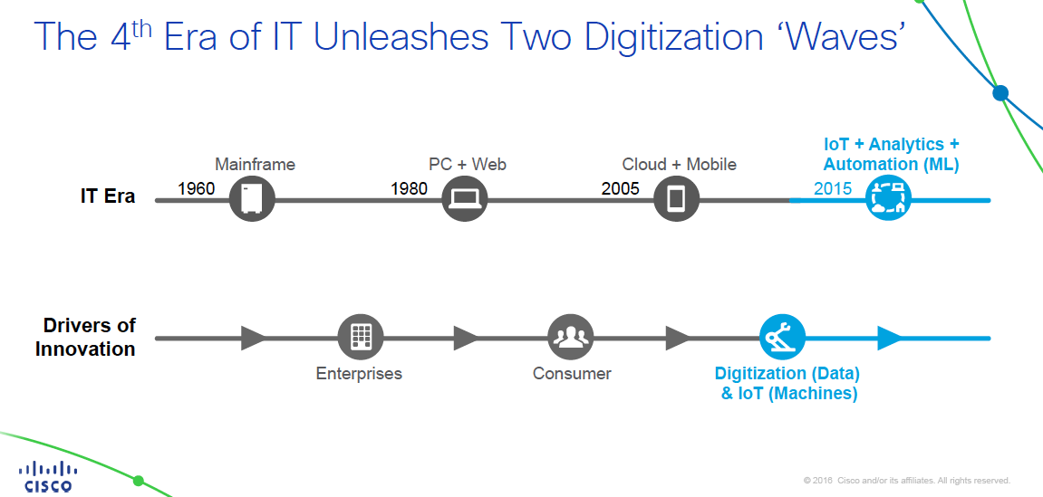

Slide 6

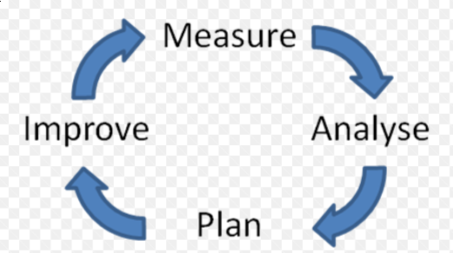

Digital Disruption & Transformation is…
.....’’The application of Information Technology (IT) to implement innovative business models, improved customer experience and/or operational improvements that have the potential to disrupt entire industry sectors.’’
Customer Experience
Business Operations
Business Model Innovation
Notes:
https://www.capgemini.com/resource-file-access/resource/pdf/Digital_Transformation__A_Road-Map_for_Billion-Dollar_Organizations.pdf
Short version: http://sloanreview.mit.edu/article/the-nine-elements-of-digital-transformation/
Although I am sure there are many models to represent various types of digital transformation and disruption, I have found this model represents a useful perspective.
First, when considering digital transformation, there are three key areas to observe. One is the impact on customer experience, a second is the impact on operational improvements within the company, and third changes to the companies business model
Operational Improvements tend to be focused internal to the company, and although very valuable, are likely to be enablers of improving efficiency and productivity of internal processes, or worker productivity, or internal communications as can be seen in the results of this MIT Sloan study. Although this area can certainly extend to being disruptive, many transformations here tend to be enablers and operational efficiency improvers.
Customer experience represents a key source of disruptive changes since they impact the interface between your customer and their customer. These changes could be in the form of improved customer experience, launching new products and services, enhancing existing products and services and finally ensuring cross channel consistency. This area is one in which numerous companies have indicated they have made investments and clearly represent the opportunity to disrupt a way business is done.
Finally, changes to the business model can be highly disruptive as we’ve seen with examples of other companies who have applied digital transformation to implement new and unique business models. This is where you’ve seen Uber, Amazon, Spotify, Starbucks and Airbnb bring you an innovative business models to their industries. This is where serious disruption can happen displacing incumbents and rapidly gaining market share based on new ways of thinking connected with information technology or Digital Transformation in the marketplace.
So, with all of these examples of companies making disruptive changes what are some studies finding in the marketplace?

Slide 7
The ‘Digital Business’ Is Powered by IoE
The “Digital Business” Defined
“Digital business is the creation of new business designs that not only connect people and business, but also connect people and business with things to drive revenue and efficiency.
“Digital business helps to eliminate barriers that now exist among industry segments while creating new value chains and opportunities that traditional businesses cannot offer.”
— Gartner, 2015
Notes:
Organizations can drive their own disruption, but only if they embrace digital business transformation that blends physical and virtual assets. As Gartner defines it, “Digital business is the creation of new business designs that not only connect people and business, but also connect people and business with things to drive revenue and efficiency. Digital business helps to eliminate barriers that now exist among industry segments while creating new value chains and opportunities that traditional businesses cannot offer.”

Slide 8

Digital Disruption Resembles a Vortex: A Relentless, Chaotic Force Pulling Industries Toward a Digital Center
A vortex pulls everything toward the center
Chaotic: objects drawn to the center with exponentially increasing velocity
Objects may break apart and recombine
The center is the “new digital normal,”
and its constant change can be a threat or an opportunity
© 2015 Global Center for Digital Business Transformation. All rights reserved.
Notes:
The impact of digital disruption can best be understood through the construct of a vortex. A vortex exerts a rotational force that draws everything that surrounds it into its center. The Digital Vortex is the inevitable movement of industries toward a “digital center” in which business models, offerings, and value chains are digitized to the maximum extent possible.
While vortices are very complex, they have three main features that are relevant to digital disruption:
A vortex pulls objects relentlessly toward its center. As objects approach the center of the vortex, their velocity increases exponentially. The center of the Digital Vortex is an environment where everything that can be digitized is digitized.
Within the basic rule of movement toward the center, vortices are highly chaotic. There is no uniform, predictable path to the center. An industry can be near the edge, then be pulled directly to the center without warning. This happened with the taxi business when Uber and Lyft entered the market and changed the entire paradigm.
Objects within a vortex may break apart and recombine as they converge toward the center. As industries collide, the digital and physical elements of their value chain are breaking apart. The digital aspects can then be recombined with elements from other value chains/industries.
.The center of the vortex is neither something to fear or aspire to. It is simply the “new normal” of constant change driven by digital innovation. It can represent an existential threat, or an unparalleled opportunity.

Slide 9

In the Digital Vortex, Technology, Media, and Retail Industries Are Most Vulnerable to Disruption
#7
Hospitality &
Travel
#8
CPG &
Manufacturing
#6
Education
#2
Media &
Entertainment
#1
Technology
Products & Services`
#9
Healthcare
#3
Retail
#5
Telecommunications
#4
Financial Services
#10
Utilities
#12
Pharmaceuticals
#11
Oil & Gas
© 2015 Global Center for Digital Business Transformation. All rights reserved.
Source: Global Center for Digital Business Transformation, 2015
Notes:
We asked executives in each of the 12 industries we studied to estimate the likelihood of disruption based upon four variables—investment, timing, means, and impact. Their responses were translated into a ranking that shows the extent of digital disruption by industry.
An industry’s ranking (and its position in the Digital Vortex) represents the extent of potential competitive disruption within five years as a result of digital technologies and business models. Industries poised for greatest disruption are those in which the most digitization is taking place; those on the periphery of the Digital Vortex are less vulnerable to disruption and may enjoy greater relative insularity. However, all industries—including those that have been more stable in recent years—will see competitive upheavals as innovations become increasingly exponential.
The industry that will experience the most digital disruption between now and 2020 is technology products and services—a sector that is unique because it supplies the technological foundations of all disruptions. Its proximity to the center reflects disruptive innovations in cloud, mobile, social, and other areas, and shows the extent of digital disruption occurring.
Near the outside of the vortex are the more asset-intensive industries, as opposed to the data-intensive industries closer to the center. Executives in these industries may think they are safe because of higher barriers to entry, such as capital required. But as we’ll see, the barriers are dropping, making all industries vulnerable.

Slide 10
Most Firms Will Attempt Digital Transformation,
But Most Will Fail
By 2020…
75% of businesses
will be digital or have digital business transformations underway
78% have not established the capability to manage and transform processes across different parts of the organization
Only 30% of those will be successful,
in part from lack of specialized talent and technical expertise
Source: Gartner; 2014, 2015
Notes:
Considering the speed at which disruption is occurring, change will be uncomfortable, even when it presents new opportunities:
In 2014, only 12.2 percent of the Fortune 500 companies from 1955 were still on the list, and their life expectancy is continuing to decline.
Gartner estimates that by 2020, 75 percent of businesses will be digital, or have digital business transformations underway. However, only 30 percent of those efforts will be successful, owing in part to a lack of specialized talent and technical expertise.
Seventy-eight percent of organizations have not yet established the capability to manage and transform processes across different parts of their organization. Yet delivering expected returns from digital business investments requires process reinvention—that is, significantly innovating how products and services are created, priced, distributed, and serviced across not just one group, but often across the value chain.

Slide 11
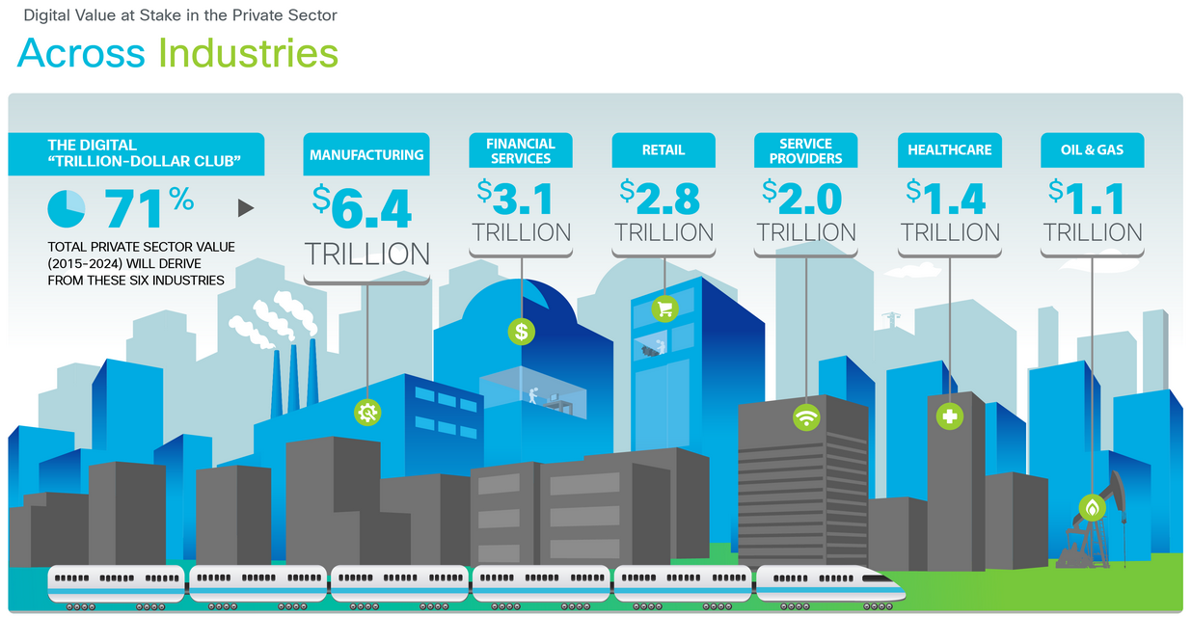


Slide 12
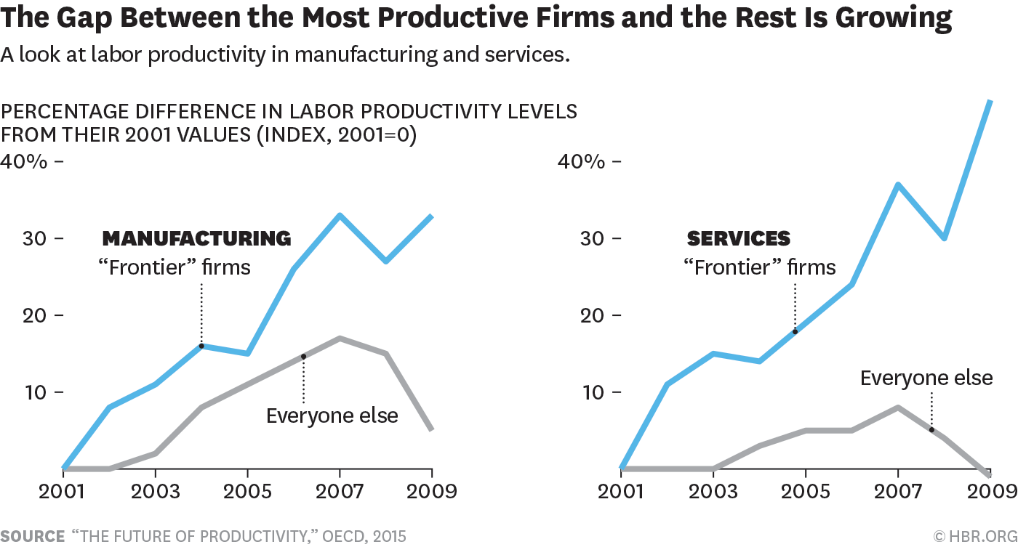
Who get’s it .. And who don’t (source HBR, OECD)

Slide 13
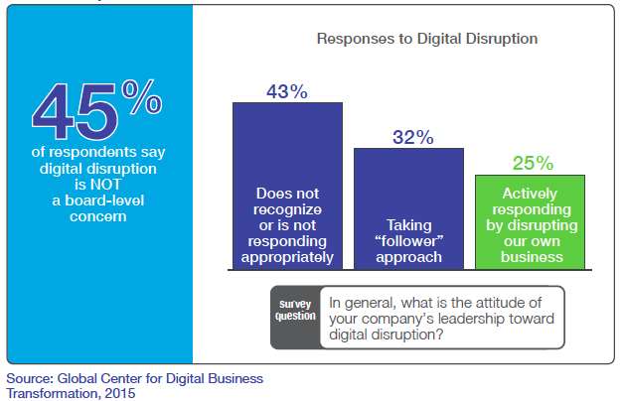
Digitization requires IT in the driving seat
Technology
Enable
Differentiate
Define
Strategy

Slide 14


The New Digital Business/City/Country
Transform Processes
and Business Models
Empower Workforce
Efficiency and Innovation
Personalize Customer /
Citizen Experience
Leads To:
Leads To:
Leads To:
Innovation
Faster Time to Market
Increased Productivity
Better Retention
Increased Loyalty
Greater Insight
Notes:
New Digital Businesses - A Journey, Led By Culture & Powered by IT
Lets begin with the million-dollar question – What is Digital Business Transformation?
Gartner defines this as “Digital business is the creation of new business designs by blurring the digital and physical worlds”
To transform into a successful digital business you will need 3 critical capabilities
Transform Processes and Business Models which leads to faster time to market and leaner operations
- Explosion of connected devices disrupts value chains paving the way for Business Model disruption. By 2020, one million new devices will go online every hour which enabling quicker automated decisions driving efficiencies to a new level
Personalize Customer/Citizen experience which leads to increased customer loyalty and greater insight to predict future purchases
-Why so?
Accenture surveyed ~13,000 consumers in 33 different countries and found that 66% i.e 2 out of every 3 consumers switched providers due to poor customer experience and by 2016 Gartner predicts that “89%i.e 9 out of every 10 companies will compete primarily on the basis of the customer experience
Empower their workforce for efficiency and innovation which leads to increased productivity and better employee retention
-Again, why does this matter?
-Gallup surveyed over 1000 employees each in about 142 countries representative of 98% of the world population and found that about 87% of employees are disengaged and when companies address this dissatisfaction and bring it town to 10%, their earnings per share jumps by a whopping 50%
These changes are forcing companies to become more digital when people and things interact to conduct business
Source:
Digital Business Definition
Gartner IT Glossart - http://www.gartner.com/it-glossary/digital-business/
18M quote
Gartner G00293702, 30 Oct 2015, Forecast Alert: Internet of Things — Endpoints and Associated Services, Worldwide, 2015
“…Gartner is now projecting shipments of 6.6 billion Internet of Things (IoT) endpoints in 2020 …”
Logic
In 2020 devices shipped = 6600 million
365*24 hours = 6600
Devices shipped every day in 2020 = 6600/365 = 18.082 M
87% quote
Gallup 2013, State of the Global Workplace: Page 7
“…Overall, among the 142 countries included in the current Gallup study, 13% of employees are engaged in their jobs, while 63% are not engaged and 24% are actively disengaged…”
1.5x quote
Gallup 2013, State of the Global Workplace: Page 7
“…Organizations with an average of 9.3 engaged employees for every actively disengaged employee in 2010-2011 experienced 147% higher earnings per share (EPS) compared with their competition in 2011-2012. In contrast, those with an average of 2.6 engaged employees for every actively disengaged employee experienced 2% lower EPS compared with their competition during that same time period…”
66% quote
Accenture 2013 Global Consumer Pulse Survey – Page 10
“…Globally, there is a 4 percent increase in switching due to poor customer service to 66%...”
Sample size: 13168 consumers in 33 countries
89% quote
Gartner Survey Finds Importance of Customer Experience is on the Rise; Marketing is on the Hook, Jake Sorofman, Laura McLellan, Sep 2014
Actual quote – “…The trend is clear: the percentage of companies competing primarily on the basis of customer experience is rising from 36% two years ago to 58% today to a whopping 89% two years from now. The implication is that customer experience has become a strategic imperative.”

Slide 15
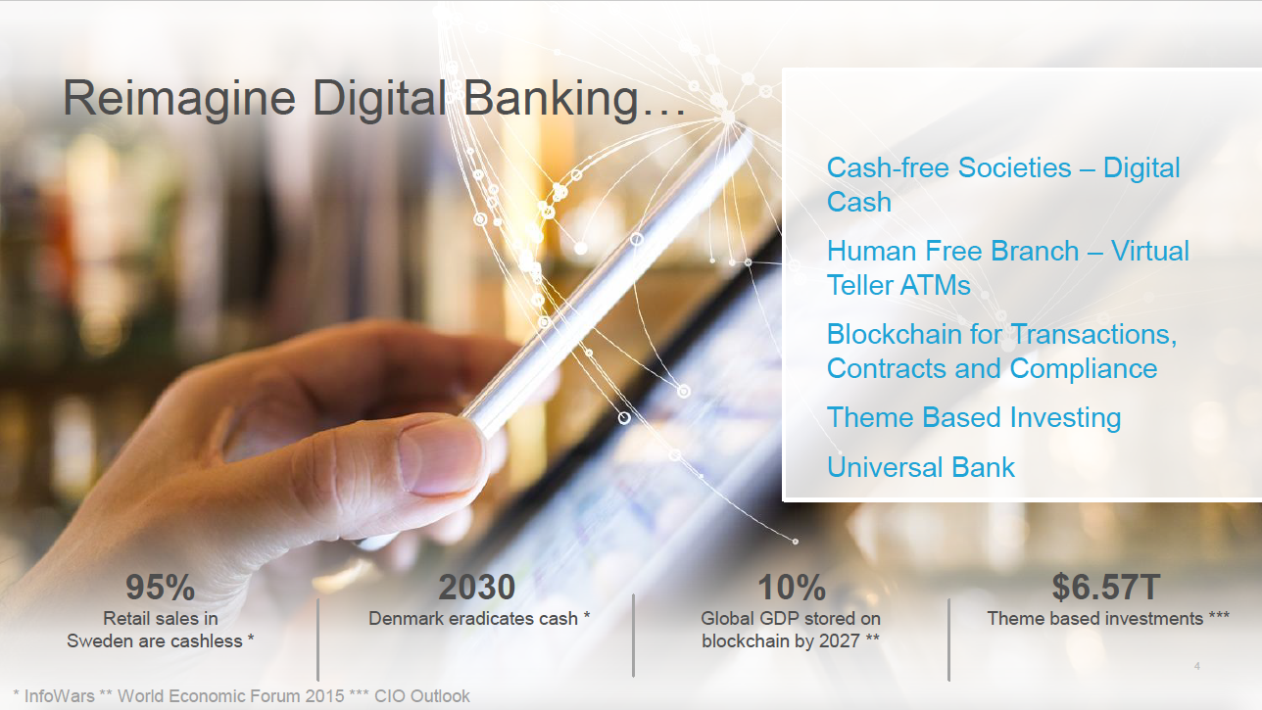

Slide 16
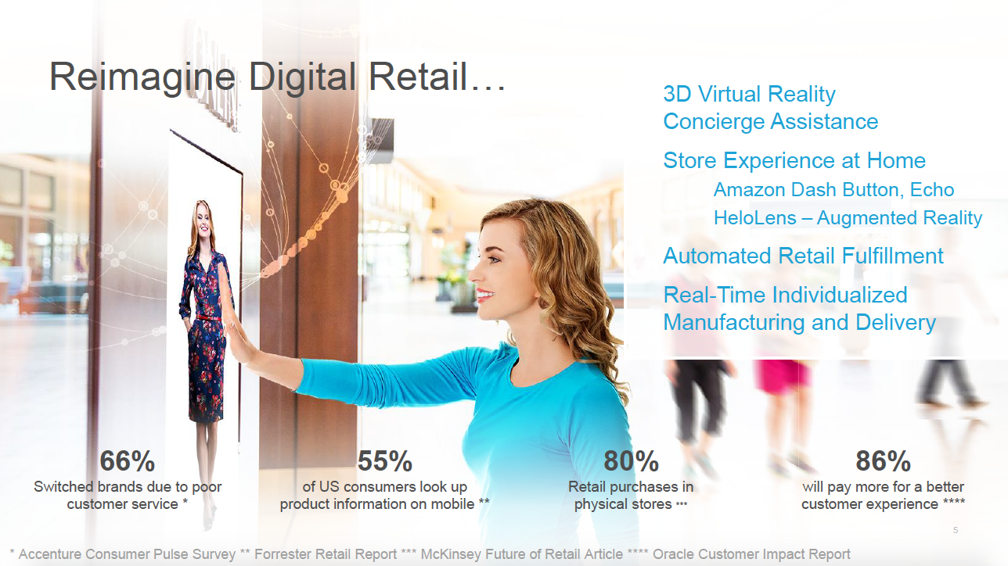

Slide 17
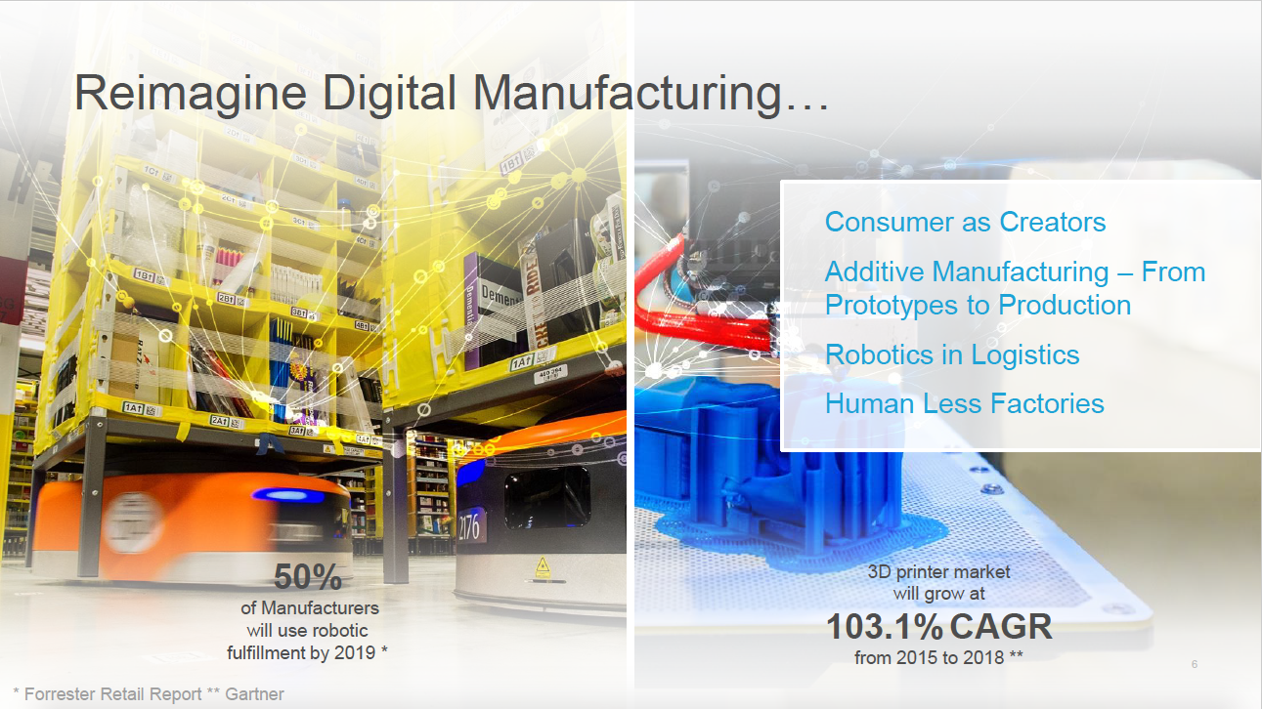

Slide 18
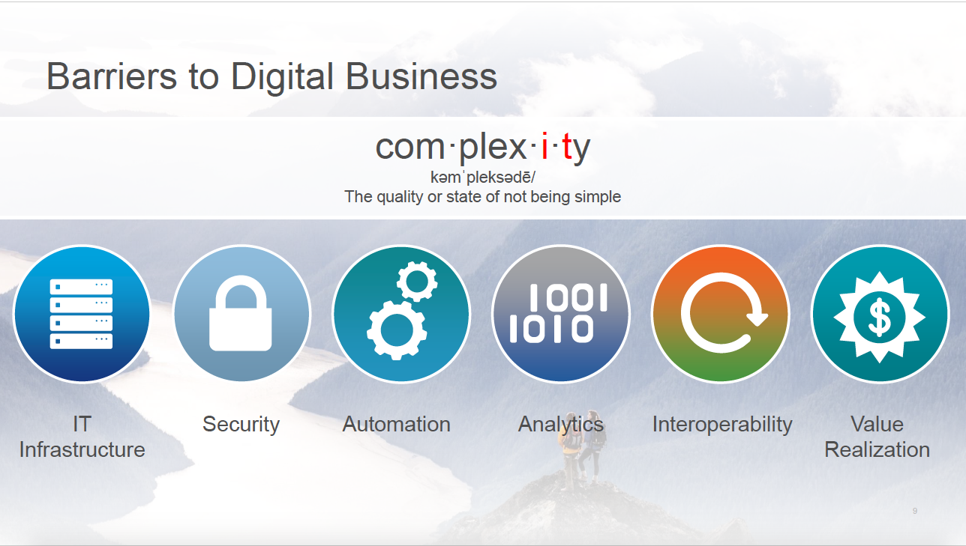

Slide 19
Simple: Reduce Complexity To Lower Costs
1
Converge and optimize discrete IT domains (network, security, storage, compute) to manage as a “pool” of physical/virtual, mobile/fixed, on- and off-premise resources
Unify
2
Enable open and programmable infrastructure, ready to respond intelligently to application requirements; accelerate provisioning of needed resources
Create Programmability
3
Use abstraction and programmability of resources across domains to automate and orchestrate manual, error-prone, and labor-intensive IT tasks and workflows and to drive down costs
Automate
Notes:
The IoE dividend is directly enabled by the three key principles of Fast IT: IT must become smarter, more simple, and more secure.
Let’s take a more detailed look at how each of these principles contributes to the IoE dividend:
Fast IT is Simple , and by reducing complexity you can lowers costs. The steps to take are:
Unifying your infrastructure: bridge physical/virtual infrastructure, mobile and fixed networks and on-prem and off capacity so that you can treat your infrastructure as a flexible pool of resources to tap as needed
Create programmability through abstraction of your infrastructure can respond dynamically to application requirements. Infrastructure programmability gives access to Application Programming Interfaces (APIs) that provide the appropriate abstraction for the required infrastructure functions that application developers need to change. (what this means is that app developers don’t need to know the specifics of the underlying infrastructure — they can use APIs to tap the needed resources)
Once you have programmable resources, you can automate and orchestrate workflows across network, compute, storage, and security so you can deploy and provision applications and services faster

Slide 20
Smart: Capitalize on Intelligence for More Agile Operations
1
Create centralized policy and management to streamline infrastructure changes, reduce errors, and drive repeatability
Drive Policy
Tap Intelligence
Use infrastructure analytics to optimize operations end to end so the infrastructure can respond intelligently and automatically to changing application and security demands
2
3
Push compute and analytics capabilities to the network “edge”; correlate data in real time to respond to fast-moving changes
Harness Data in Motion
Notes:
Smart
The IoE-ready organization is prepared to harness intelligence for better application performance and end user experiences and faster response times.
That entails:
Driving policy: once you have a programmable and automated infrastructure, you can create policies to govern application and infrastructure configuration and changes, and respond to security threats (by for example, diverting and containing DDOS traffic to a newly configured server)
Tapping intelligence resident in infrastructure through analytics so applications run smoothly and users can additional useful information based on, for example, location or device.
Harnessing data in motion through edge computing capabilities so that real time data is captured faster and data transfer is smoother across the enterprise.

Slide 21
Secure: Defend Against Attacks Dynamically
1
Protect against advanced malware and threats across all infrastructure and the entire security continuum; detect and quarantine cyberattacks
Expand
Security Perimeter
2
Improve Visibility
Through analytics, increase visibility around threats, users, behavior, and infrastructure
3
Respond Faster
Use identity- and context-based information and behavior to improve security response
Notes:
Secure
And the IoE-ready organization is more secure :
Fast IT addresses todays’ evolving security landscape by expanding and rethinking the whole concept of a security perimeter, so that you don’t just prevent malicious attacks but you can mitigate attacks as they are happening and you can analyze what happened.
Improve visibility in your infrastructure through analytics so you can see anomalous user access or data behavior as it’s happening so damage can be contained faster and risk is reduced.
Building in faster response times via real-time identity- and context-based information for more automated threat detection

Slide 22
Digitization Supercharges IT Complexity and IT Challenges
73% of IT leaders expect security threats to increase in severity over the next two years
Digitization places new demands on IT
Increased surface of attack
50 billion devices - intelligent/autonomous
A data explosion – creating the opportunity and requirement for data driven decisions
The virtualized network - exposes new vulnerabilities
Seamless identity with, at the same time, an increasing focus on privacy
An unrelenting need for speed –
need to support permission-less innovation
Source: CCS, Fast IT: Accelerating Innovation, 2014

Slide 23





Industrialization of Hacking
There is a multi-billion dollar global industry targeting your prized assets
$
Malware
Development
$2500
(commercial
malware)
Bank
Account Info
>$1000 depending
on account type
and balance
$450 Billion
to
$1 Trillion
Facebook
Accounts
$1 for an
account with
15 friends
Social
Security
$1
Mobile
Malware
$150
Exploits
$1000-
$300K
Credit Card
Data
$0.25-$60
DDoS
Spam
$50/500K
emails
Medical
Records
>$50
DDoS as
A Service
~$7/hour
© 2015 Cisco and/or its affiliates. All rights reserved. Cisco Confidential
23

Slide 24

Next Generation Cyber Threat Defense
Increases
visibility
Enhances
protection
Simplifies
operations

Slide 25











































Ecosystem and Integration
Combined API Framework
Vulnerability Management
Packet Brokering
Network Infrastructure & Policy Management
Performance Management & Visualization
Mobility
Packet Capture & Forensics
SIEM & Analytics
Custom Detection
Remediation & Incident Response
IAM/SSO
Firewall/Access Control

Slide 26
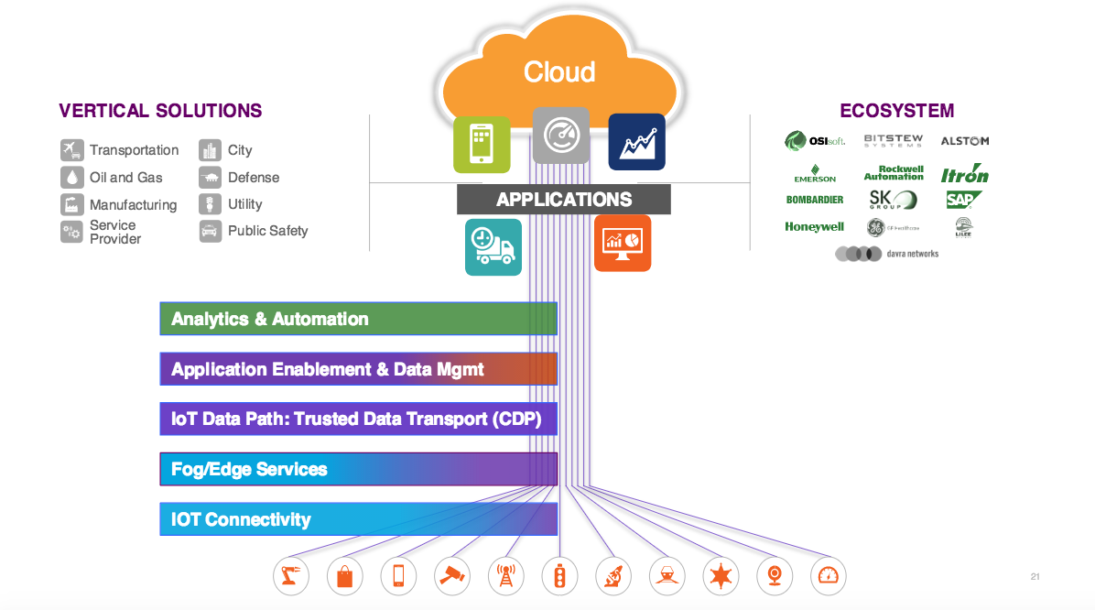
ANALYTICS and APP Enablement
Automation
Orchestration
CULTURE
Security
CONNECTIVITY and FOG

Slide 27


A New Approach Is Needed to Solve
Hyper-Distribution of Applications and Data
Traditional
Applications
ERP, Financial, Client/Server, CRM, Email
Cloud Native
Applications
IoT, Big Data, Analytics, Gaming
SaaS
PaaS
IaaS
Data Center
Cloud
IoE and Edge Computing
Security Everywhere

Slide 28








A New Approach Is Needed for Application Development
Existing IT
Cloud-Enabled
Cloud-Native
(Containers)
Service
App
Service
App
App
App
App
App
App
Service
Service
App
Web
Servers
App
Servers
Database
Web
Servers
App
Servers
Database
.rb
.py
.go
Java
Physical Infrastructure
Runtime Micro-services on Containers
Local
Dedicated
Shared

Slide 29
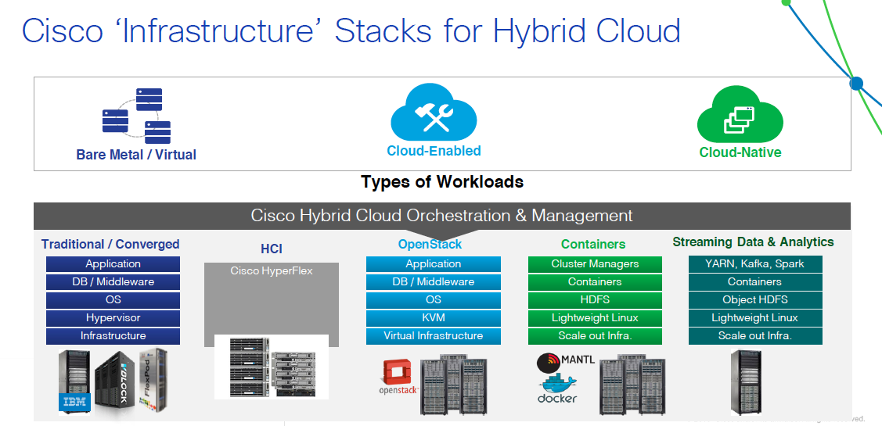

Slide 30






Only 1% of Organizations Are There…
Lower Adoption
Greater Adoption
Ad Hoc
Opportunistic
Repeatable
Managed
Optimized
Organizations in each stage
32%
11%
16%
8%
1%
THE REMAINING 32% OF ORGANIZATIONS HAVE NO CLOUD STRATEGY AT ALL
Source: IDC InfoBrief, sponsored by Cisco, Don't Get Left Behind: The Business Benefits of
Achieving Greater Cloud Adoption, Aug 2015.
Notes:
IDC describes five levels of increasing cloud adoption (also known as cloud maturity) starting with ad hoc followed by, opportunistic, repeatable, managed and finally at the highest level, optimized.
The missed opportunity for most organizations is their ability to extract the most value out of their cloud deployments. In fact only 1% of the organizations ww (and across a broad sample of over 19K respondents) have an optimized cloud strategy in place today. We know it can pay off to get there and this is why we have developed a segmentation model that maps how business outcomes based on well defined KPIs change as organizations increase consumption and deployment of cloud services.
Basically, the opportunity is for us to help our customers shape their cloud journey and we are able to do that thanks to a repeatable framework we put in place with IDC across five stages of cloud adoption from ad-hoc to optimized. For the first time, we are able to provide estimates (backed by research data) regarding how key metrics change across multiple stages of cloud adoption. This is a better approach compared to any self-serving proprietary model we would have been able to come up with.
1. Ad Hoc. Beginning to increase awareness of cloud options and turning to cloud because of the immediacy of their need, often in an unauthorized manner.
2. Opportunistic. Experimenting with short-term improvements IT cloud resource access. Usually consider cloud for new solutions or isolated computing environments.
3. Repeatable. Enabling more agile access to IT resources through standardization and implementation of best practices. Rely on self-service portals to access cloud services.
4. Managed. Implementing a consistent, enterprise-wide best practices approach to cloud and orchestrating service delivery across an integrated set of resources.
5. Optimized. Delivering innovative IT-enabled products and services from internal and external cloud providers and driving business innovation through transparent access to IT capacity based on the value to the business and transparent cost measures.

Slide 31
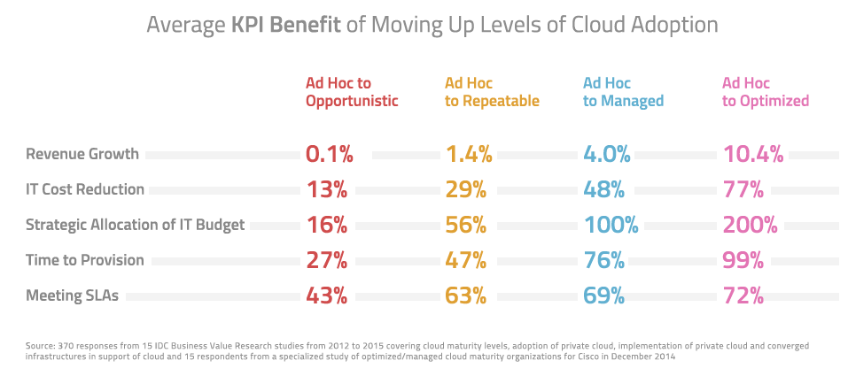
Benchmarking: Potential Gains are clear

Slide 32
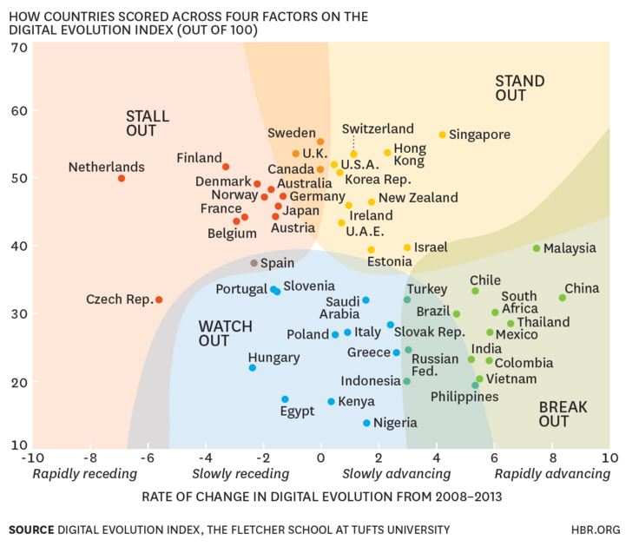
Notes:
To understand more about these types of changes around the world, we developed an “index” to identify how a group of countries stack up against each other in terms of readiness for a digital economy. Our Digital Evolution Index (DEI), created by the Fletcher School at Tufts University (with support from Mastercard and DataCash), is derived from four broad drivers: supply-side factors (including access, fulfillment, and transactions infrastructure); demand-side factors (including consumer behaviors and trends, financial and Internet and social media savviness); innovations (including the entrepreneurial, technological and funding ecosystems, presence and extent of disruptive forces and the presence of a start-up culture and mindset); and institutions (including government effectiveness and its role in business, laws and regulations and promoting the digital ecosystem). The resulting index includes a ranking of 50 countries, which were chosen because they are either home to most of the current 3 billion internet users or they are where the next billion users are likely to come from.
As part of our research, we wanted to understand who was changing quickly to prepare for the digital marketplace and who wasn’t. Perhaps not surprisingly, developing countries in Asia and Latin America are leading in momentum, reflecting their overall economic gains. But our analysis revealed other interesting patterns. Take, for example, Singapore and The Netherlands. Both are among the top 10 countries in present levels of digital evolution. But when we consider the momentum – i.e., the five-year rate of change from 2008 to 2013 – the two countries are far apart. Singapore has been steadily advancing in developing a world-class digital infrastructure, through public-private partnerships, to further entrench its status as a regional communications hub. Through ongoing investment, it remains an attractive destination for start-ups and for private equity and venture capital. The Netherlands, meanwhile, has been rapidly losing steam. The Dutch government’s austerity measures beginning in late 2010 reduced investment into elements of the digital ecosystem. Its stagnant, and at times slipping, consumer demand led investors to seek greener pastures.
Based on the performance of countries on the index during the years 2008 to 2013, we assigned them to one of four trajectory zones: Stand Out, Stall Out, Break Out, and Watch Out.
Stand Out countries have shown high levels of digital development in the past and continue to remain on an upward trajectory.
Stall Out countries have achieved a high level of evolution in the past but are losing momentum and risk falling behind.
Break Out countries have the potential to develop strong digital economies. Though their overall score is still low, they are moving upward and are poised to become Stand Out countries in the future.
Watch Out countries face significant opportunities and challenges, with low scores on both current level and upward motion of their DEI. Some may be able to overcome limitations with clever innovations and stopgap measures, while others seem to be stuck.

Slide 33
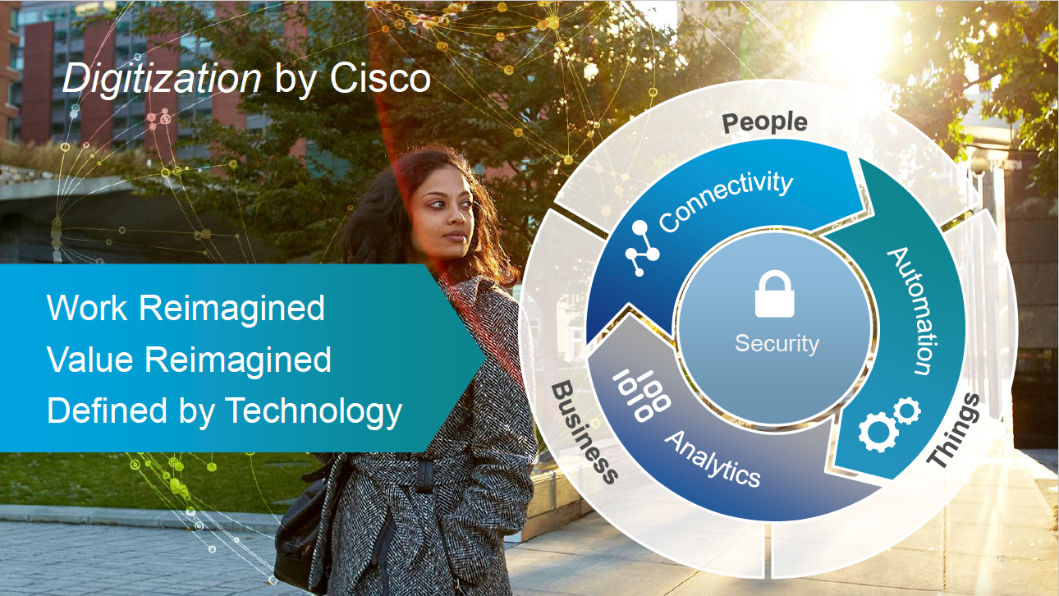

Slide 35
Who get it .. And who don’t : The Mighty Will Fall
Disruption to Shake Up all Industries, and Shake Out 4 of 10 Market Leaders
4 out of 10 Displaced
Existential Threat
Expected time to disruption*: 3 years
*Disruption = Substantial change in market share among incumbents
Source: Global Center for Digital Business Transformation, 2015

Slide 36
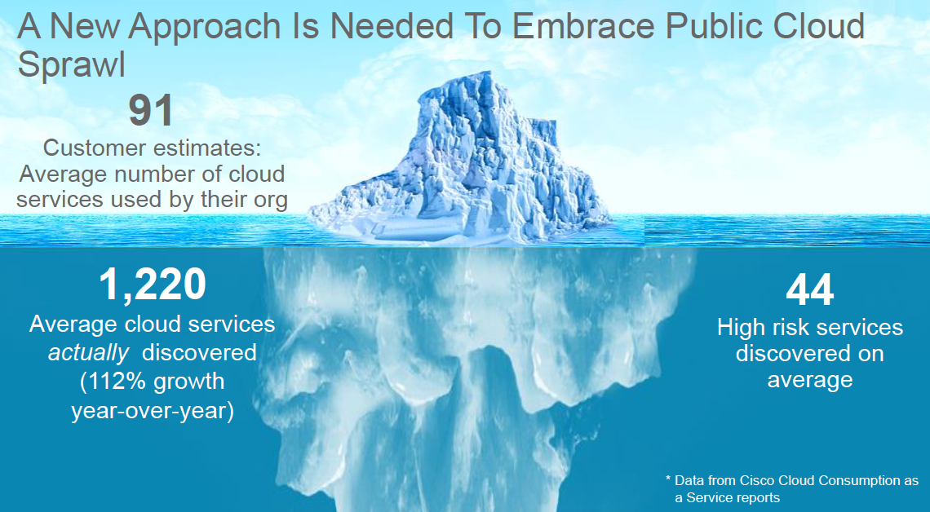

Slide 37
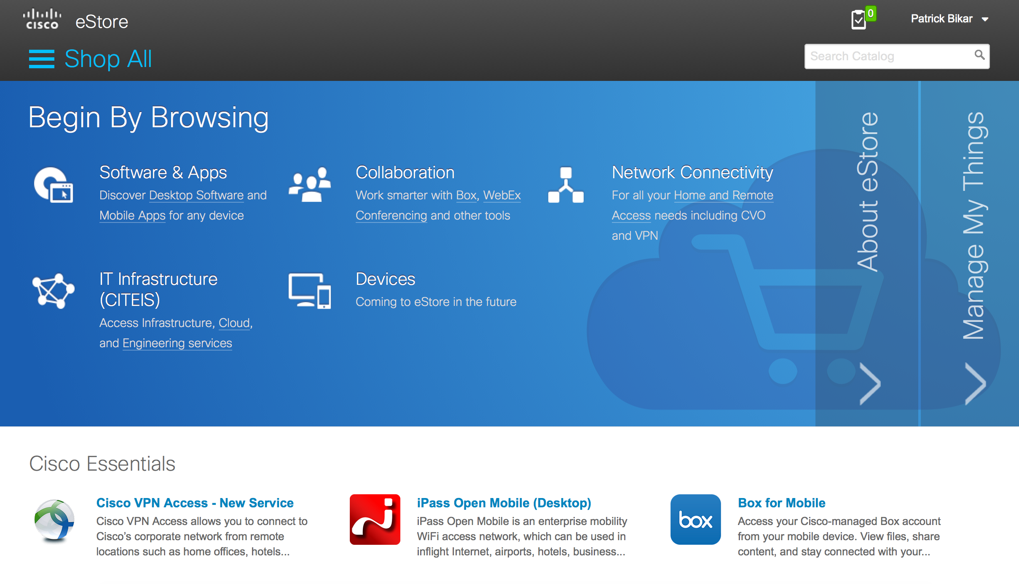

Building a Fast IT organization: Sharing Cisco IT’s in-house experience
Fast IT: transformational journey that spans years.
Cisco IT began this journey in 2007.
Getting real: eStore to order anything IT
Used by more than 70,000 employees
5 maturity levels in Cisco’s IT Operating Model journey:
  Operations
  Services
  Technical Architecture
  Business Architecture
  Fast IT
Notes:
http://www.cisco.com/c/en/us/solutions/collateral/enterprise/cisco-on-cisco/cs-boit-02232015-itaaso.html
http://www.cisco.com/c/en/us/solutions/collateral/enterprise/cisco-on-cisco/Cisco_IT_Case_Study-eStore.html
http://www.cisco.com/c/en/us/solutions/collateral/enterprise/cisco-on-cisco/cs-boit-05272014-supply-chain.html
http://www.cisco.com/c/en/us/solutions/collateral/enterprise/cisco-on-cisco/IT_as_a_Services_Org_Update.pdf
“Becoming a Hybrid IT Organization is a transformational journey that spans years. Cisco IT began this journey in 2007.
Today we are running IT like a business, delivering competitively priced services to our internal clients, measuring their needs in a total cost of ownership (TCO) mode, and directly impacting business outcomes.
Adopting a Hybrid IT model is less about technology and more about progressive cultural and process changes [“IT Operating Model”]. The transition requires pervasive shifts in the way IT is organized; how services are defined, delivered, consumed, and financed; and how IT measures success, evaluates costs, and assigns roles and responsibilities.”
eStore:
CHALLENGE
Reduce employee frustration with multiple different systems for requesting IT services
Eliminate end-user challenges in finding/ordering tools
Reduce IT support and service delivery costs with easier tracking and streamlined fulfilment
SOLUTION
Cisco eStore, powered by Cisco Prime Service Catalog and Cisco Process Orchestrator
RESULTS
Meets 3 business trends:
reduced end-user dependence on IT;
increased adoption of mobility and BYOD;
and need for greater IT agility to meet business demands
Modern, familiar consumer shopping experience for requesting IT services
Broad range of workplace IT services as well as data center infrastructure services
Flexible eStore architecture in place so that new and innovative IT services can be added quickly/efficiently
Managing service requests more easily and efficiently with eStore (cf. ITIL)

Slide 38


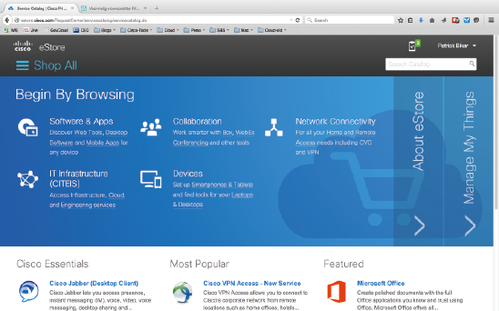



Completing our transition to a services organisation
We have successfully transformed Cisco central IT into a Fast IT Organisation.
Access to Storefront
From all OS &
Device Types
Pervasive Enterprise
Security
(versions, enhancement,
trusted devices)
Cisco eStore
Personalised &
User-Friendly
Store for all IT Services
Cisco Prime Service Catalog
Tied to Enterprise
Service Management
Reporting
Chargeback
Entitlement
Approvals
Taxonomy
Cisco Process Orchestrator
Automated and
Seamless Back-End
Service Provisioning
IT Infrastructure
Desktop HW
Mobile HW
Notes:
We know ITaaSO is a success at Cisco because our people now talk about business needs, the cost and value of the services we provide, trade-offs and funding decisions in ways that are meaningful to internal clients and customers.
In practical terms we have been able to:
Cut server provisioning from 12 wks to sub 15 mins
Migrate all apps to x86 with 85% virtualised
Consolidate 12 DCs to 1 pair of active-active DCs
Deploy new global telepresence & video architecture
Doubled the number of supported end user devices
Integrated 50+ acquisitions
Service delivery
How do we deliver IT services in our new Hybrid IT model?
Via our new Cisco eStore, one searchable, mobile-ready portal that allows our more than 70,000 employees to order all the IT services we provide.
We also run proven processes around our eStore to “end-of-life” products and services and test and trial potential new services. Only live services are permitted into our eStore.
In terms of cost and value, the system’s back end is capable of giving LOBs reports on their IT expenditure and use. This is called “show-back” and it means that our business managers can determine how much business value they are deriving from the money they spend on IT – whether that’s products, devices or even cloud-based services.
This all helps to position the central IT department as an entity that directly and proactively generates business value and contributes to our overall success.

Slide 39




Every Country, City and Business
Becomes a Digital / Technology Company
DIGITAL
INTERNET
OF EVERYTHING
FAST INNOVATION FAST IT
SECURITY
Power of Decade of Explosive IT Growth

Slide 40







Cisco and Partner Services
DIGITAL
Countries
Cities
Businesses
INTERNET OF EVERYTHING
Consulting
Support
Manufacturing
Government
Financial
Energy
Retail
Healthcare
APPLICATION INTEGRATION
FAST INNOVATION FAST IT
FAST IT
Solutions
Innovation
Architecture
SOLUTIONS
Workforce Experience
Customer Experience
Business Innovation
IT Transformation
Professional
INNOVATIONS
Managed
SOFTWARE
SECURITY
ACI
Intercloud
Analytics
Mobility
ARCHITECTURES
Enterprise Network
Data Center
Security
Collaboration
DIGITAL
INTERNET OF EVERYTHING
FAST INNOVATION FAST IT
SECURITY

Slide 41






Enhanced Security & Simplifies Operations & Cost Savings
Superior Network Visibility
Automated Tuning
Impact Assessment & Correlation
Servers, hosts, Mobiles
Applications, OS, Vulnerabilities,
Adjust IPS policies automatically
based on network changes
Threat correlation reduces actionable events by up to 99%
Advanced Malware Protection
Remediation
Indications of Compromise
Analyses files to block malware
Continuous Analysis,
Trajectory
Warning indicator to more rapidly remediate threats

Slide 42
