Slide 1
Νέες Τεχνολογικές Τάσεις και Επιχειρηματικές Ευκαιρίες
Fotis Draganidis
Technology Director
Microsoft Hellas
Twitter.com/draganidis

Slide 2
Economy ←→ Innovation

Slide 3
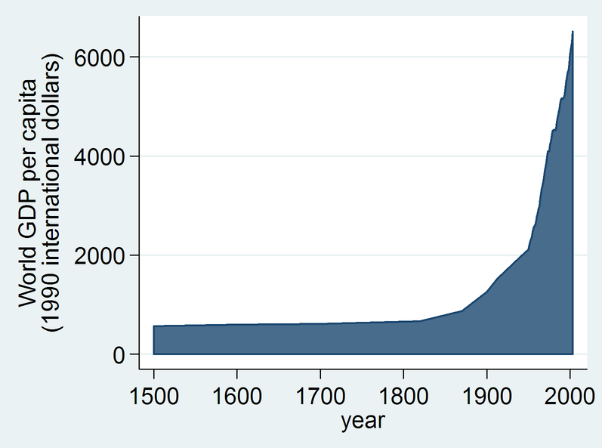

Slide 4
Global GDP is…
$83 trillion

Slide 5
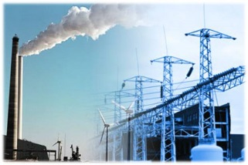
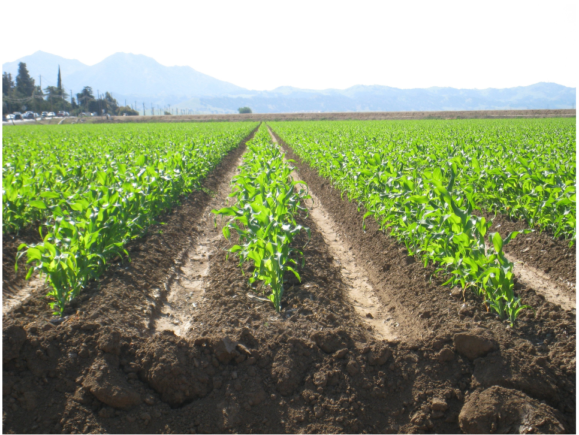
Global GDP is…
Services
64%
Agriculture 6%
Industry
30%
Source: World CIA Factbook

Slide 7
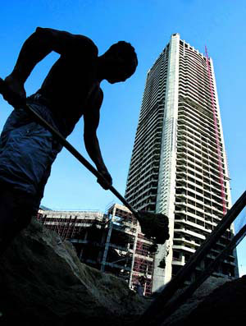
Traditional Worker
Knowledge Worker

Slide 8
What is the Target
of Technology Innovations?

Slide 9
Pervasive Integration
In the future,
any two IT systems,
any two pieces of software,
any two devices,
any two services
will automatically integrate and “talk” to each other

Slide 10
Pervasive Integration
Or …
Computing Intelligence
..existing everywhere

Slide 11
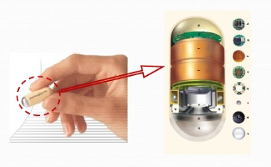
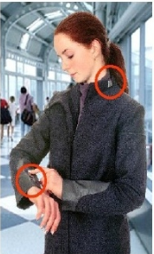
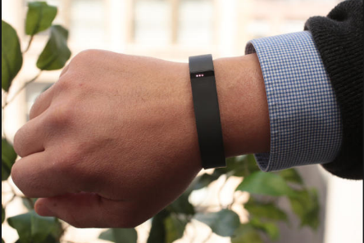
Pervasive Integration Examples (Personal)

Slide 12
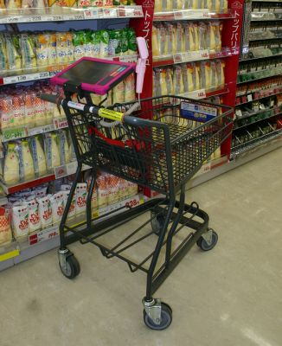
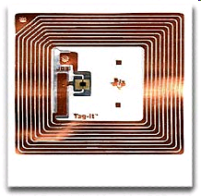
Pervasive Integration Examples (Business)

Slide 13
What are the #10 Breakthroughs towards this Vision?

Slide 14
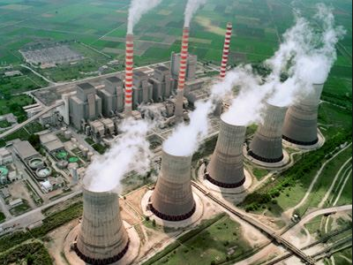
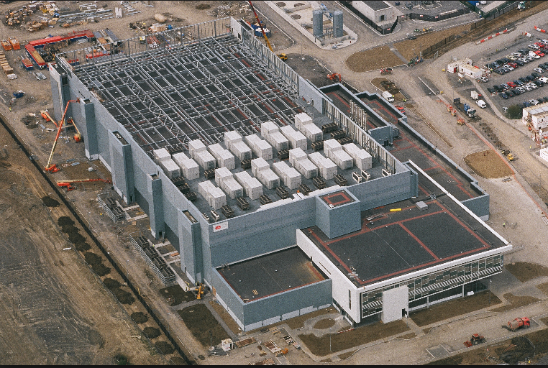
#1. Web Services, Cloud Computing

Slide 15
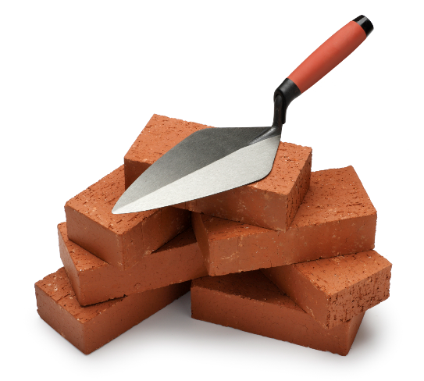
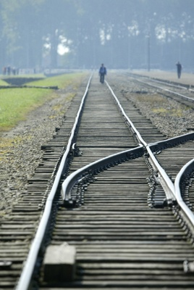
#2. Standards

Slide 16
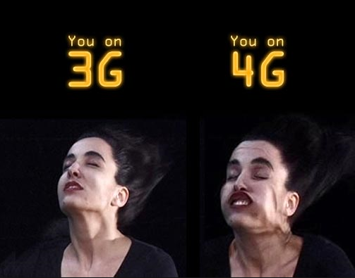
#3. Internet Everywhere

Slide 17
#4: Your Identity Card Please (IPv6)
IPv4
Internet Scaling Problem☹
32-bit=4,4 billion addresses
Most of them in USA
We need one for each device
128-bit (6,7 * 10²³ / μ²!!!) ☺
Roaming
Better Security
Easier configuration
Notes:
Η αναβάθμιση του IP είναι απαραίτητη:
Πρόβλημα κλιμάκωσης του Internet
32-bit = 4,4 δις διευθύνσεις
Οι περισσότερες στην Αμερική
Θα χρειαστούμε 1 για κάθε συσκευή!
Με το IPv6 (128-bit) θα έχουμε 6,7 * 10²³ / μ²!!!
Roaming
Καλύτερη ασφάλεια
Ευκολότερο configuration
Πρόβλημα: Δεν είναι συμβατό με το IPv4
Tunneling

Slide 18
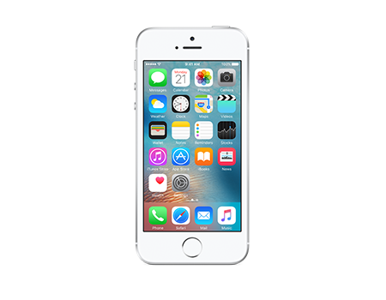
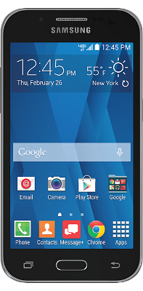
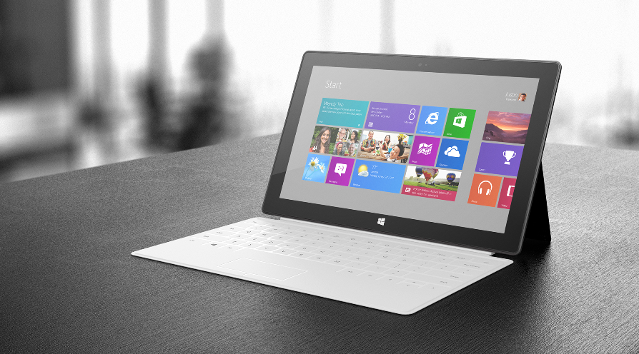
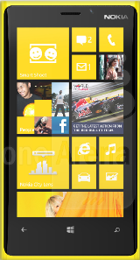
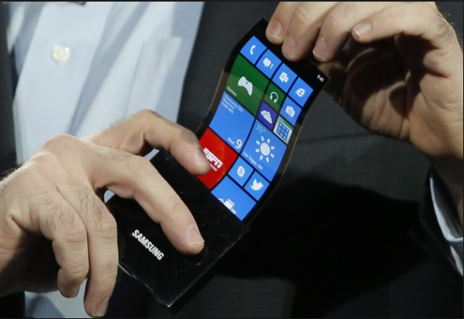
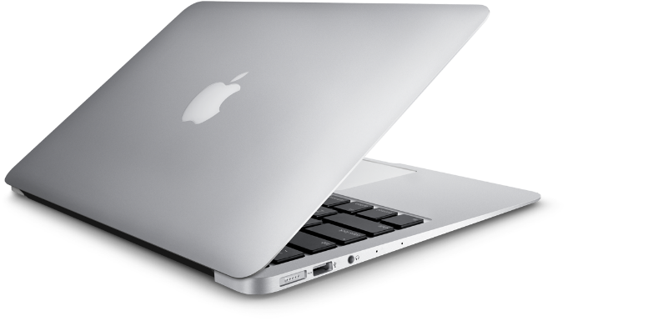
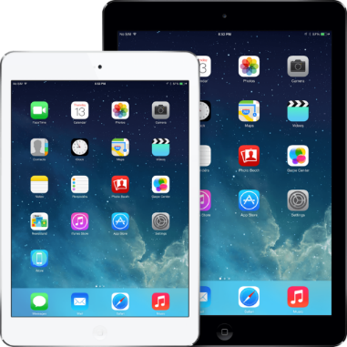
#5: Media and Devices don’t matter. Consume SAAS from everywhere.
Notes:
Web Services + Ασύρματα δίκτυα + «Έξυπνες συσκευές»
Δεν θα χρειάζεται φιλμ ή μνημούλα στις κάμερες, σκληρός δίσκος στα MP3 players ή στα laptops!
Μέσω δικτύου, όλα κεντρικά
Νέα κατηγορία επιχειρήσεων: «Υπηρεσίες Φύλαξης Δεδομένων»

Slide 19
Breakthrough #6: Privacy
Notes:
Εξελιγμένοι μηχανισμοί προστασίας προσωπικών δεδομένων
Χρειάζεται νομοθεσία:
Αποθήκευση και επεξεργασία στοιχείων μόνο με ηλεκτρονική υπογραφή
Κάθε «εγκεκριμένο» δεδομένο περιέχει:
Ημερομηνία λήξης
Επιτρεπόμενες/απαγορευμένες χρήσεις
πχ.: “Όχι για διαφημιστικά e-mail”, “Μην μοιράζεται σε τρίτους”, “Για πιστωτικό έλεγχο μόνο”, κλπ.
Ψηφιακή υπογραφή του «εκδότη»
Σε αντιδικία, ζητάς το αρχείο σου από αυτόν που σε ενοχλεί:
Αν δεν στο δώσει, ποινική δίωξη
Πρέπει να έχει την ψηφιακή υπογραφή σου – αλλιώς, ποινική δίωξη
Η συγκεκριμένη χρήση πρέπει να επιτρέπεται – αλλιώς, ποινική δίωξη

Slide 20
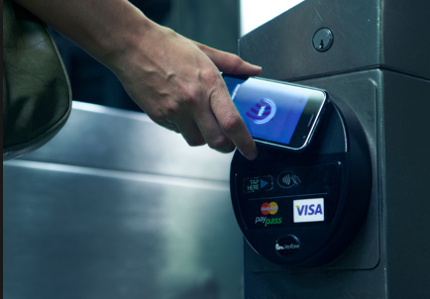
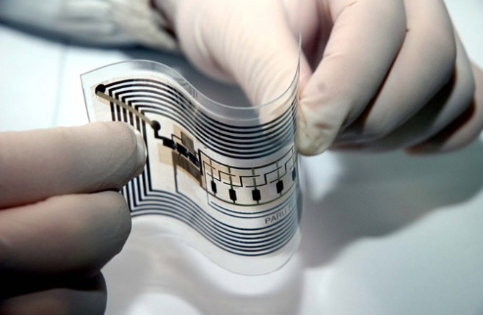
#7: Internet of Things or a “small PC” everywhere (e.g. RFID/NFC, Sensors)
Notes:
Radio-Frequency Identifiers
Προφανής χρήση: αντί για barcodes
Όχι τόσο προφανής: μικρές CPU που κοστίζουν γύρω στο 7,2cents (0,5cent από SmartCode)
Με φθηνές οθονίτσες και RFID θα έχουμε «έξυπνες ετικέτες» στα προϊόντα
Ετικέτες που αλληλεπιδρούν μεταξύ τους, με τον καταναλωτή, και με συσκευές
Coke vs Pepsi, πλυντήρια, checkouts, ψυγεία, ράφια
Ωραίο, αλλά με τι μπαταρίες?
Types of RFID tags
RFID tags can be either passive, semi-passive (also known as semi-active), or active.
[edit]
Passive
Passive RFID tags have no internal power supply. The minute electrical current induced in the antenna by the incoming radio frequency signal provides just enough power for the CMOS integrated circuit (IC) in the tag to power up and transmit a response. Most passive tags signal by backscattering the carrier signal from the reader. This means that the aerial (antenna) has to be designed to both collect power from the incoming signal and also to transmit the outbound backscatter signal. The response of a passive RFID tag is not just an ID number (GUID); the tag chip can contain nonvolatile EEPROM for storing data. Lack of an onboard power supply means that the device can be quite small: commercially available products exist that can be embedded under the skin. As of 2006, the smallest such devices measured 0.15 mm × 0.15 mm, and are thinner than a sheet of paper (7.5 micrometers).[5] The addition of the antenna creates a tag that varies from the size of postage stamp to the size of a post card. Passive tags have practical read distances ranging from about 2 mm (ISO 14443) up to a few meters (EPC and ISO 18000-6) depending on the chosen radio frequency and antenna design/size. Due to their simplicity in design they are also suitable for manufacture with a printing process for the antennas. Passive RFID tags do not require batteries, and can be much smaller and have an unlimited life span. Non-silicon tags made from polymer semiconductors are currently being developed by several companies globally. Simple laboratory printed polymer tags operating at 13.56 MHz were demonstrated in 2005 by both PolyIC (Germany) and Philips (The Netherlands). If successfully commercialized, polymer tags will be roll printable, like a magazine, and much less expensive than silicon-based tags.
Because passive tags are cheaper to manufacture and have no battery, the majority of RFID tags in existence are of the passive variety. As of 2005, the lowest cost EPC Gen 2 tags available on the market are as low as 7.2 cents each in volumes of 10 million units or more. Current demand for RFID integrated circuit chips is expected to grow rapidly based on these prices.
On May 1st 2006 Smartcode announced the $.05 tag. Although the nickel tag has been the holy grail that some industry members think will bring RFID to the masses, many in the RFID community feel that cost is not the only (or the most imposing) caveat to large-scale acceptance. Furthermore, this price is only for the inlay (chip and antenna only) and does not include the label (adhesive etc.) that makes the tag useful and this price is only good on orders of 100 million or more, which is an extremely large number even for major distributors.
[edit]
Semi-passive
Semi-passive RFID tags are very similar to passive tags except for the addition of a small battery. This battery allows the tag IC to be constantly powered, which removes the need for the aerial to be designed to collect power from the incoming signal. Aerials can therefore be optimized for the backscattering signal. Semi-passive RFID tags are faster in response and therefore stronger in reading ratio compared to passive tags.
[edit]
Active
Unlike passive and semi-passive RFID tags, active RFID tags have their own internal power source which is used to power any ICs that generate the outgoing signal. Active RFID tags are typically beacon tags but are also available as response tags. Beacon tags are often called beacon or broadcast because they transmit their tag data and ID at a predetermined fixed interval. Whereas, “response” tags only respond when an active RFID reader requests the tags to transmit. Some active RFID tags also have advanced features such as temperature logging which have been used in concrete maturity monitoring or to monitor the temperature of perishable goods. Other uses for active RFID tags is in pick-to-light applications where active RFID tags with LEDs can be flashed to guide the user to a specific item. They may have longer range and larger memories than passive tags, as well as the ability to store additional information sent by the transceiver. To economize power consumption, many beacon tags operate at fixed intervals. At present, the smallest active tags are about the size of a coin. Many active tags have practical ranges of ten of meters, and a battery life of up to 5 years.
[edit]
The RFID system
An RFID system may consist of several components: tags, tag readers, edge servers, middleware, and application software.

Slide 21
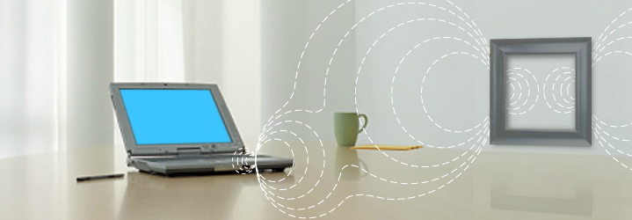
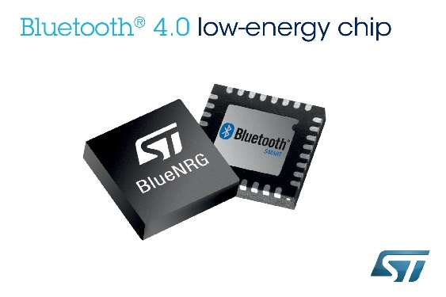
#8: How to Power-up everything?
Wireless Power
Ultra Low-Power Chips
Notes:
Το ηλεκτρομαγνητικό πεδίο της γης μπορεί να τροφοδοτήσει μικρές συσκευές
Δίνει 0.25-1.0 Watt με μία μικρή κεραία και μία συσκευή όσο ένας κύβος ζάχαρης
Παρεμφερές και άμεσο:
Splashpower

Slide 22
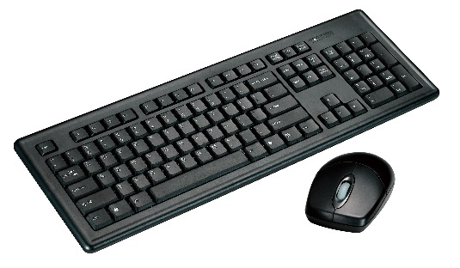
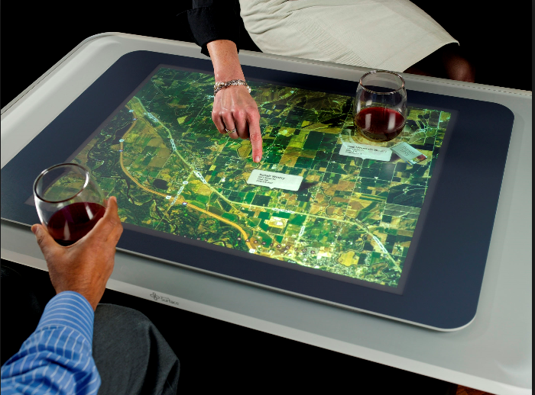
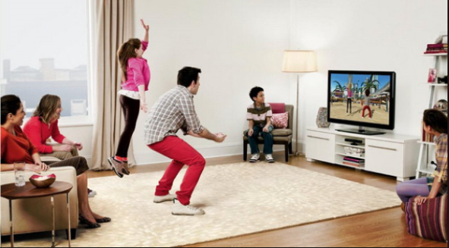
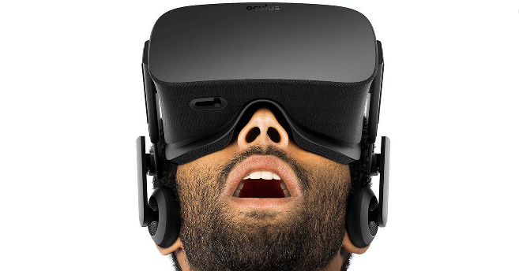
#9: NUIs
Keyboard
+ Mouse
Touch
Gesture
Speech
Augmented Reality
Virtual Reality
Notes:
Το ηλεκτρομαγνητικό πεδίο της γης μπορεί να τροφοδοτήσει μικρές συσκευές
Δίνει 0.25-1.0 Watt με μία μικρή κεραία και μία συσκευή όσο ένας κύβος ζάχαρης
Παρεμφερές και άμεσο:
Splashpower

Slide 23
Breakthrough #10: Pervasive Integration
With all the previous breakthroughs put together, we will solve the most important problem of IT:
Integration of Everything.
Existing Everywhere.

Slide 24
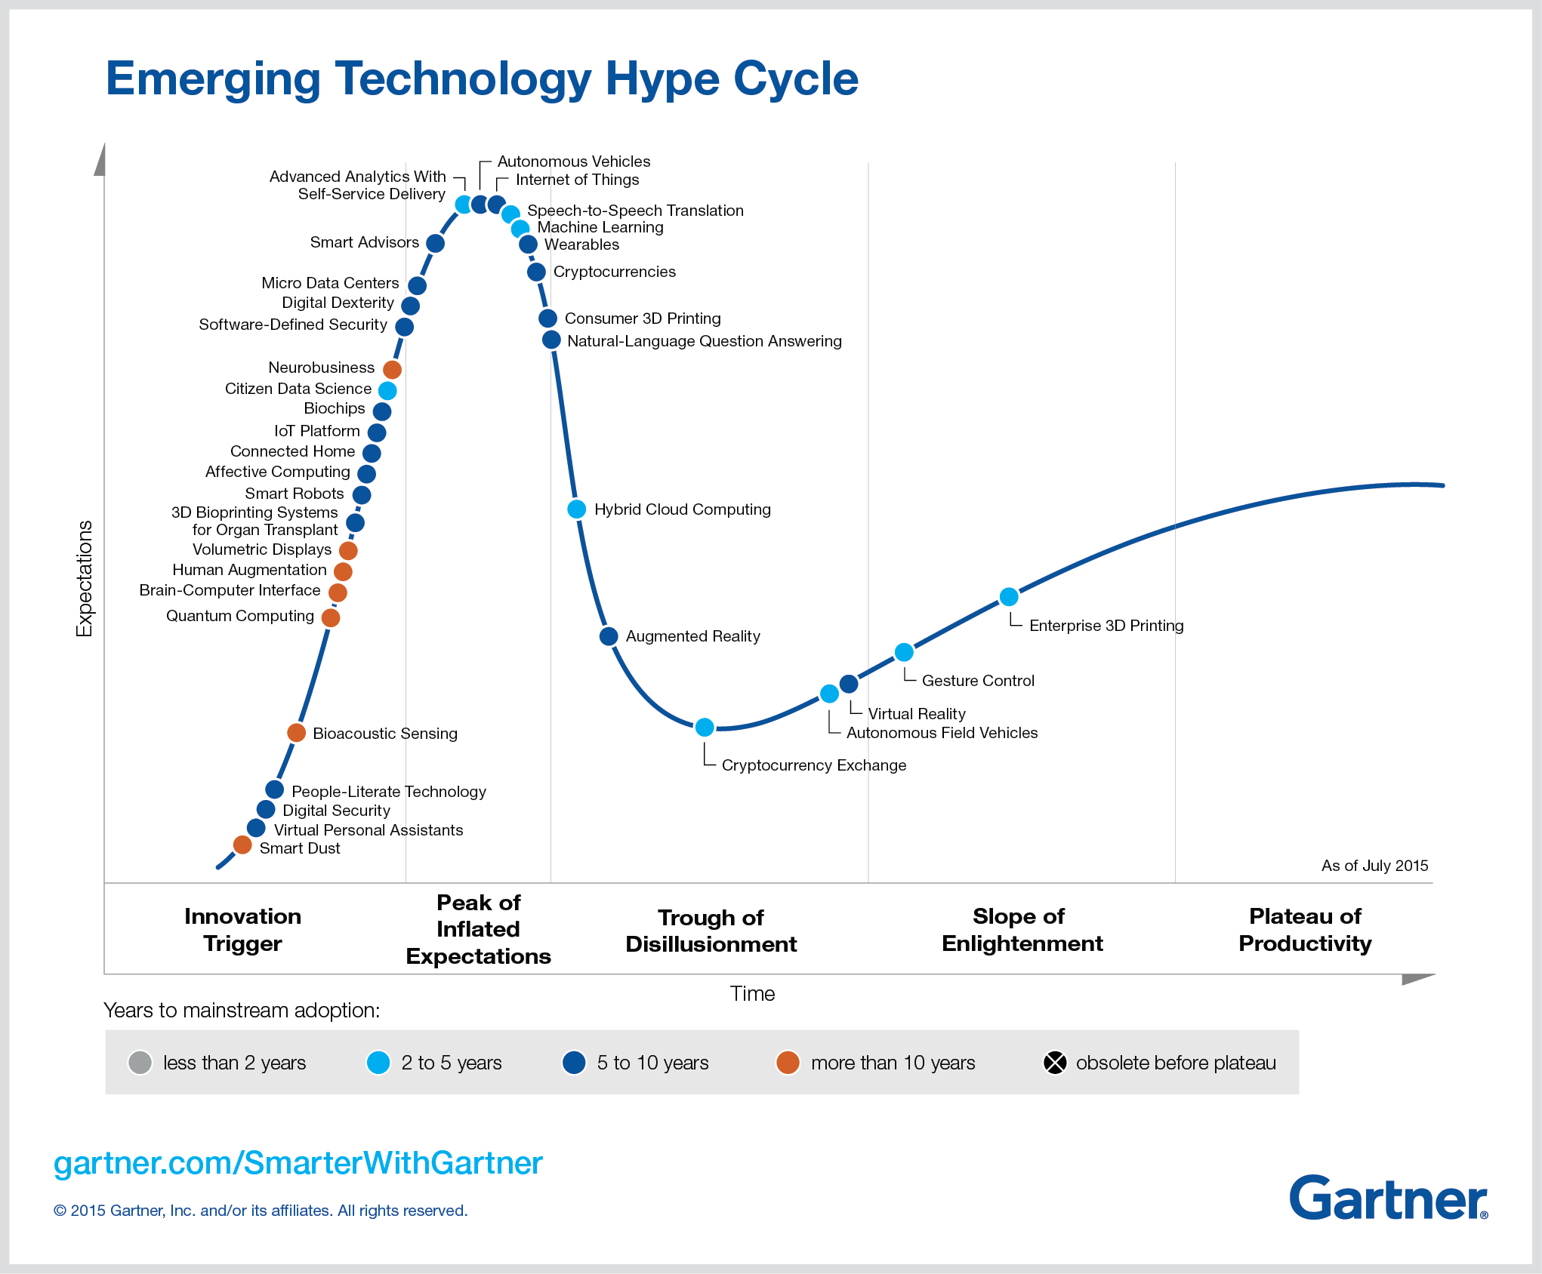
Internet of Things
Machine Learning
Blockchain
Bots

Slide 25
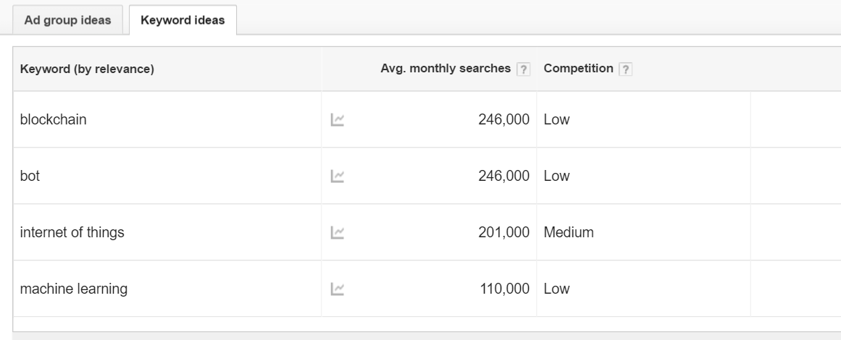

Slide 26
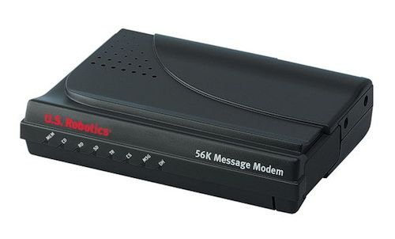
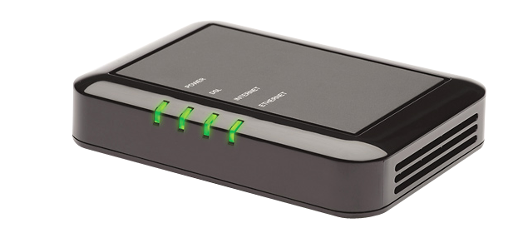
New Tech Trends Business Opportunities
56k Modem
DSL Modem
ISDN Modem

Slide 27
Internet of Things Business Opportunities
1. Transform the Insurance Company Business Models

Slide 28
Internet of Things Business Opportunities
2. Transform the Elevators Business

Slide 29
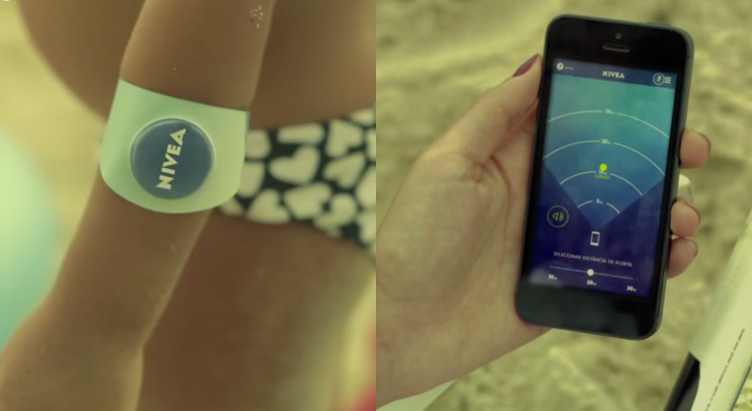
Internet of Things Business Opportunities
3. Kids Tracking

Slide 30
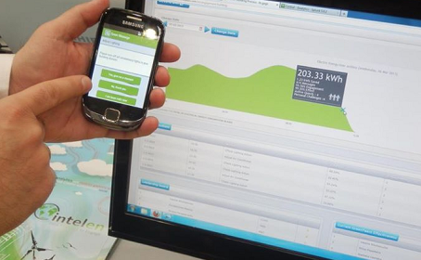
Internet of Things Business Opportunities
4. Energy Monitoring

Slide 31
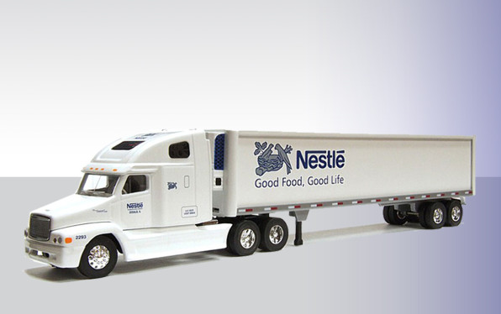
Internet of Things Business Opportunities
5. Temperature Monitoring

Slide 32
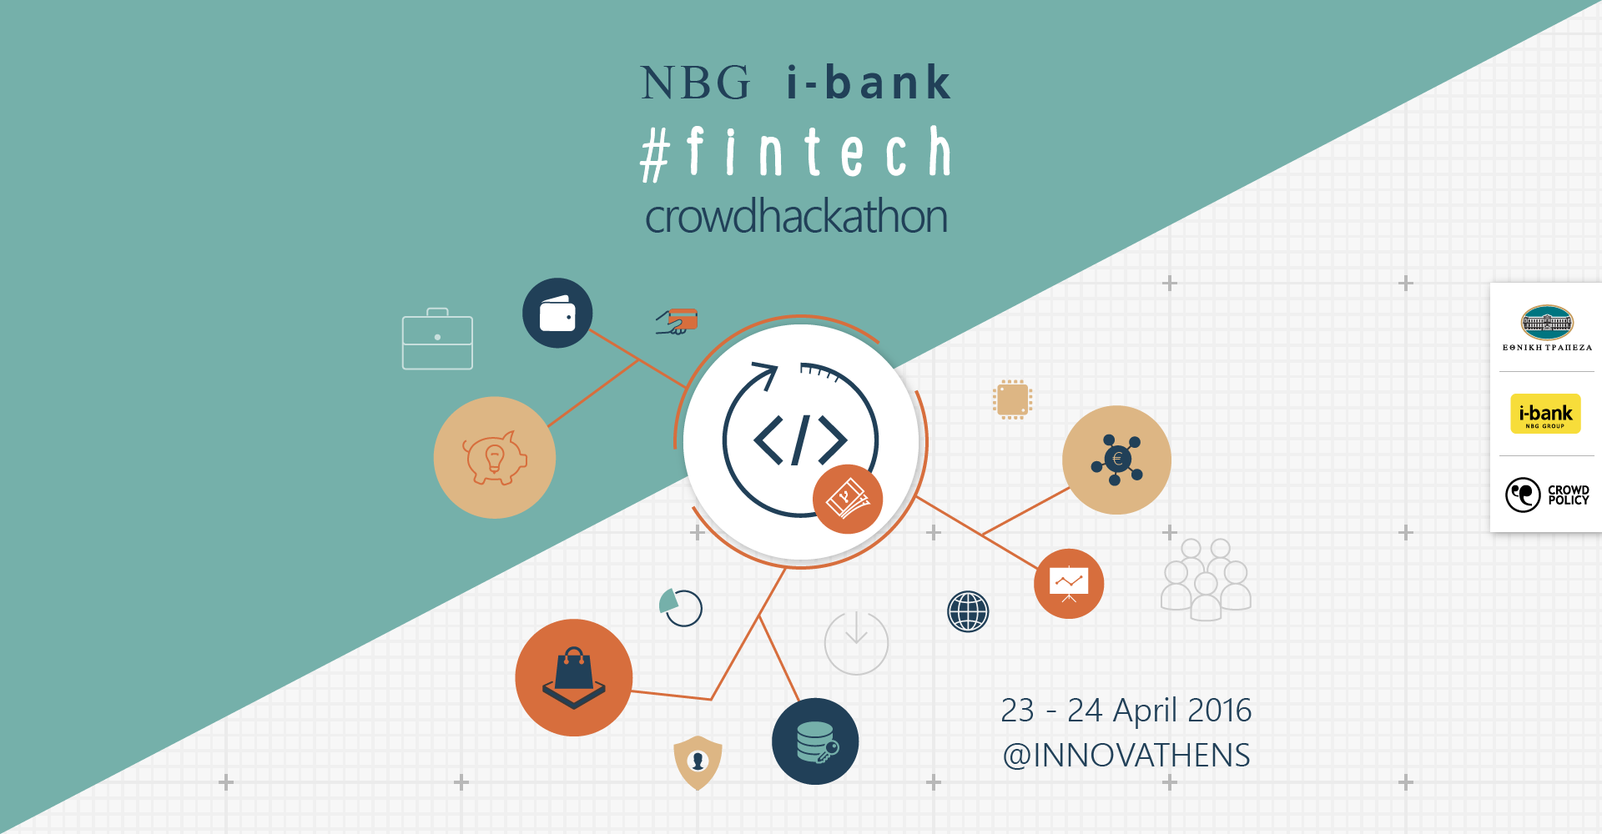
Machine Learning Business Opportunities
1. Anti-fraud detection

Slide 33
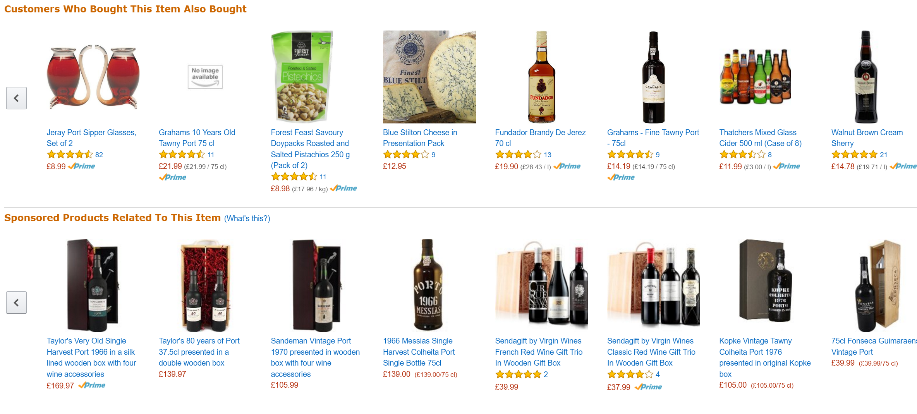
Machine Learning Business Opportunities
2. E-shops Recommendation Engine

Slide 34
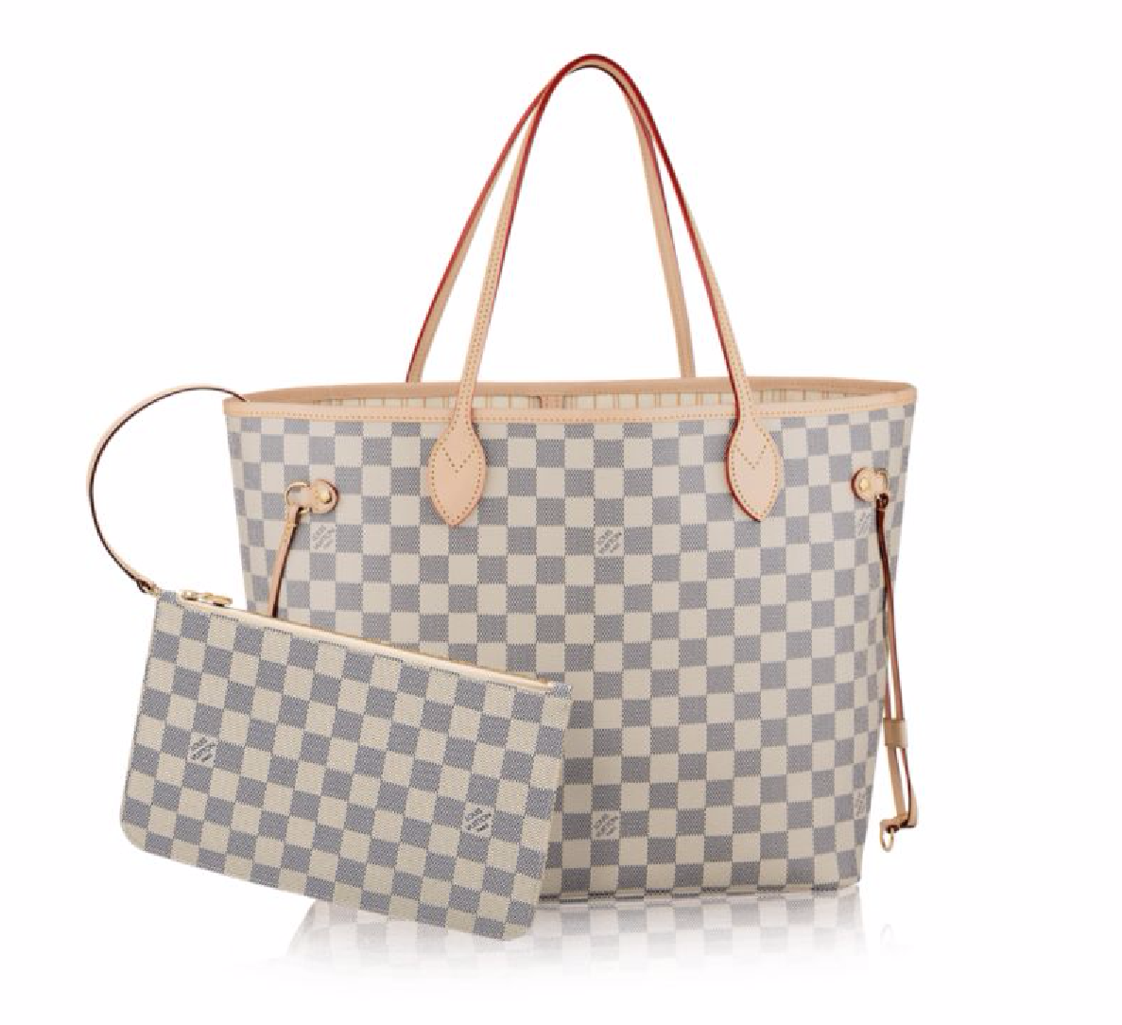
Blockchain Business Opportunities
1. Is this product really authentic?

Slide 35
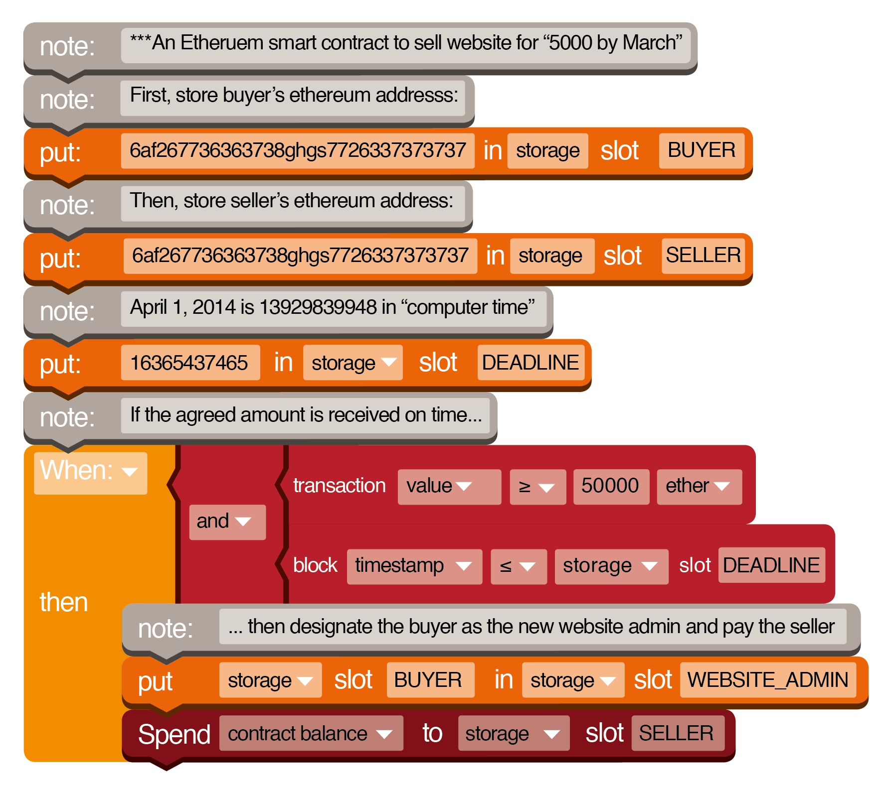
Blockchain Business Opportunities
2. Smart Contracts to Automate Digital Business

Slide 36
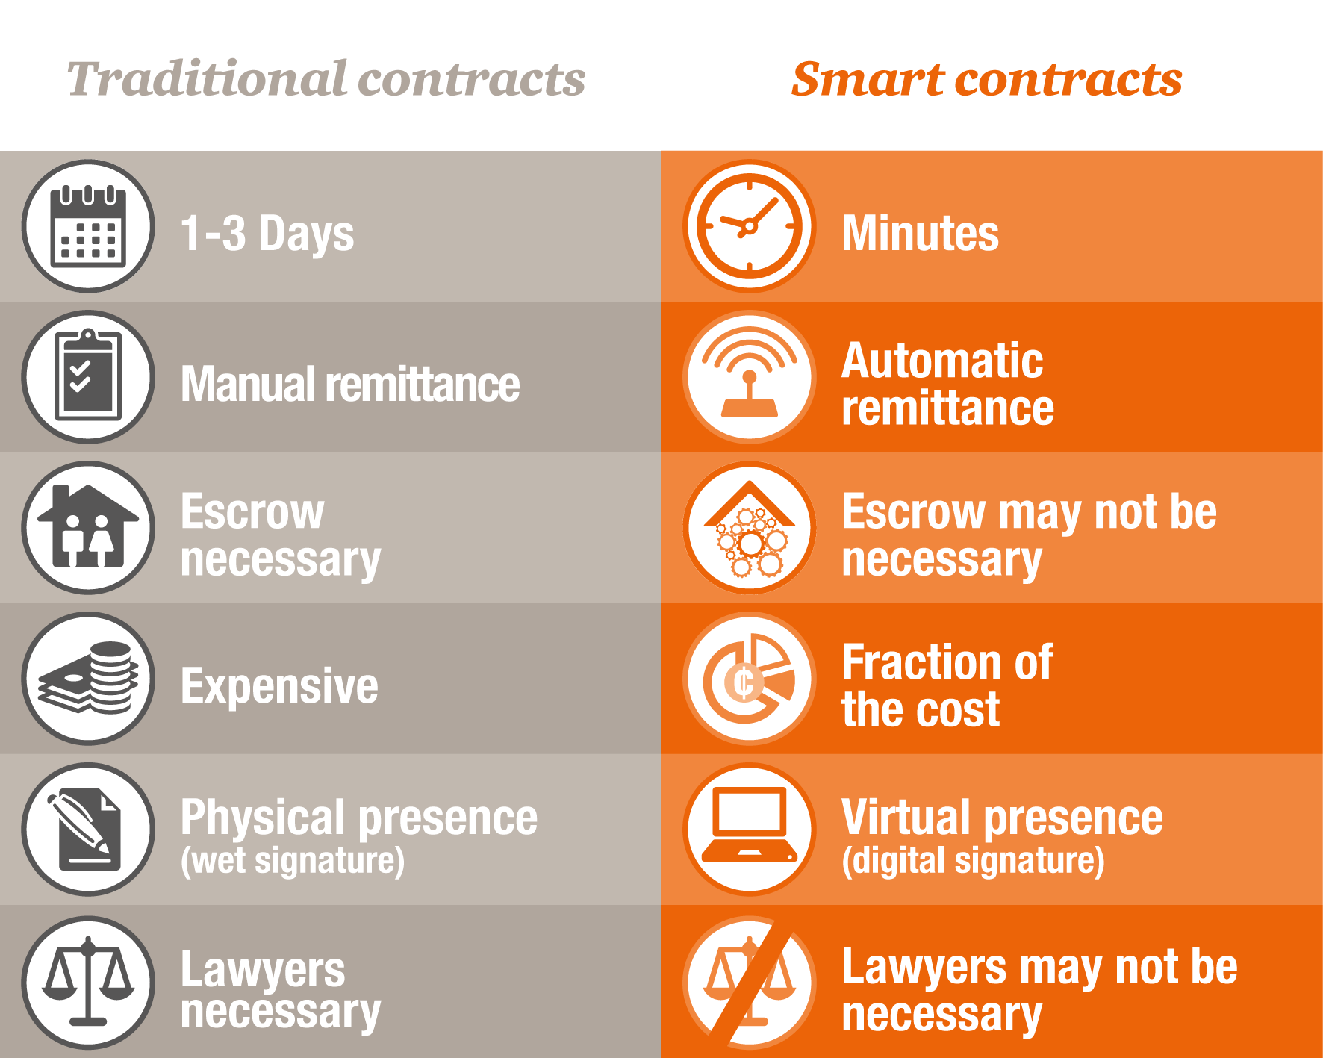
Blockchain Business Opportunities
2. Smart Contracts to Automate Digital Business

Slide 37
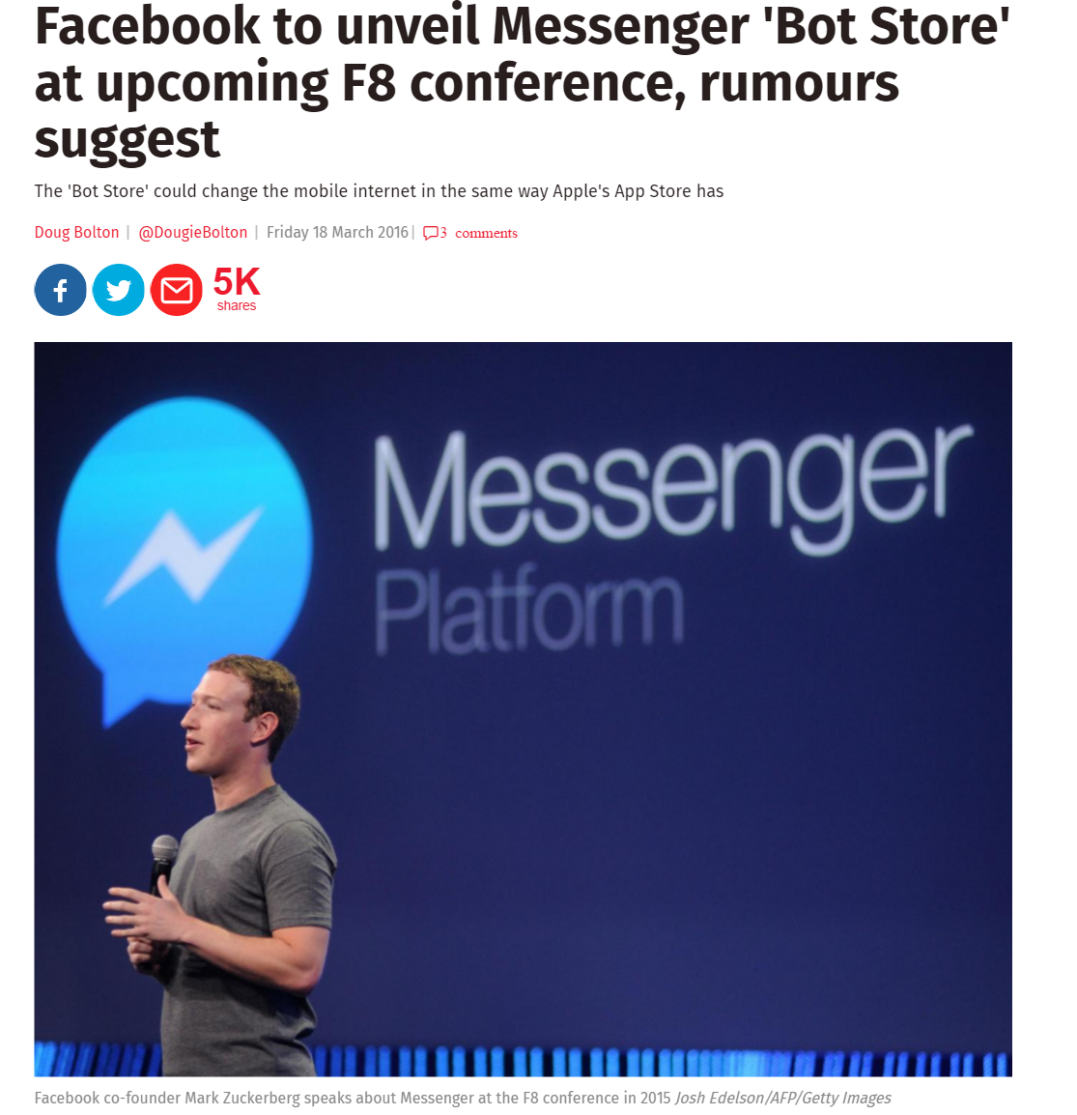
Bots Business Opportunities
1. Bankbots (E.g. Facebook bots connecting you to the Bank)

Slide 38
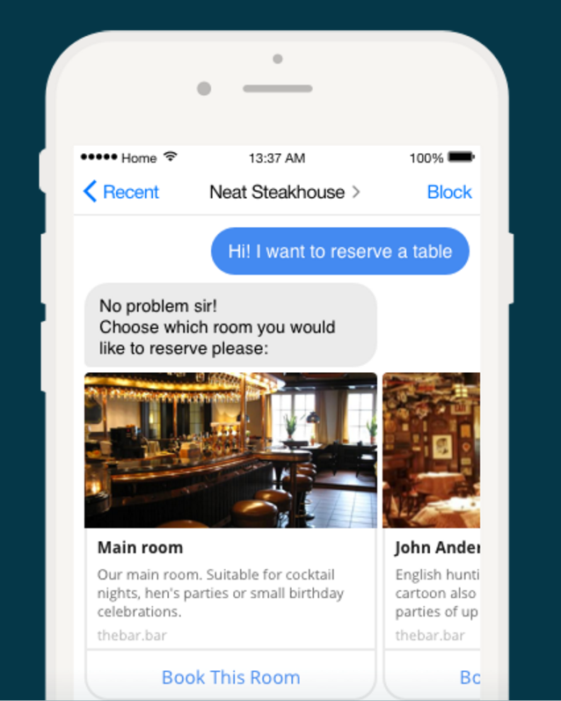
Bots Business Opportunities
1. Bankbots (E.g. Facebook bots connecting you to the Bank)

Slide 39
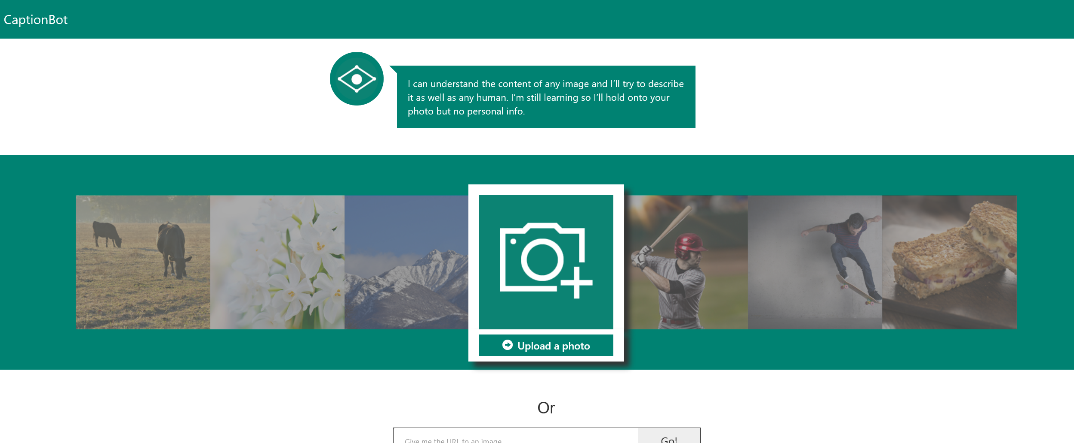
Bots Business Opportunities
1. Image Bots + X (X=drones? E-shops?)

Slide 40
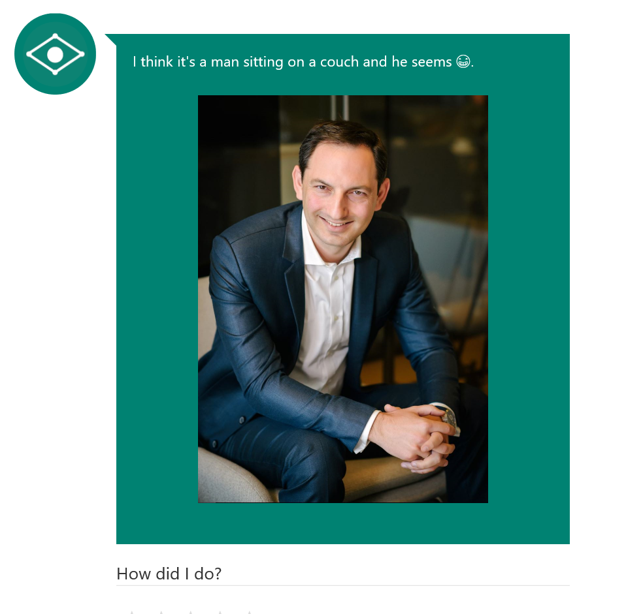
Bots Business Opportunities
1. Image Bots + X (X=drones? E-shops?)

Slide 41
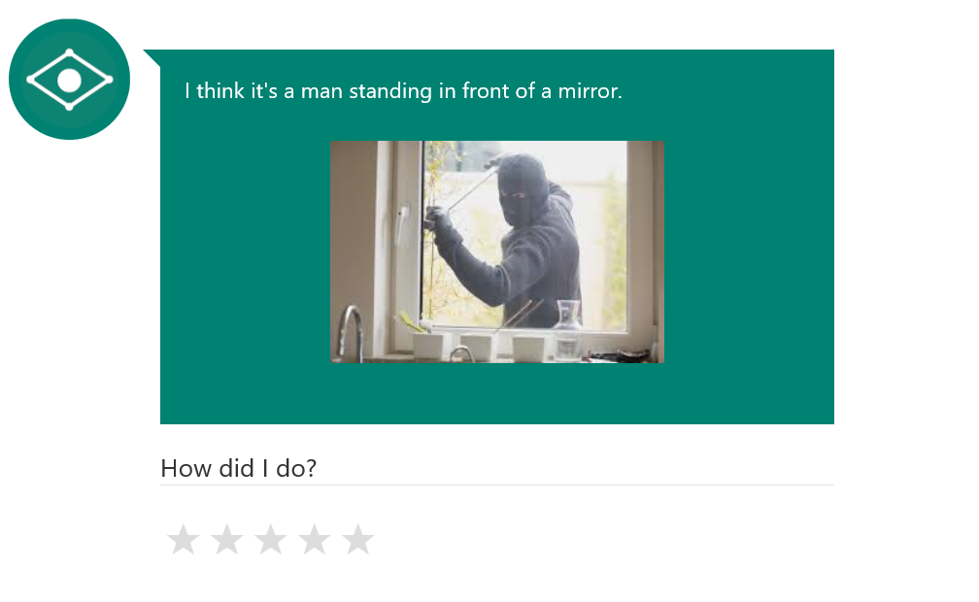
Bots Business Opportunities
1. Image Bots + X (X=drones? E-shops?)

Slide 42
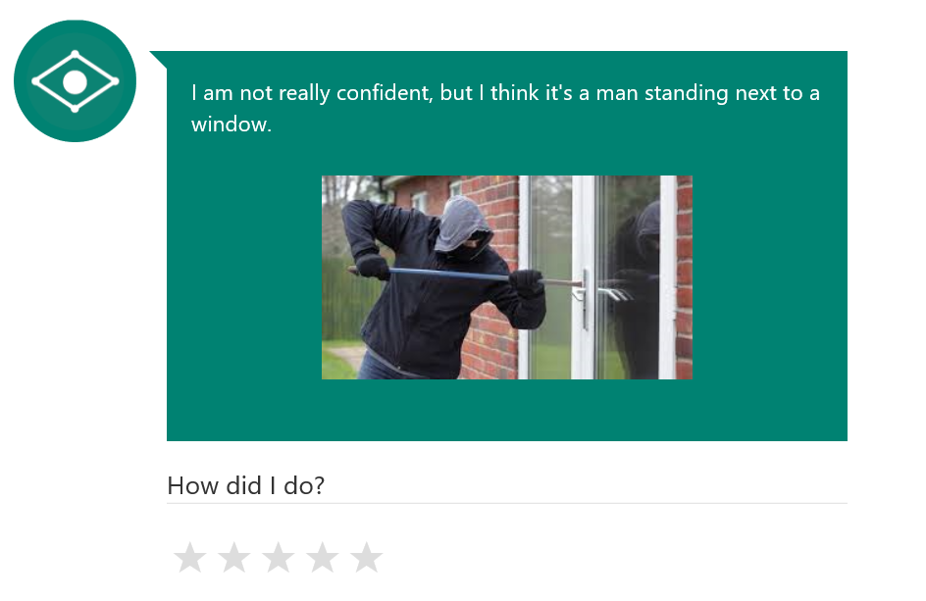
Bots Business Opportunities
1. Image Bots + X (X=drones? E-shops?)

Slide 43
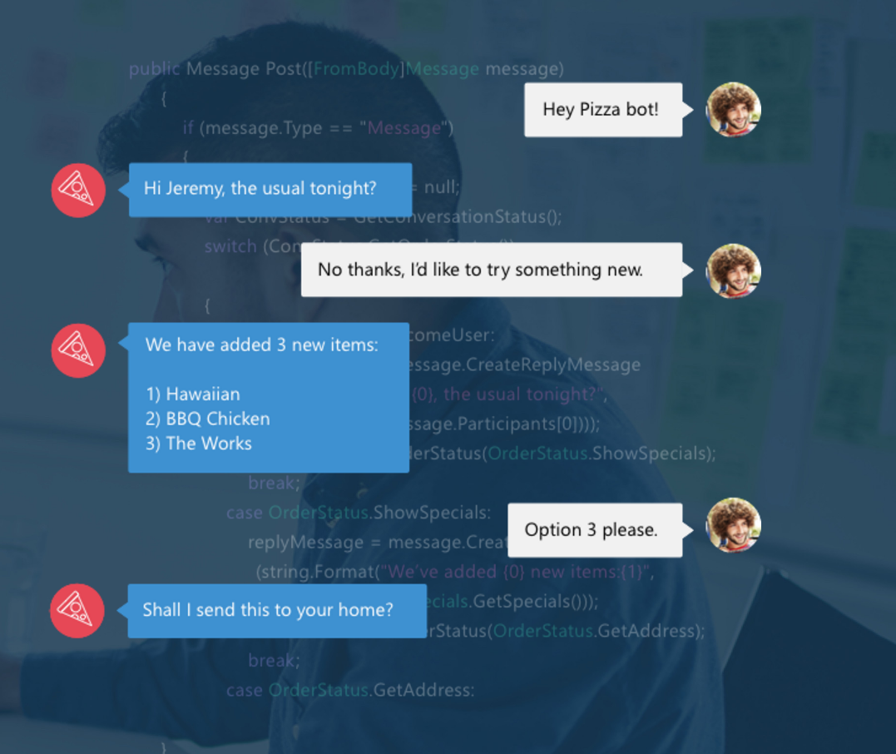
Bots Business Opportunities
3. Taking Orders (e.g. for Pizza, Hotels etc)

Slide 44
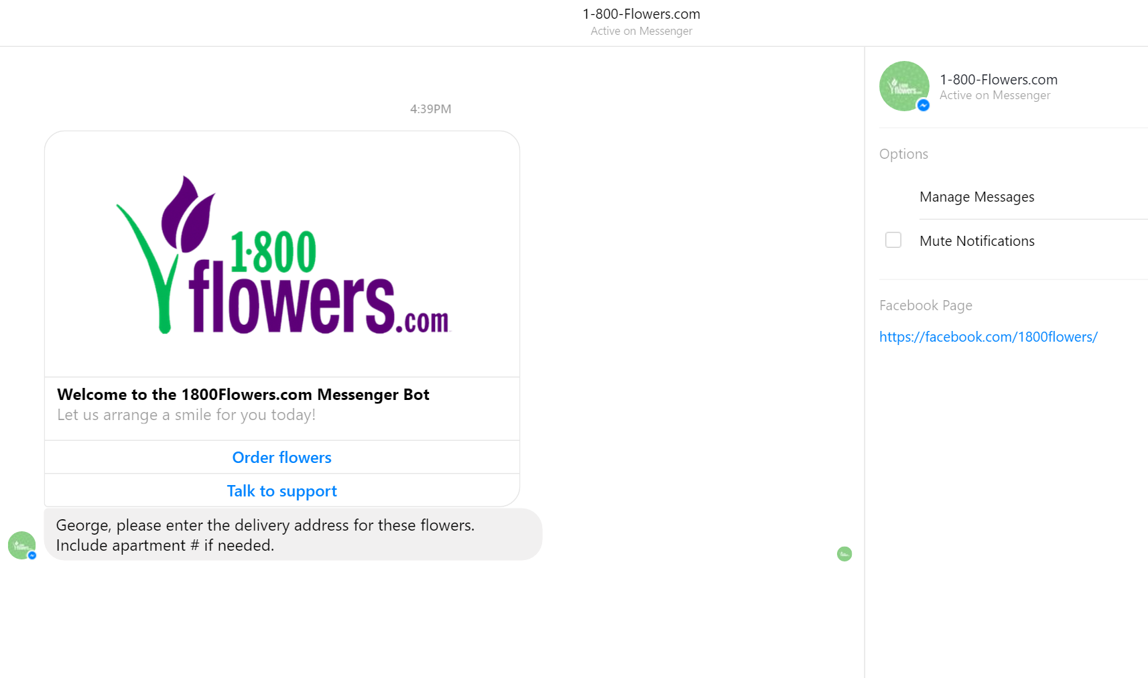
Bots Business Opportunities
3. Taking Orders (ordering flowers)

Slide 45
What About Microsoft?
Internet of Things
Azure IoT Hub
Machine Learning
Azure ML
Blockchain
Azure Blockchain as a Service
Bots
Microsoft Bot Framework

Slide 46
www.bizspark.com

Slide 47
Thank you
fotisd@microsoft.com|www.Draganidis.com|

