Slide 1

Σταύρος Μένεγος
R&D Director | Microsoft Regional Director
sme@entersoft.gr
@smeneg
http://smeneg.blogspot.com

Slide 2

Entersoft Web API
7years 8.000APIs 3.000news stories
Why API ?
Drive Traffic
BizDev / LeadGen
New line of business
Increase footprint
Distribution channel
Partner opportunities
Increase stickiness
Extend product
Drive innovation
User acquisition
Marketing channel
API as Product
Upsell opportunity
Device and mobile support
Content acquisition

Slide 3
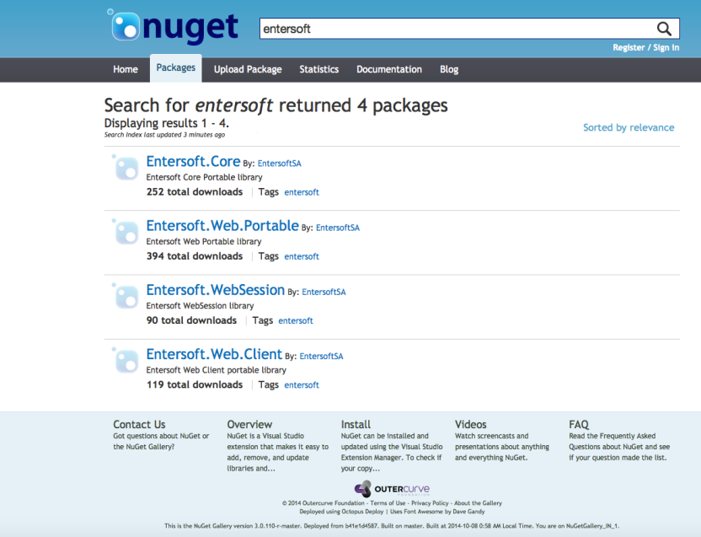
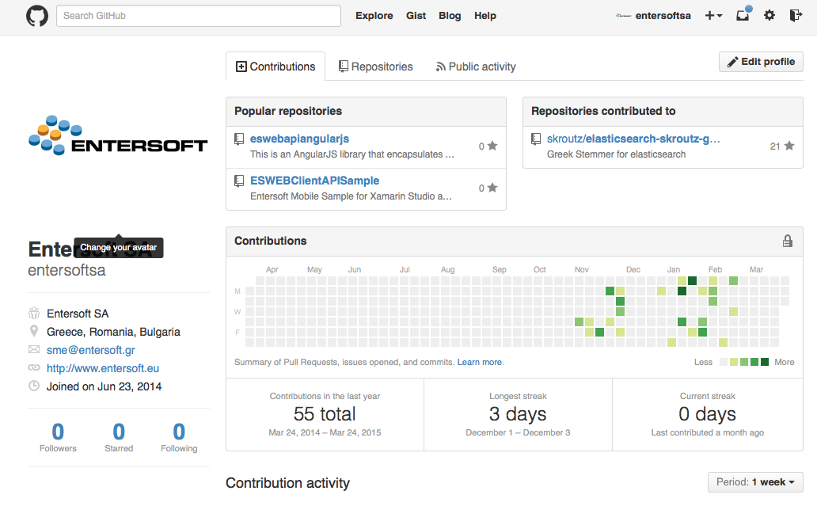






Entersoft Web API

Slide 4


Open source
.NET
Xamarin
Mobile
{ }
< >
WEB
Javascript
Web
Angular JS
Sub
Scrip
tionID
Load
Balanced
REST
Based
Multi
Tenant
JQuery
.NET
Windows
HTTPS
security
{ }
{ }

Slide 5


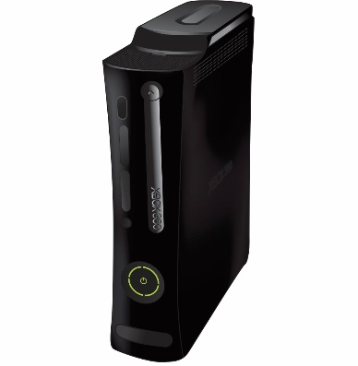
Across Channels

Slide 6
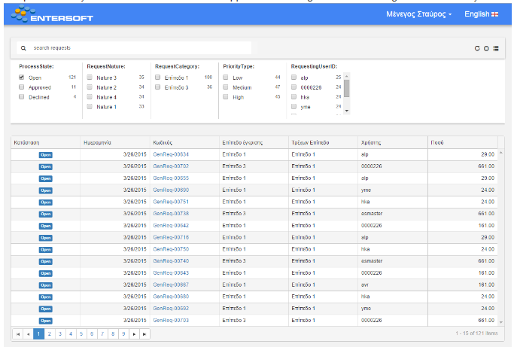
Request for approval

Slide 7
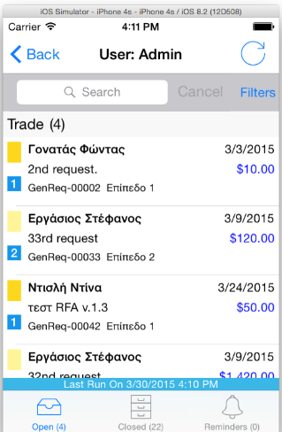

Request for approval

Slide 8
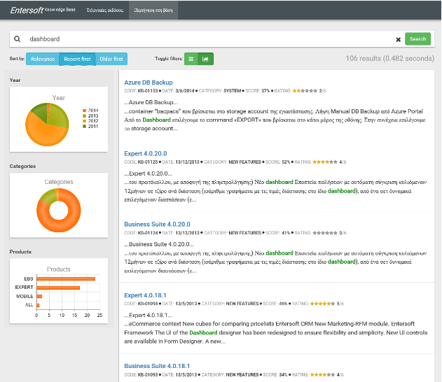


Knowledge base

Slide 9


attributions: www.freepik.com | www.soundbible.com

