Slide 1
Produce locally, Compete globally
Petros P. Soukoulias, MSc
Scientific / Advisory Board
petros@prisma.gr

Slide 2
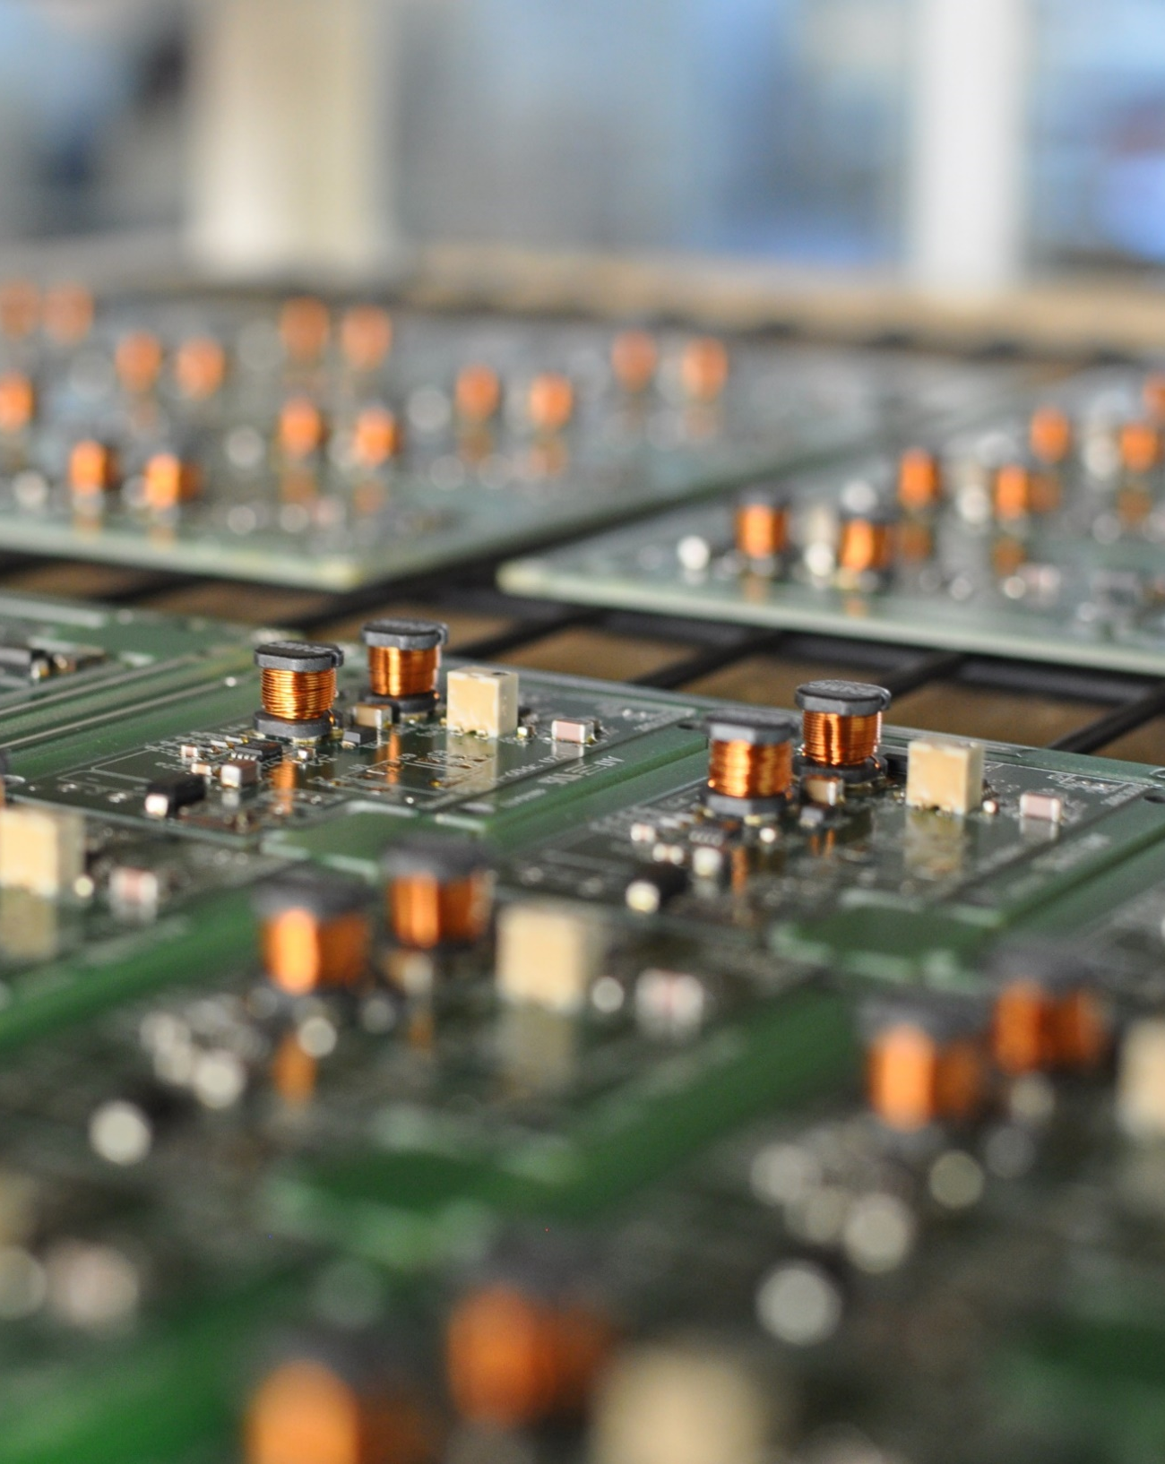
In a nutshell
Prisma Electronics SA is a hi-tech Company established in 1991 in Alexandroupolis, NEastern Greece.
Main activities:
Electronics Assembly
R&D Projects
I C T
www.prisma.gr
Electronics * IT * R&D

Slide 3
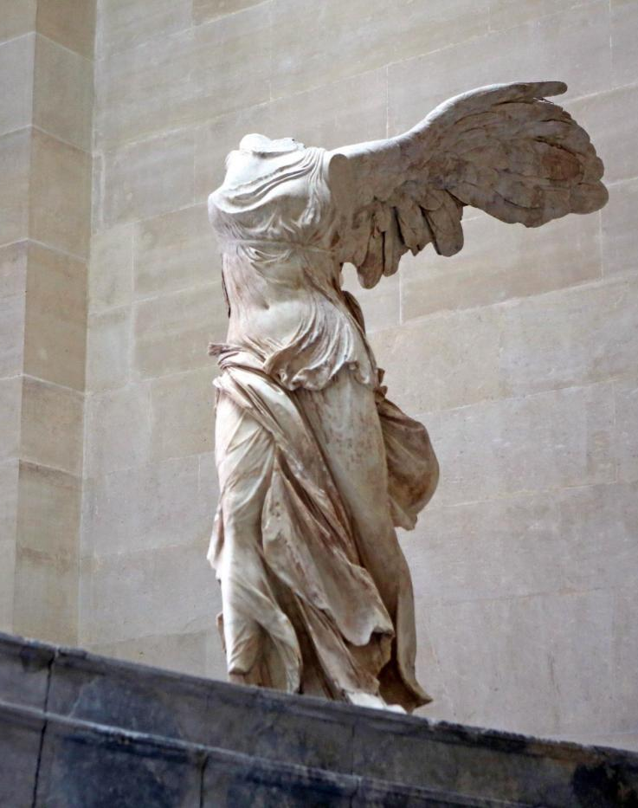
Our Vision
Being a technology pole
in the wider geographical area.
Through cooperative Research, develop innovative corporate products/services to compete globally.
www.prisma.gr
Electronics * IT * R&D

Slide 4
Personnel
67
people
engineers, technicians and administrative personnel
with continuous training and education
www.prismael.com
Electronics * IT * R&D
Notes:
In Prisma Electronics we believe that our people is our value.
Here you can have a look at our Personnel’s education.
12 People hold a PhD and MSc degree, 19 people a university degree and 16 people degree from technical institutions.

Slide 5
Prisma ….. in Numbers
M€
> 60
> 65%
> 5
Personnel
Higher Education
TurnOver
Electronics * ICT * R&D
www.prismael.com

Slide 6
Quality Systems
www.prisma.gr
Electronics * IT * R&D

Slide 7
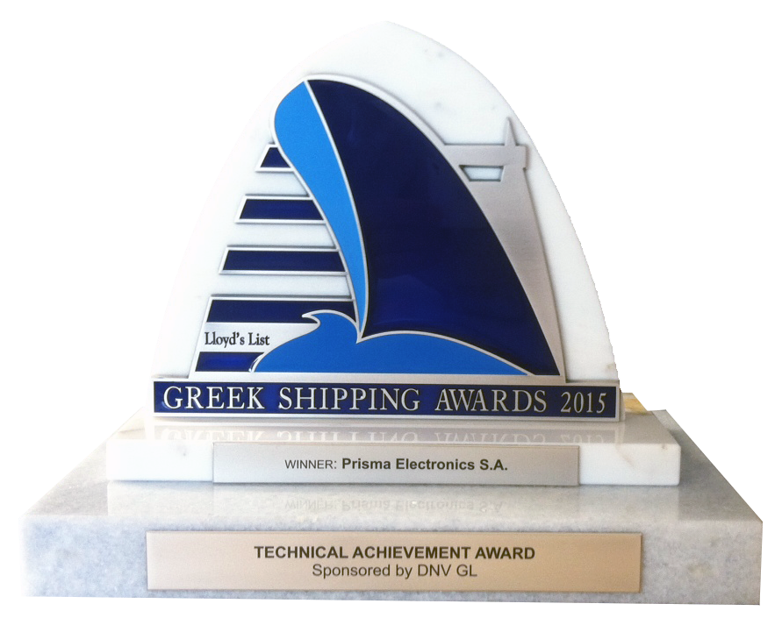
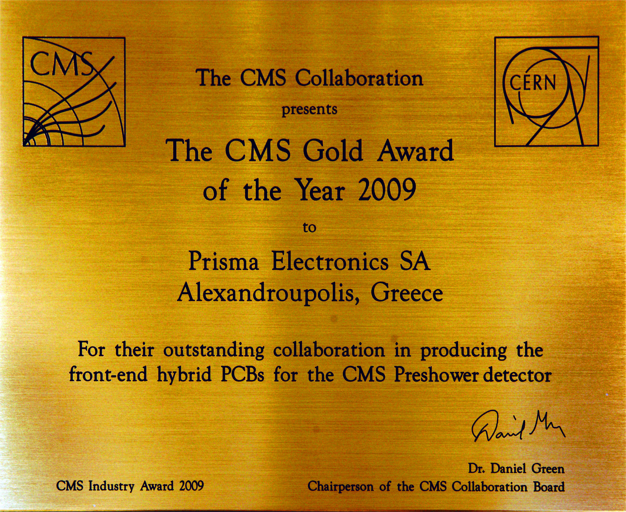
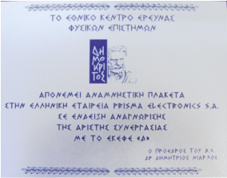
Awards
www.prisma.gr
Electronics * IT * R&D

Slide 8
R&D Projects
1997 – 2015
19 National
projects
15 European
projects
34
R&D projects
> 20%
Continuous
cooperation
of annual return
invested in R&D
> 100
Researchers
www.prisma.gr
Electronics * IT * R&D

Slide 9
Electronics for CERN and ESA
Electronics for hazardous Environments
Petros P. Soukoulias, MSc
Scientific / Advisory Board
petros@prisma.gr

Slide 10
www.prisma.gr
Electronics * IT * R&D

Slide 11
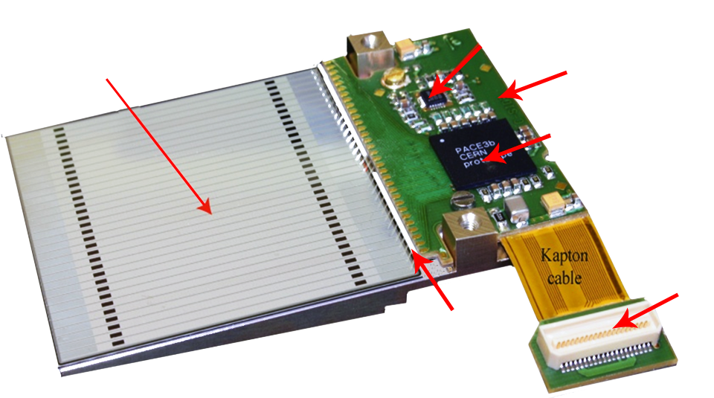
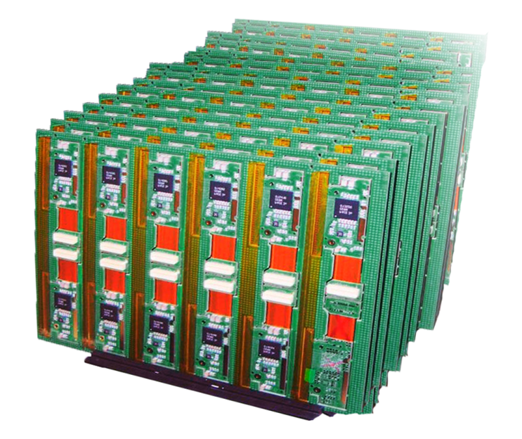
Electronics (CERN/CMS)
CMS Presower
Silicon Sensor with 32 stripes
DCU25F ASIC
Hybrid Front End
(HFE)
PACE3 ASIC
Wire bonds between
sensor and HFE
Connector
< 0,02% Defect Rate, in 5500 HFE boards produced
www.prisma.gr
Electronics * IT * R&D

Slide 12
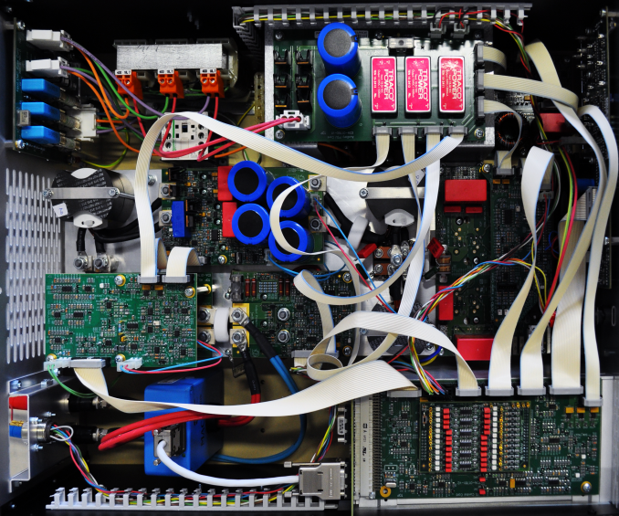
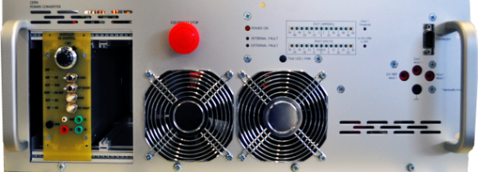
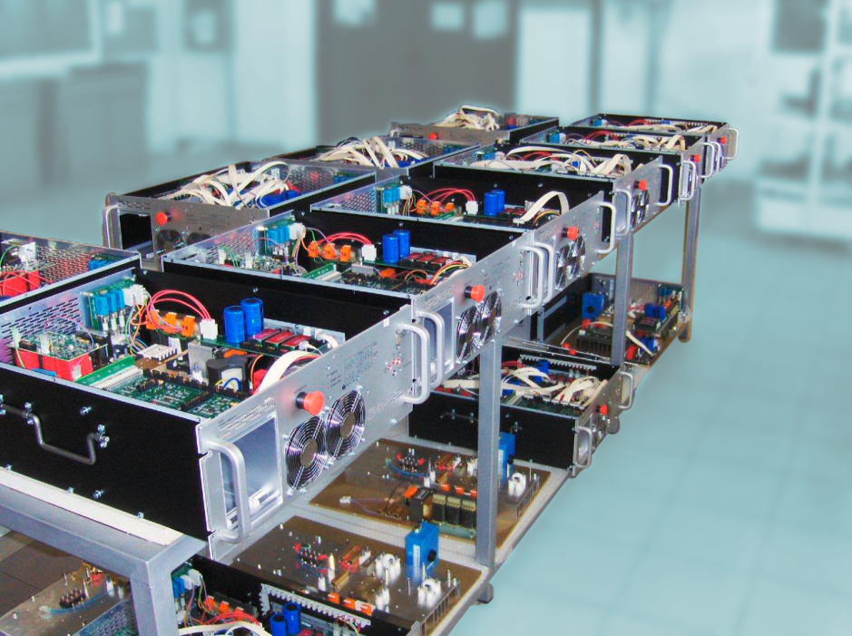
Electronics (CERN/PSB)
Power Converters
www.prisma.gr
Electronics * IT * R&D

Slide 13
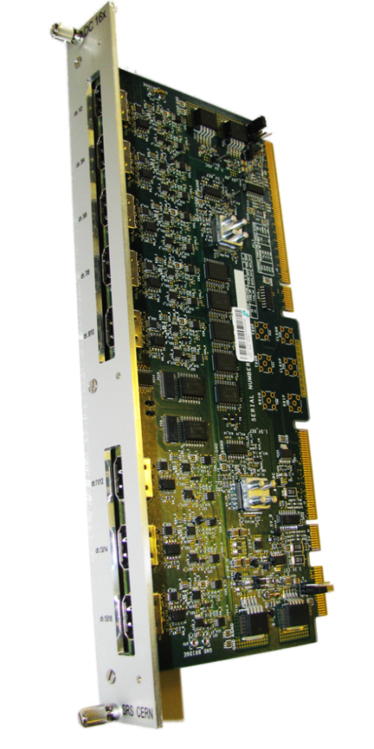
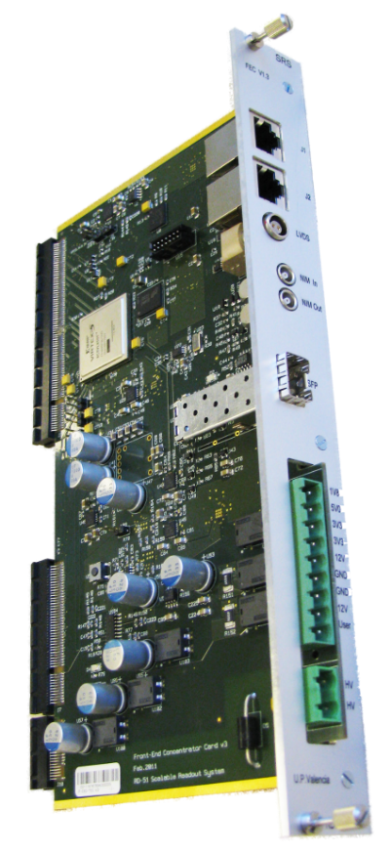
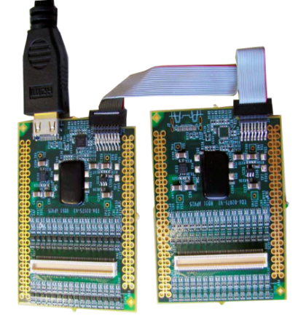
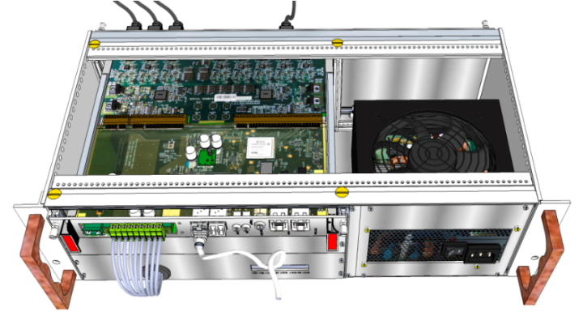
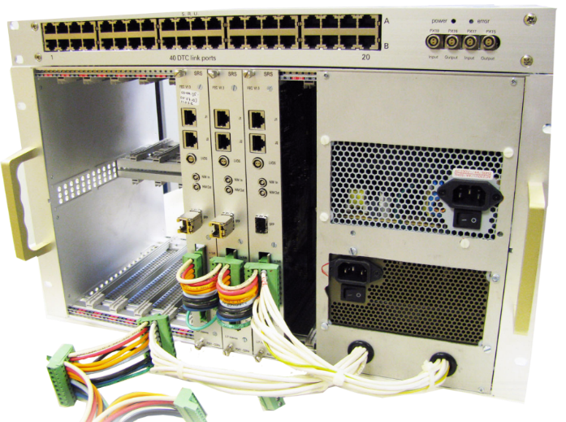
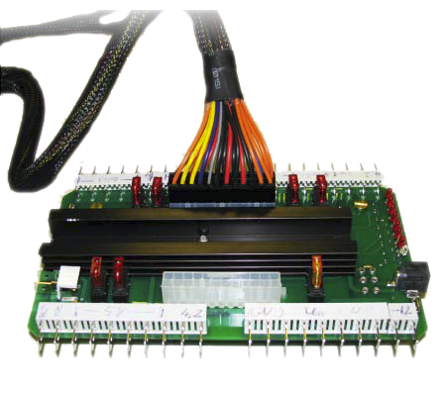
Electronics (CERN/RD51)
RD51 / SRSs
Hybrids
FEC
ADC
ATX Adapter
www.prisma.gr
Electronics * IT * R&D

Slide 14
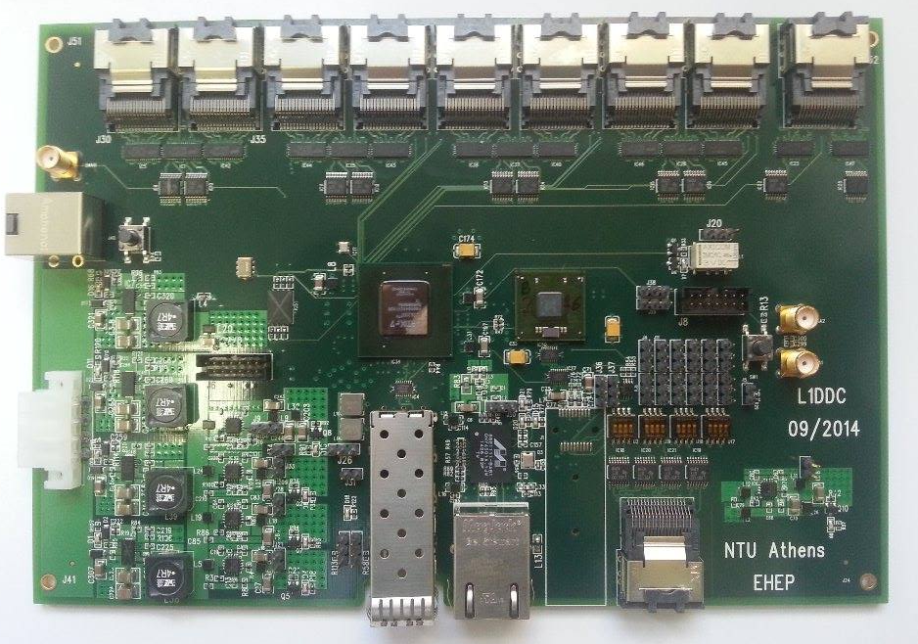
Electronics (CERN/ATLAS)
ATLAS / NSW / L1D2
www.prisma.gr
Electronics * IT * R&D

Slide 15
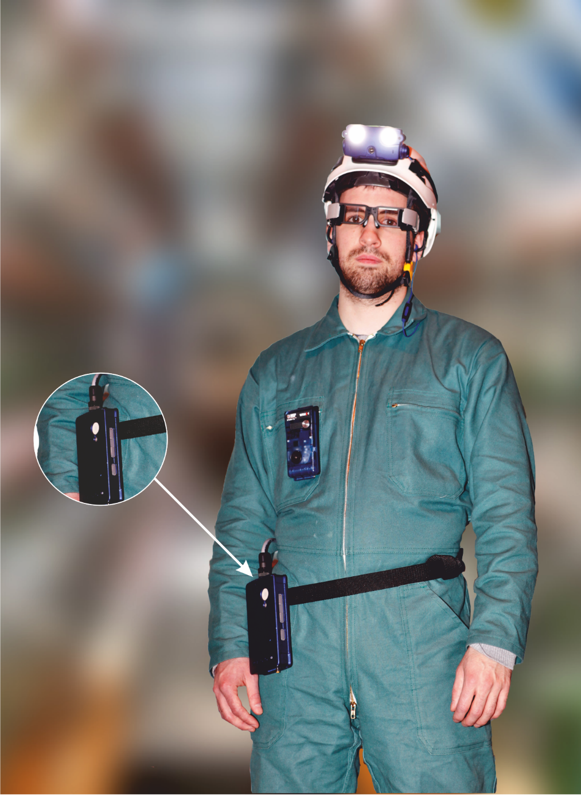
R&D with CERN
Wireless Personal
Supervision System
Remote monitoring of Engineers/Technicians
to increase personnel safety, while working in hazardous environments
employing PrismaSense® technology
FTK
Electronics * ICT * R&D
www.prismael.com

Slide 16
www.prisma.gr
Electronics * IT * R&D

Slide 17
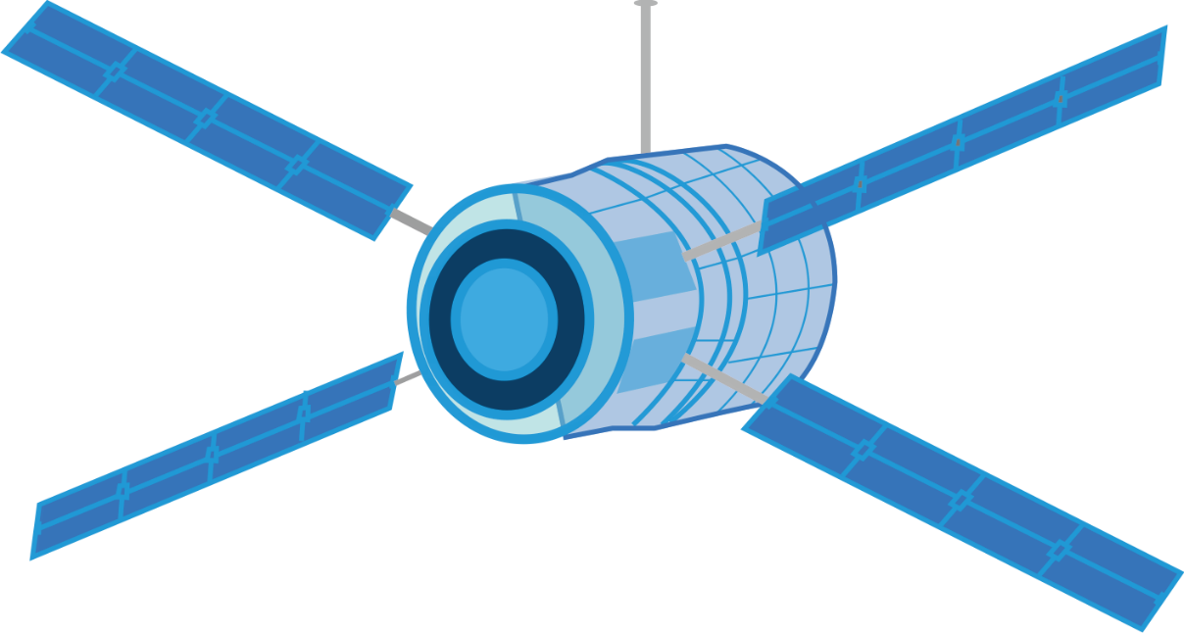
Electronics (AIRBUS)
SOLAR ORBITER PROJECT
Design, Development and Production
Of EGSE for Airbus UK
Electronics * ICT * R&D
www.prismael.com

Slide 18
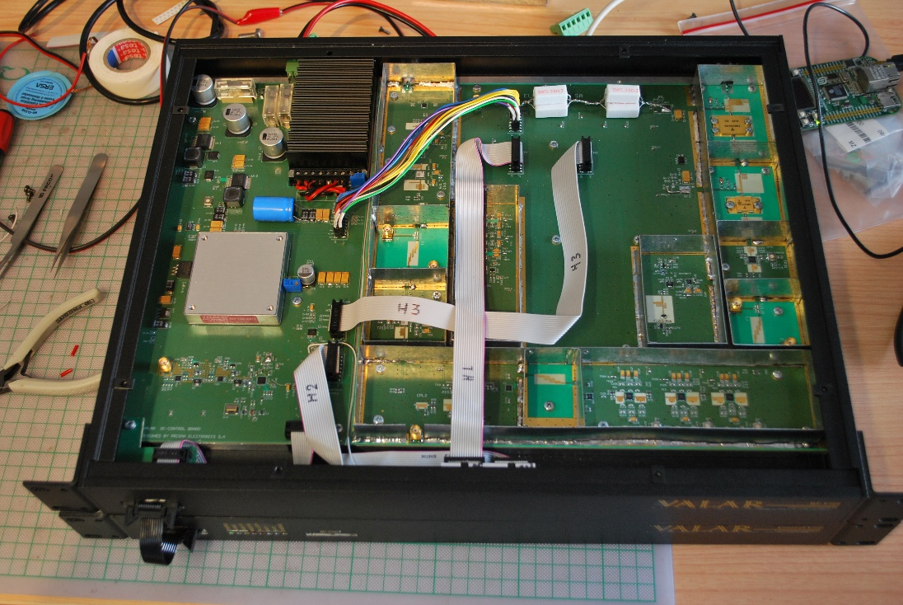
Ηλεκτρονικά (Διάστημα)
SOFIA PROJECT
Microcontroller of GMES satelites altimeter
(environmental monitoring)
Electronics * ICT * R&D
www.prismael.com

Slide 19
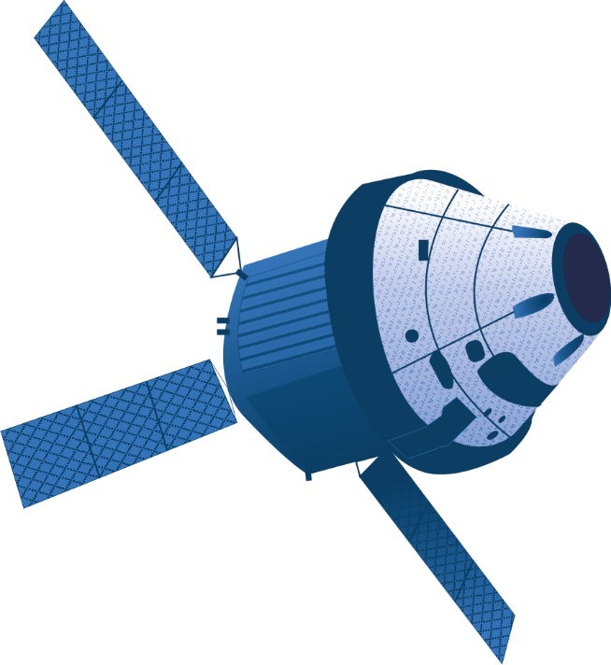
Electronics (si-Cluster)
MENELAOS PROJECT
Miniaturization of space electronics
Electronics * ICT * R&D
www.prismael.com

Slide 20
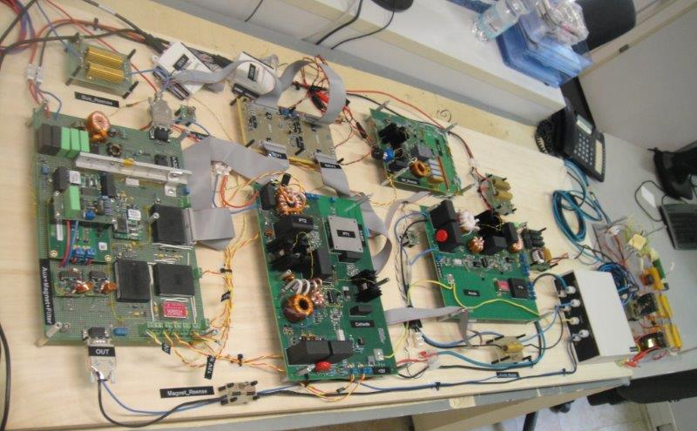
R&D Projects (Space)
MEPS PROJECT
Design,Manufacture and Qualification of a
Power Processing Unit ( PPU)
for the Hall Effect Thruster (HET)
of Micro Satellites
Electric Propulsion Subsystem (MEPS)
www.prisma.gr
Electronics * IT * R&D

Slide 21
Electronics for hazardous Environments

Slide 22
Hazardous Environment (HE)
every environment’s effect can be dangerous:
either for the Human or
for the Equipment or
for the Environment
Electronics * ICT * R&D
www.prismael.com

Slide 23
Hazardous Environment
Categories |  | Measurable Parameters
Biological | Allergies, transmitted diseases and viruses, dangerous gases, … | Virus tracing and disease monitoring in cattles and agriculture, organisms impact in potential polluted areas
Chemical | Dangerous alloys, chemical elements, pollution, toxics, smoke | Dangerous gases likage, atmospheric pollution, fire safety
Mechanical | Enginees function or systems that affect environment | Noise level, accelaration(G), magnetic fields, vibrations, EMC, ….
Physical | Natural phenomena affecting Humans or Equipment such as erthquakes, volcanos, solar radiation | Seismic protection data (prognosis), radiation, temp, humidity, atmospheric pressure
Electronics * ICT * R&D
www.prismael.com

Slide 24
Hazardous Environment (HE)
Temperature,
Humidity,
Electromagnetic fields,
Radiation,
Gases,
Atmospheric pollution,
Accelaration,
Noise,
Fire safety,
Vibrations,
Seismic data,
Biological parameters
Electronics * ICT * R&D
www.prismael.com

Slide 25
Hazardous Environment (HE)
Equipment Operation in Extreme Conditions:
Temperature close to absolute zero (-271 C)
Energy created: 13 TeV
Magnetic Fields up to 7.7 Tesla
a very high reliability of the hardware required
with almost no possibility of maintenance
Electronics * ICT * R&D
www.prismael.com

Slide 26
Electronics (CERN/CMS)
CMS Presower
Silicon Sensor with 32 stripes
DCU25F ASIC
Hybrid Front End
(HFE)
PACE3 ASIC
Operating temperature -10°C. down to -20°C.
In a 4 Tesla magnetic field and
In Radiation environment of 10 Mrad.
The fraction of dead channels must remain
very low during the lifetime of experiment.
Wire bonds between
sensor and HFE
Connector
www.prisma.gr
Electronics * IT * R&D

Slide 27
Hazardous Environment (HE)
Personnel training
ISO certification
Technical procedures and Work Instructions,
Safety procedures,
Quality procedures,
Tracability
Documentation,
Specific (multiple) tests
Electronics * ICT * R&D
www.prismael.com

Slide 28
Electronics for CERN and ESA
Electronics for hazardous Environments
Petros P. Soukoulias, MSc
Scientific / Advisory Board
petros@prisma.gr

