Slide 1
DataScouting
Stavros Vologiannidis
Founder
www.datascouting.com

Slide 2
Software R&D COMPANY FOCUSED ON DATA ANALYTICS
Media intelligence and communications insights
Digitization, preservation and retrieval of print and audiovisual content
Software solutions
Expertise/Technologies
Web based cloud applications, distributed computing
Text, video and speech analytics
Multimedia knowledge discovery

Slide 3
media intelligence and communications insight
MediaScouting Print –Print media monitoring software suite
Robust, scalable
SaaS, local
Covers the whole production line from digitization up to reviewing and customer portal
MediaScouting Broadcast – TV/radio/IP stream management and retrieval environment
News Insight: Automatic Speech Recognition (15 languages)
Ad/song Monitoring: Audio/Video fingerprinting
Logo detection: Scale, rotation and translation invariant geometry matching
Record, process, archive, query, used as SaaS or locally
Robust, scalable

Slide 4
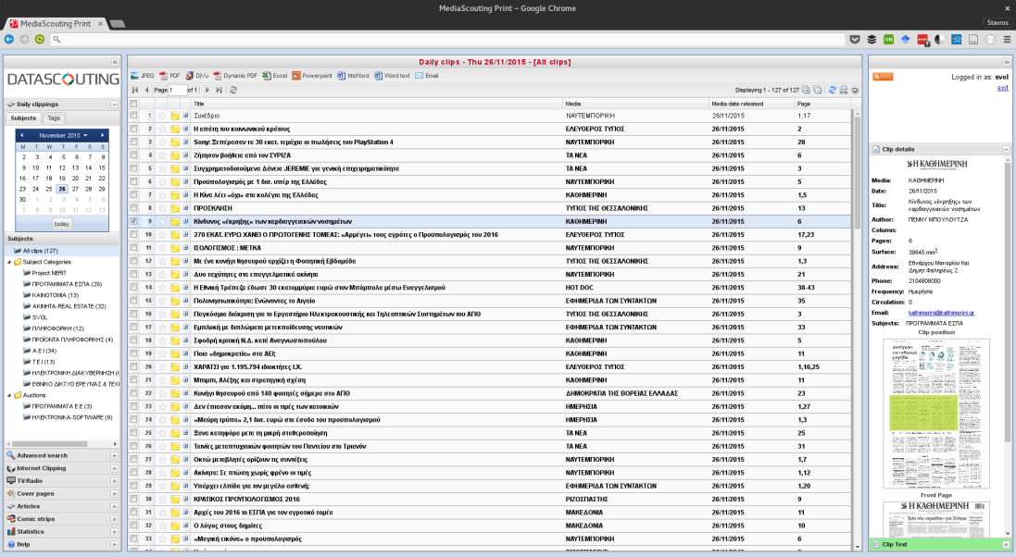
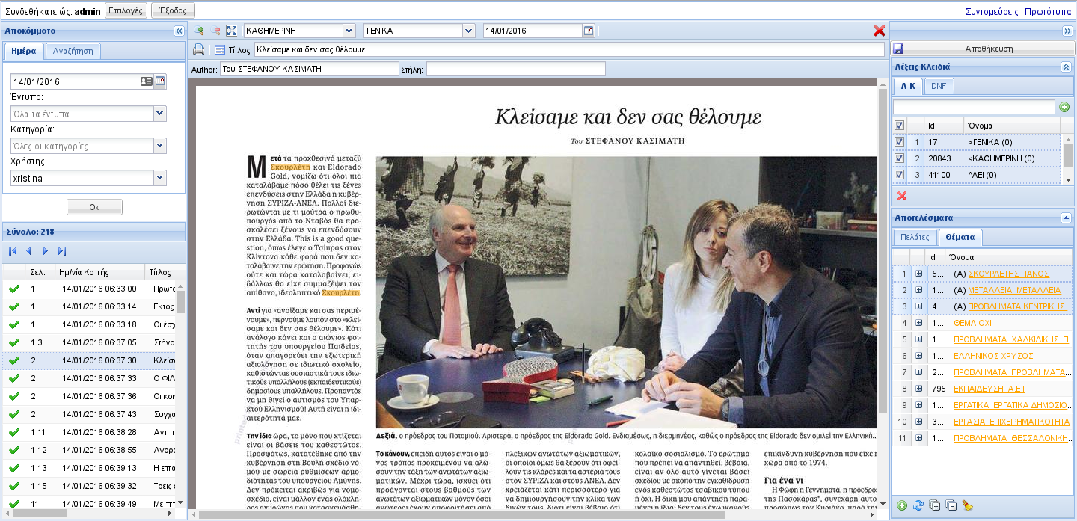
MediaScouting Print

Slide 5
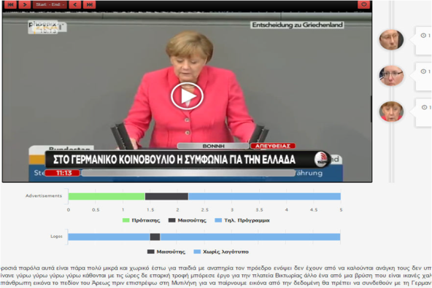
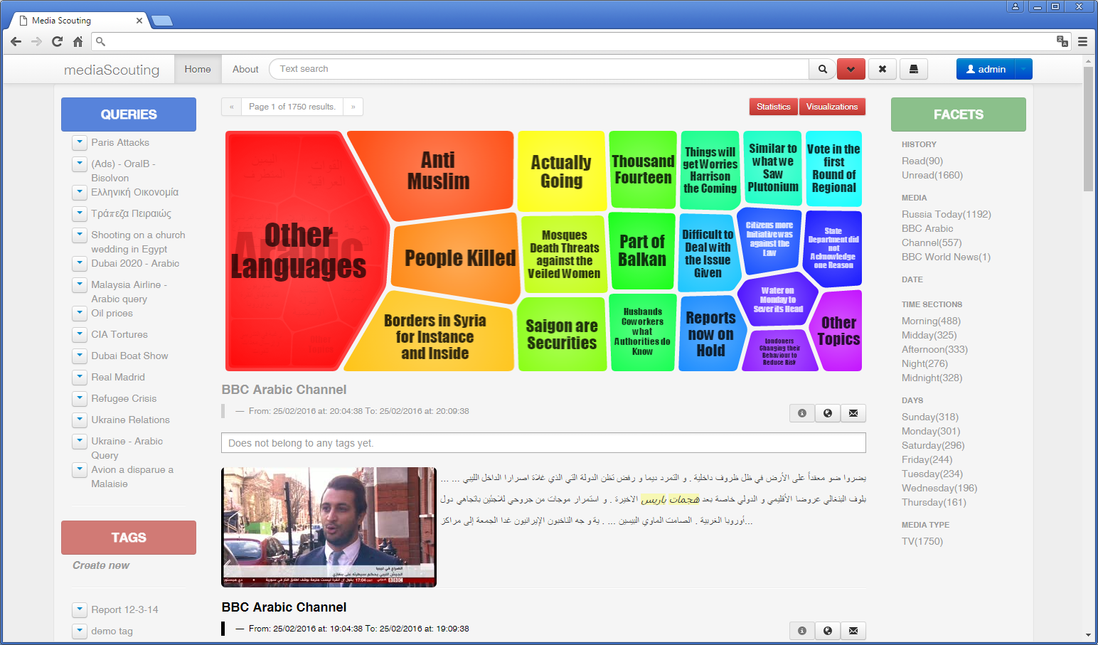
MediaScouting Broadcast

Slide 6
CULTURAL HERITAGE
DataScouting provides software and services for the digitization, management and retrieval of print, digital and audiovisual content for companies/organizations
Digitization services
Data Management and Institutional Repositories
Integrated library systems
E-Learning platforms

Slide 7
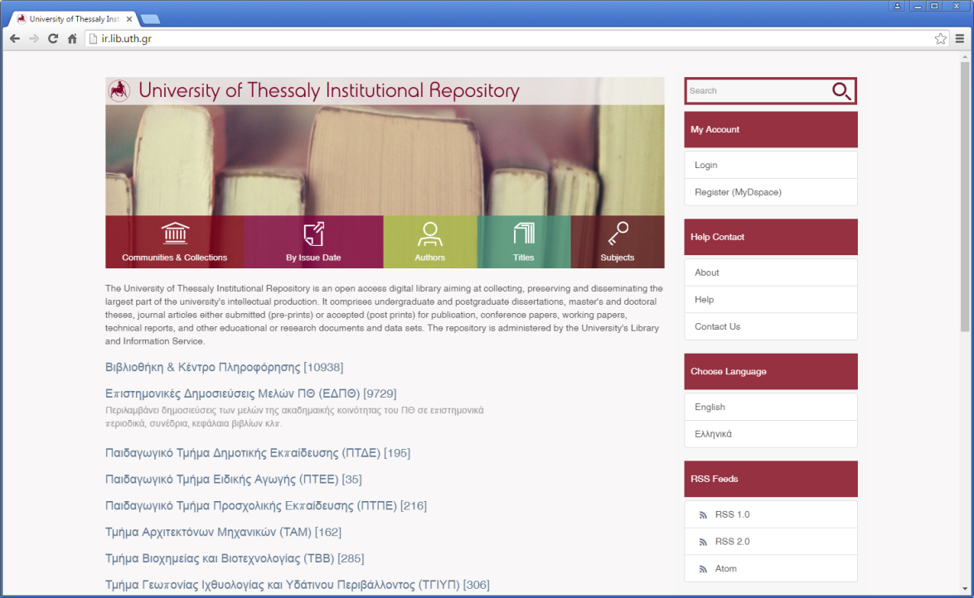
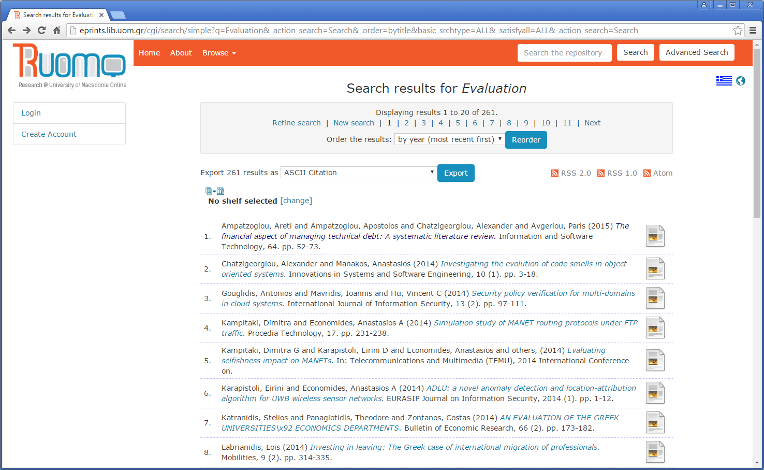

Slide 8
OUTSOURCING - Custom software solutions
We build partnerships
Transparent agile project management
Solutions that scale
Data analytics
Highly qualified personnel
ISO certified in software development

Slide 9
Research
R&D: Multimedia knowledge discovery, Data analytics
Role: (traditional and new) media intelligence use case, integration, data management
Research programs
ICT4Growth, ΠΕΠ
Partner in EPSRC ESRC Centre for Doctoral Training
Active in Horizon 2020 calls, COST

Slide 10
Roadmap
Research/Development on data analytics
Create Research/development partnerships
Joint ventures/Global partner network
Current work
Text mining
Optimizations for logo detection
Face recognition
Scale
Notes:
Φτιάξαμε όχι απλά ένα πρωτότυπο αλλά μια εφαρμογή που δουλέυει

