Slide 1
Internet of Things (IoT) in the Agriculture
2nd Technology Forum
Χαρά Κουτάλου

Slide 2
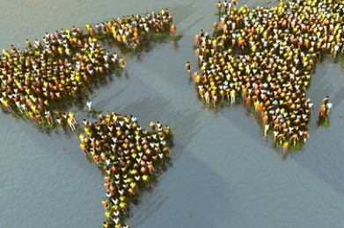
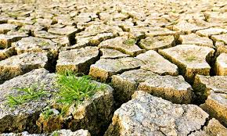
Demand for more food / Environmental impacts of intensive farming practices
IoT in the Agriculture
2nd Technology Forum, Χαρά Κουτάλου
The UN’s Intergovernmental Panel on Climate Change (IPCC) says that there will be a number of effects of climate change on agriculture.
The Food and Agricultural Organisation (FAO) predicts that the global population will reach 8 billion people by 2025 and 9.6 billion people by 2050

Slide 3
Precision Agriculture (PA)
IoT in the Agriculture
2nd Technology Forum, Χαρά Κουτάλου
Provides the possibility to do right things, in the right place, in the right time and in the right way.
Bases its applicability on the use of technologies to detect and decide what is ‘right’

Slide 4
Application Areas of Precision (Smart) Farming
IoT in the Agriculture
2nd Technology Forum, Χαρά Κουτάλου
Fleet management
Arable farming, large and small field farming
Livestock monitoring
Indoor farming
Fish farming
Forestry
Storage monitoring

Slide 5
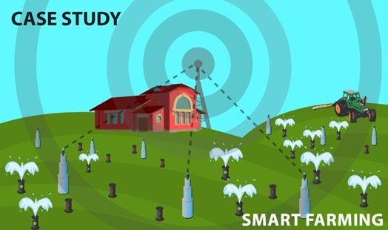
Precision Farming – How does it work
IoT in the Agriculture
2nd Technology Forum, Χαρά Κουτάλου

Slide 6
Smart Farming - Benefits
IoT in the Agriculture
2nd Technology Forum, Χαρά Κουτάλου
Saves water
Reduces the need for fertilizers, pesticides and energy
Lowers the environmental impact of farming
Improves product quality, nutrients and taste

Slide 7
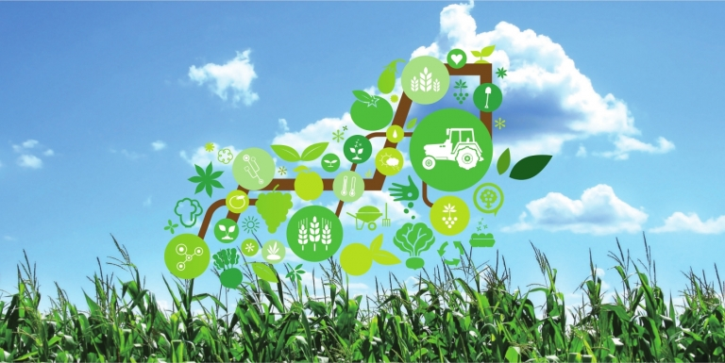
Agriculture Meets the Internet of Things (IoT)
IoT in the Agriculture
2nd Technology Forum, Χαρά Κουτάλου

Slide 8
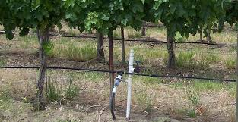
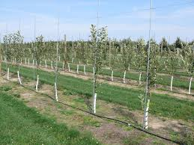
Our AGRENIO app
IoT in the Agriculture
2nd Technology Forum, Χαρά Κουτάλου
An easy-to-use smart app that advises farmers how much and when to irrigate their crops using data from sensors installed in their fields. Case study: pear, peach and vine.
We are focusing to small & medium farms.
The project is funded from SmartAgriFood (FIWARE Accelerator)

Slide 9
Using the AGRENIO app farmers can
IoT in the Agriculture
2nd Technology Forum, Χαρά Κουτάλου
Save water
Reduce production costs
Improve product quality
Protect the environment

Slide 10
Drivers (Beecham Research)
IoT in the Agriculture
2nd Technology Forum, Χαρά Κουτάλου
Business and Market Drivers | Technology Drivers
Urgent need to reduce waste and increase efficiency | M2M based monitoring and tracking becoming more mainstream across industries
Need to address soil erosion from intensive farming | Reducing costs of sensors, connectivity
Help from public funding and projects | Improving data management technologies to manage tidal wave of M2M data
Need to respond to climate change and environmental deterioration | Farmers becoming more familiar with everyday IT use

Slide 11
Barriers (Beecham Research)
IoT in the Agriculture
2nd Technology Forum, Χαρά Κουτάλου
Business and Market Barriers | Technology Barriers
Return of investment not easy to prove and precision agriculture installations are few and fragmented | Rural wireless and broadband coverage patchy
Shortage of new blood in the industry | Standards for the sensor networks and datacomms still under development
Uncertainty inherent in the industry e.g. weather events, political issues elsewhere in the world | Specialist agricultural software still maturing
Questions to be resolved regarding ownership of the data collected | Uncertainly as to how to treat and safeguard data

Slide 12
US vs Europe market
IoT in the Agriculture
2nd Technology Forum, Χαρά Κουτάλου
US market is leading the way in smart farming, particularly in areas such as arable farming
Europe is increasingly looking into small sized field farming, precision livestock farming and smart fish farming and, this trend will soon expand into other important agricultural economies.

Slide 13
EU Farms by size
IoT in the Agriculture
2nd Technology Forum, Χαρά Κουτάλου
*the darker the color the larger the size of the farm

Slide 14
Investments in Smart Agriculture in 2014 (USA – private sector)
IoT in the Agriculture
2nd Technology Forum, Χαρά Κουτάλου
Nearly $471 million invested in the first half of 2014 alone
Venture capitalists invested a record amount in the agriculture and food startups in the 3rd quarter 2014, totaling $269 million across 41 deals

Slide 15
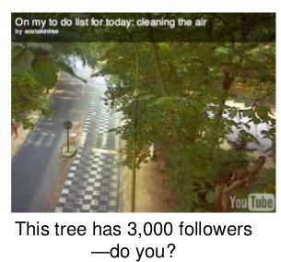
IoT in the Agriculture
2nd Technology Forum, Χαρά Κουτάλου
Thank you!

